Slide 1


Slide 2


Element
Homogeneous Mixt.
Compound
Heterogeneous Mixt.

Slide 3



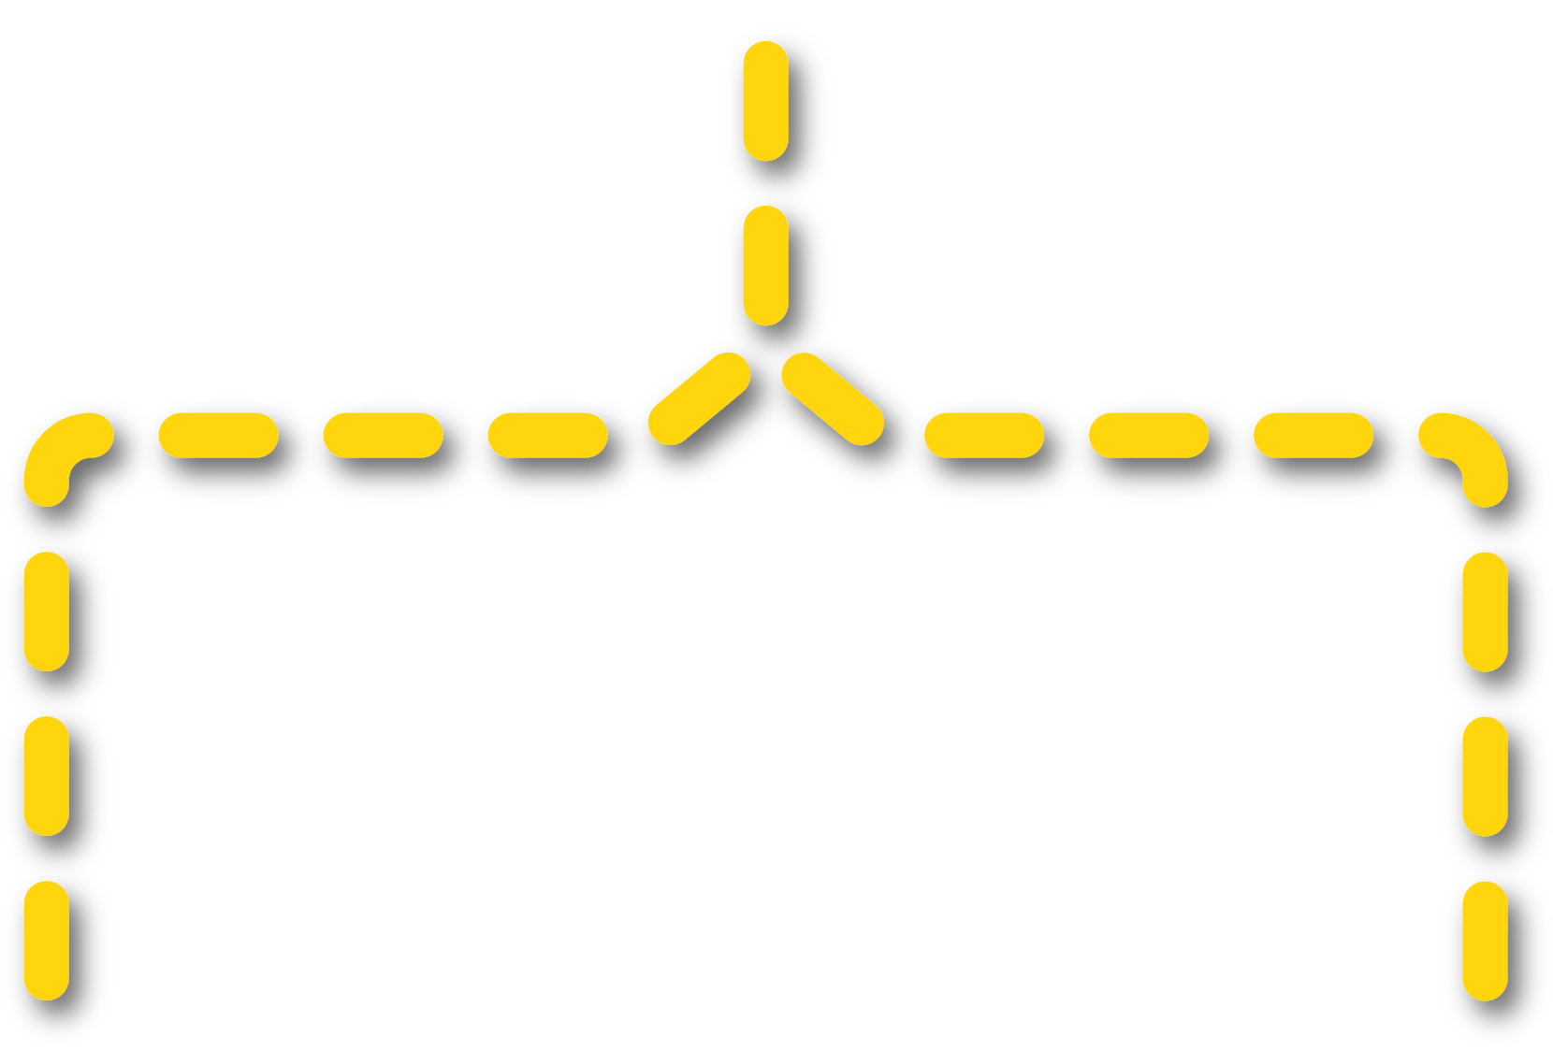


Matter
Pure
Impure
Substance
Mixture
Element
Compound
Homogeneous
Mixture
Heterogeneous
Mixture

Slide 4





A substance is the pure form of matter.
Only one type of matter / Only one type of units
Atom
Grp. of Atoms

Slide 5
Units of Matter
Ball A
Ball B
Atom X
Atom Y
Atom Z

Slide 6
Only one type of matter / Only one type of units
Pure Matter
Pure Matter

Slide 7
Only one type of matter / Only one type of units
Substance
Substance
Impure Matter

Slide 8
Only one type of matter / Only one type of units
Substance
Substance
Impure Matter

Slide 9


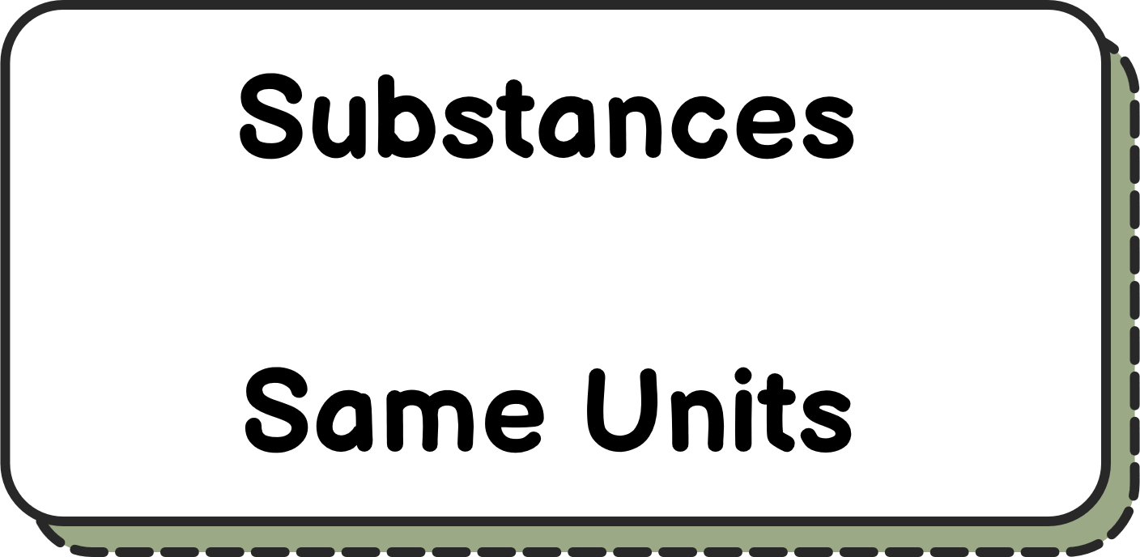
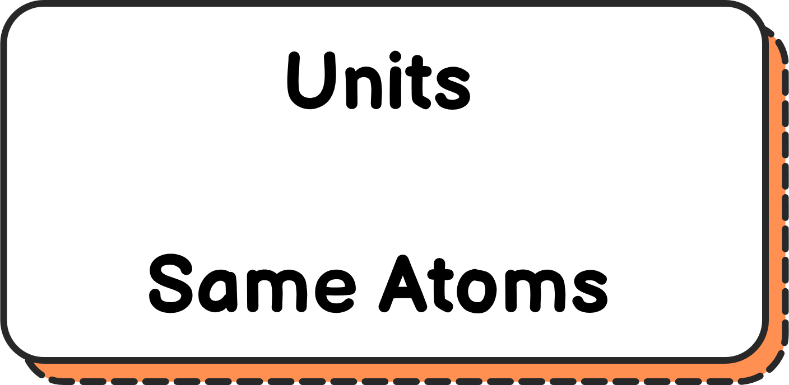
Elements are the purest form of matter.

Slide 10

Elements are the purest form of matter.
Element
Dioxygen (O₂)

Slide 11
Elements are the purest form of matter.
Element
Dioxygen (O₂)
O₂ unit

Slide 12
1
2
H
He
1.008
4.003
3
4
5
6
7
8
9
10
Li
Be
B
C
N
O
F
Ne
6.94
9.012
10.81
12.01
14.01
15.99
18.99
20.18
11
12
13
14
15
16
17
18
Na
Mg
Al
Si
P
S
Cl
Ar
22.99
24.31
26.98
28.09
30.97
32.06
35.45
39.95
19
20
21
22
23
24
25
26
27
28
29
30
31
32
33
34
35
36
K
Ca
Sc
Ti
V
Cr
Mn
Fe
Co
Ni
Cu
Zn
Ga
Ge
As
Se
Br
Kr
39.10
40.08
44.96
47.88
50.94
52.00
54.94
55.85
58.93
58.69
63.55
65.39
69.72
72.64
74.92
78.96
79.90
83.79
37
38
39
40
41
42
43
44
45
46
47
48
49
50
51
52
53
54
Rb
Sr
Y
Zr
Nb
Mo
Tc
Ru
Rh
Pd
Ag
Cd
In
Sn
Sb
Te
I
Xe
85.47
87.62
88.91
91.22
92.91
95.96
(98)
101.1
102.9
106.4
107.9
112.4
114.8
118.7
121.8
127.6
126.9
131.3
55
56
72
73
74
75
76
77
78
79
80
81
82
83
84
85
86
Cs
Ba
Hf
Ta
W
Re
Os
Ir
Pt
Au
Hg
Tl
Pb
Bi
Po
At
Rn
132.9
137.3
178.5
180.9
183.9
186.2
190.2
192.2
195.1
197.0
200.5
204.38
207.2
209.0
(209)
(210)
(222)
87
88
104
105
106
107
108
109
110
111
112
113
114
115
116
117
118
Fr
Ra
Rf
Db
Sg
Bh
Hs
Mt
Ds
Rg
Cn
Nh
Fl
Mc
Lv
Ts
Og
(223)
(226)
(265)
(268)
(271)
(270)
(277)
(276)
(281)
(280)
(285)
(284)
(289)
(288)
(293)
(294)
(294)
57
58
59
60
61
62
63
64
65
66
67
68
69
70
71
La
Ce
Pr
Nd
Pm
Sm
Eu
Gd
Tb
Dy
Ho
Er
Tm
Yb
Lu
138.9
140.1
140.9
144.2
(145)
150.4
152.0
157.2
158.9
162.5
164.9
167.3
168.9
173.0
175.0
89
90
91
92
93
94
95
96
97
98
99
100
101
102
103
Ac
Th
Pa
U
Np
Pu
Am
Cm
Bk
Cf
Es
Fm
Md
No
Lr
(227)
232.0
231.0
238.0
(237)
(244)
(243)
(247)
(247)
(251)
(252)
(257)
(258)
(259)
(262)

Slide 13
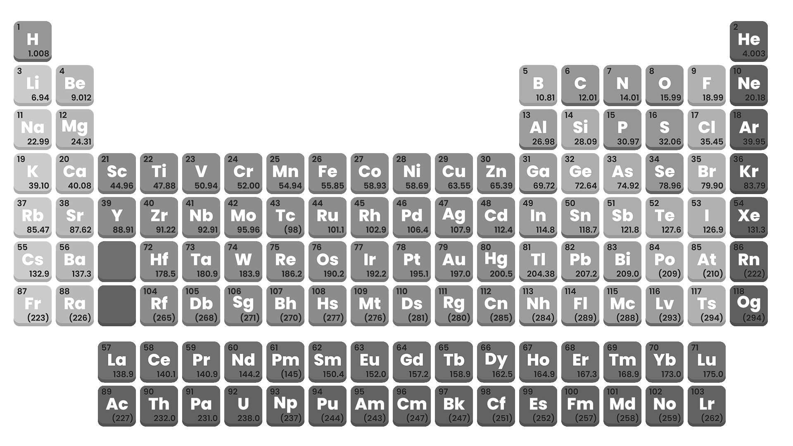
1
2
H
He
1.008
4.003
3
4
5
6
7
8
9
10
Li
Be
B
C
N
O
F
Ne
6.94
9.012
10.81
12.01
14.01
15.99
18.99
20.18
11
12
13
14
15
16
17
18
Na
Mg
Al
Si
P
S
Cl
Ar
22.99
24.31
26.98
28.09
30.97
32.06
35.45
39.95
19
20
21
22
23
24
25
26
27
28
29
30
31
32
33
34
35
36
K
Ca
Sc
Ti
V
Cr
Mn
Fe
Co
Ni
Cu
Zn
Ga
Ge
As
Se
Br
Kr
39.10
40.08
44.96
47.88
50.94
52.00
54.94
55.85
58.93
58.69
63.55
65.39
69.72
72.64
74.92
78.96
79.90
83.79
37
38
39
40
41
42
43
44
45
46
47
48
49
50
51
52
53
54
Rb
Sr
Y
Zr
Nb
Mo
Tc
Ru
Rh
Pd
Ag
Cd
In
Sn
Sb
Te
I
Xe
85.47
87.62
88.91
91.22
92.91
95.96
(98)
101.1
102.9
106.4
107.9
112.4
114.8
118.7
121.8
127.6
126.9
131.3
55
56
72
73
74
75
76
77
78
79
80
81
82
83
84
85
86
Cs
Ba
Hf
Ta
W
Re
Os
Ir
Pt
Au
Hg
Tl
Pb
Bi
Po
At
Rn
132.9
137.3
178.5
180.9
183.9
186.2
190.2
192.2
195.1
197.0
200.5
204.38
207.2
209.0
(209)
(210)
(222)
87
88
Fr
Ra
(223)
(226)
57
58
59
60
61
62
63
64
65
66
67
68
69
70
71
La
Ce
Pr
Nd
Pm
Sm
Eu
Gd
Tb
Dy
Ho
Er
Tm
Yb
Lu
138.9
140.1
140.9
144.2
(145)
150.4
152.0
157.2
158.9
162.5
164.9
167.3
168.9
173.0
175.0
89
90
91
92
93
94
Ac
Th
Pa
U
Np
Pu
(227)
232.0
231.0
238.0
(237)
(244)

Slide 14
104
105
106
107
108
109
110
111
112
113
114
115
116
117
118
Rf
Db
Sg
Bh
Hs
Mt
Ds
Rg
Cn
Nh
Fl
Mc
Lv
Ts
Og
(265)
(268)
(271)
(270)
(277)
(276)
(281)
(280)
(285)
(284)
(289)
(288)
(293)
(294)
(294)
95
96
97
98
99
100
101
102
103
Am
Cm
Bk
Cf
Es
Fm
Md
No
Lr
(243)
(247)
(247)
(251)
(252)
(257)
(258)
(259)
(262)

Slide 15
1
2
H
He
1.008
4.003
3
4
5
6
7
8
9
10
Li
Be
B
C
N
O
F
Ne
6.94
9.012
10.81
12.01
14.01
15.99
18.99
20.18
11
12
13
14
15
16
17
18
Na
Mg
Al
Si
P
S
Cl
Ar
22.99
24.31
26.98
28.09
30.97
32.06
35.45
39.95
19
20
21
22
23
24
25
26
27
28
29
30
31
32
33
34
35
36
K
Ca
Sc
Ti
V
Cr
Mn
Fe
Co
Ni
Cu
Zn
Ga
Ge
As
Se
Br
Kr
39.10
40.08
44.96
47.88
50.94
52.00
54.94
55.85
58.93
58.69
63.55
65.39
69.72
72.64
74.92
78.96
79.90
83.79
37
38
39
40
41
42
43
44
45
46
47
48
49
50
51
52
53
54
Rb
Sr
Y
Zr
Nb
Mo
Tc
Ru
Rh
Pd
Ag
Cd
In
Sn
Sb
Te
I
Xe
85.47
87.62
88.91
91.22
92.91
95.96
(98)
101.1
102.9
106.4
107.9
112.4
114.8
118.7
121.8
127.6
126.9
131.3
55
56
72
73
74
75
76
77
78
79
80
81
82
83
84
85
86
Cs
Ba
Hf
Ta
W
Re
Os
Ir
Pt
Au
Hg
Tl
Pb
Bi
Po
At
Rn
132.9
137.3
178.5
180.9
183.9
186.2
190.2
192.2
195.1
197.0
200.5
204.38
207.2
209.0
(209)
(210)
(222)
87
88
104
105
106
107
108
109
110
111
112
113
114
115
116
117
118
Fr
Ra
Rf
Db
Sg
Bh
Hs
Mt
Ds
Rg
Cn
Nh
Fl
Mc
Lv
Ts
Og
(223)
(226)
(265)
(268)
(271)
(270)
(277)
(276)
(281)
(280)
(285)
(284)
(289)
(288)
(293)
(294)
(294)
57
58
59
60
61
62
63
64
65
66
67
68
69
70
71
La
Ce
Pr
Nd
Pm
Sm
Eu
Gd
Tb
Dy
Ho
Er
Tm
Yb
Lu
138.9
140.1
140.9
144.2
(145)
150.4
152.0
157.2
158.9
162.5
164.9
167.3
168.9
173.0
175.0
89
90
91
92
93
94
95
96
97
98
99
100
101
102
103
Ac
Th
Pa
U
Np
Pu
Am
Cm
Bk
Cf
Es
Fm
Md
No
Lr
(227)
232.0
231.0
238.0
(237)
(244)
(243)
(247)
(247)
(251)
(252)
(257)
(258)
(259)
(262)

Slide 16
Elements are the purest form of matter.
Element
Dioxygen (O₂)
O₂ unit

Slide 17
Elements can exist in multiple forms, called allotropes.
Element
Dioxygen (O₂)
O₂ unit

Slide 18

Elements can exist in multiple forms, called allotropes.
Ozone (O₃)
Dioxygen (O₂)
O₂ unit
O₃ unit

Slide 19
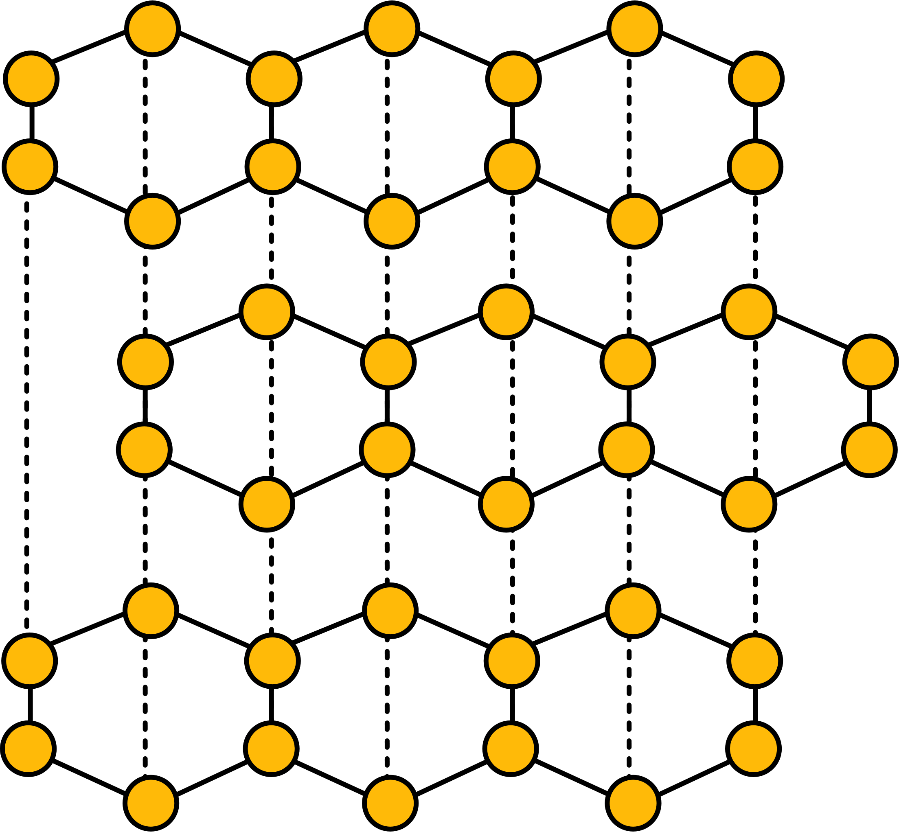
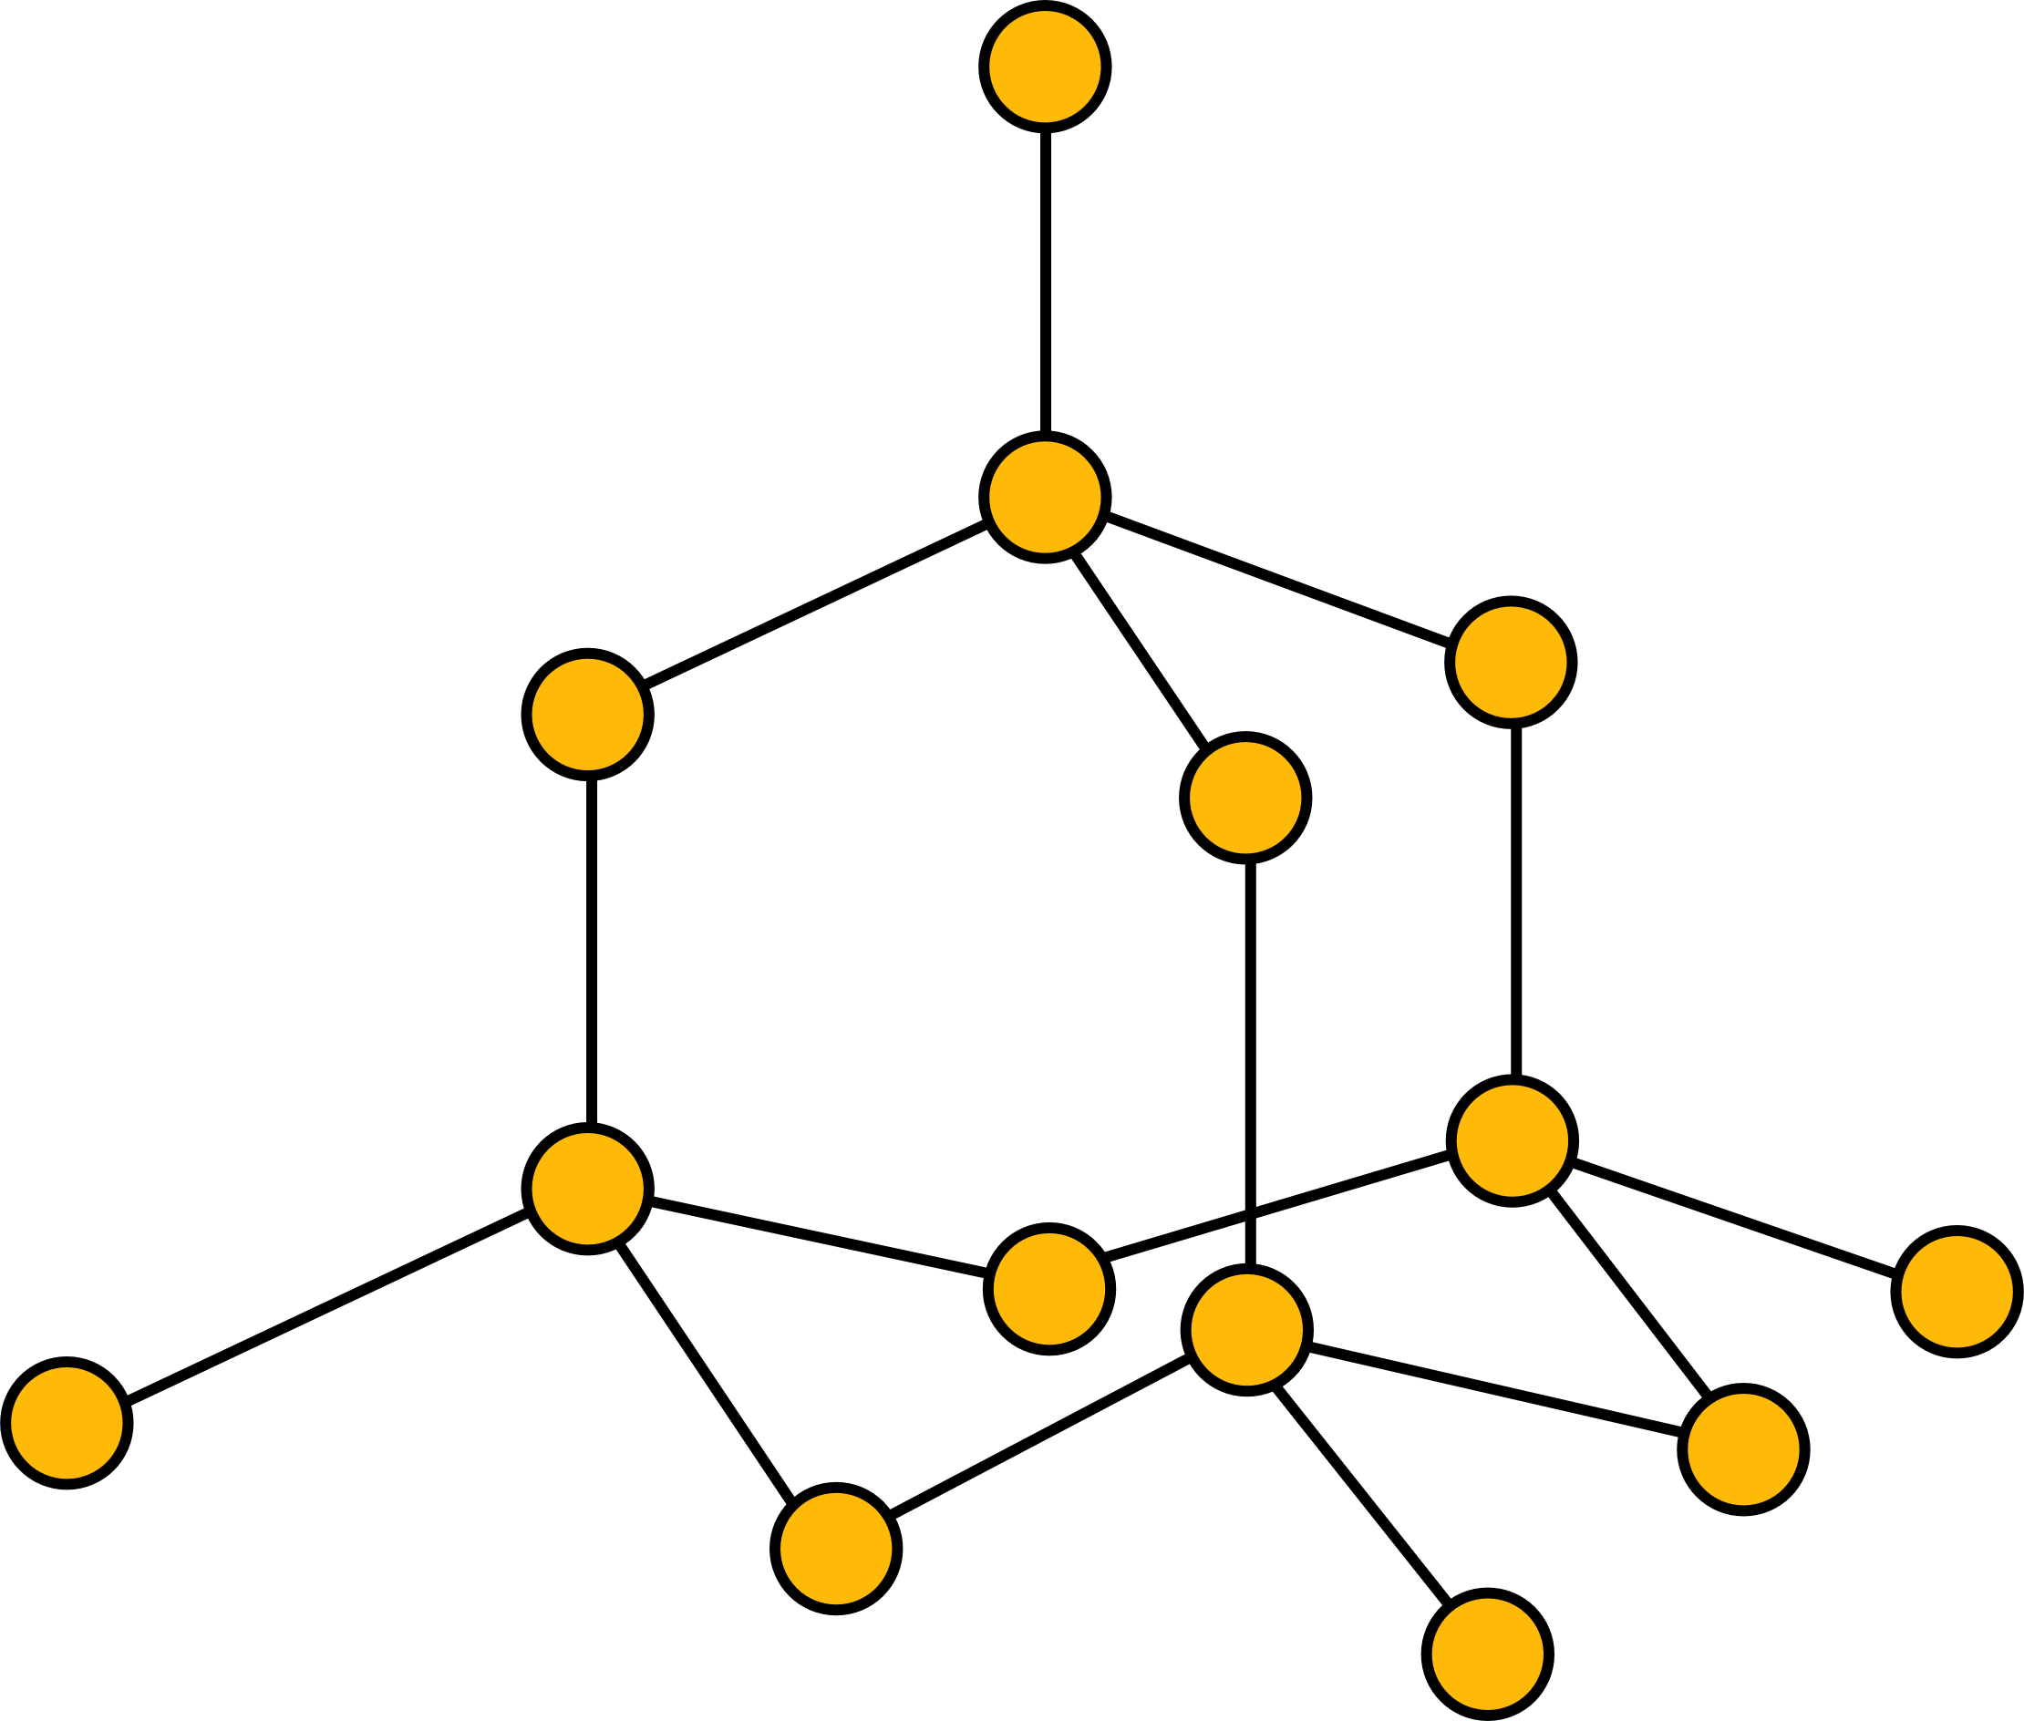
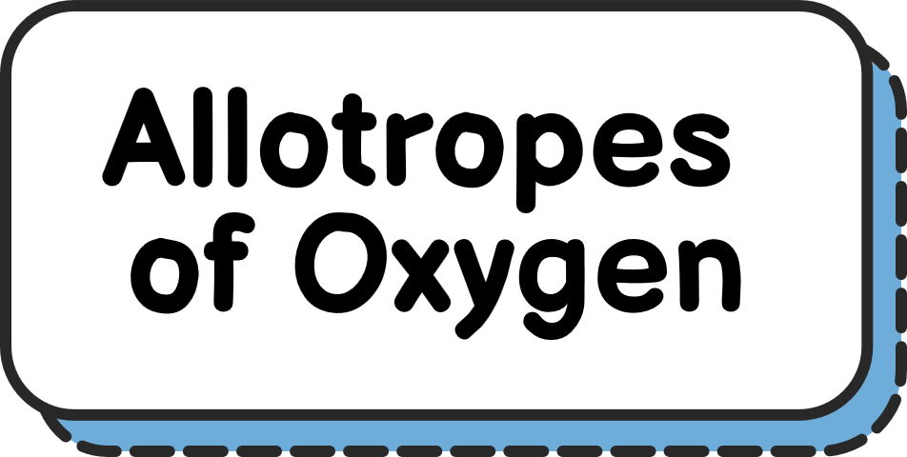
Elements can exist in multiple forms, called allotropes.
Graphite
Ozone (O₃)
Dioxygen (O₂)
Diamond

Slide 20

Elements can exist in multiple forms, called allotropes.
Ozone (O₃)
Graphite
Diamond
Dioxygen (O₂)

Slide 21



Matter in which two or more different elements are bonded together in a fixed ratio is called a compound.
Its unit must contain atoms of at least two different elements.
The atoms must be chemically bonded.
The ratio of atoms must be fixed.

Slide 22

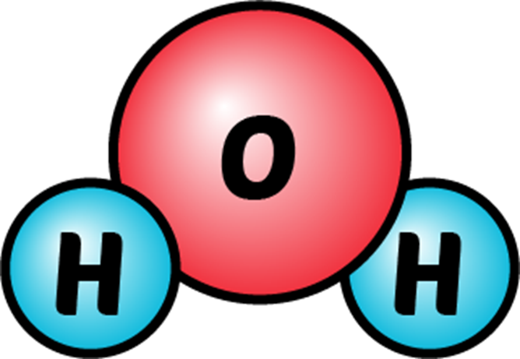

Its unit must contain atoms of at least two different elements.
The atoms must be chemically bonded.
The ratio of atoms must be fixed.

Slide 23

Its unit must contain atoms of at least two different elements.
The atoms must be chemically bonded.
The ratio of atoms must be fixed.

Slide 24
Water (a compound)

Slide 25



A mixture is a physical combination of two or more substances.
It must consist of two or more substances.
The substances must not have chemically reacted.
The substances may or may not be distributed uniformly.

Slide 26




A mixture is a physical combination of two or more substances.
It must consist of two or more substances.
The substances must not have chemically reacted.
The substances may or may not be distributed uniformly.

Slide 27


A mixture with the uniform composition of components is called a homogeneous mixture.
Water (H₂O)
Salt (NaCl)

Slide 28
A mixture with the uniform composition of components is called a homogeneous mixture.
Salt Water (H₂O + NaCl)

Slide 29
A mixture with the uniform composition of components is called a homogeneous mixture.
Substance A
Substance B

Slide 30
A mixture with the uniform composition of components is called a homogeneous mixture.
Homogeneous Mixture
Substance A
Substance B

Slide 31
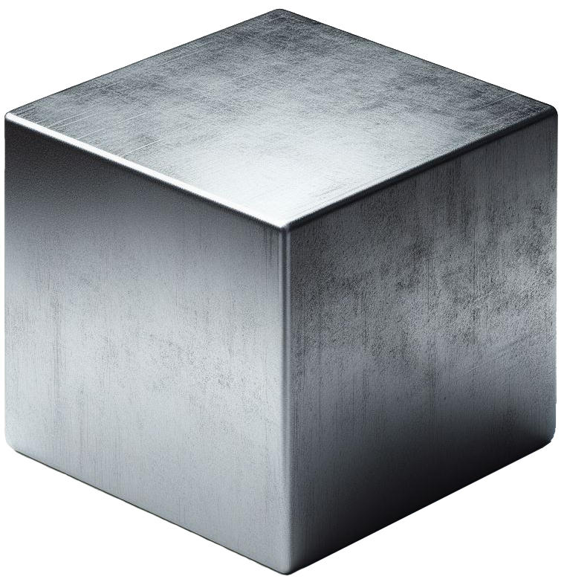
A mixture with the uniform composition of components is called a homogeneous mixture.
Steel (Iron [Fe]+ Carbon [C])

Slide 32

A mixture with the non-uniform composition of components is called a heterogeneous mixture.
Salad (A heterogeneous mixture of vegetables)

Slide 33
A mixture with the non-uniform composition of components is called a heterogeneous mixture.
Heterogeneous Mixture

Slide 34


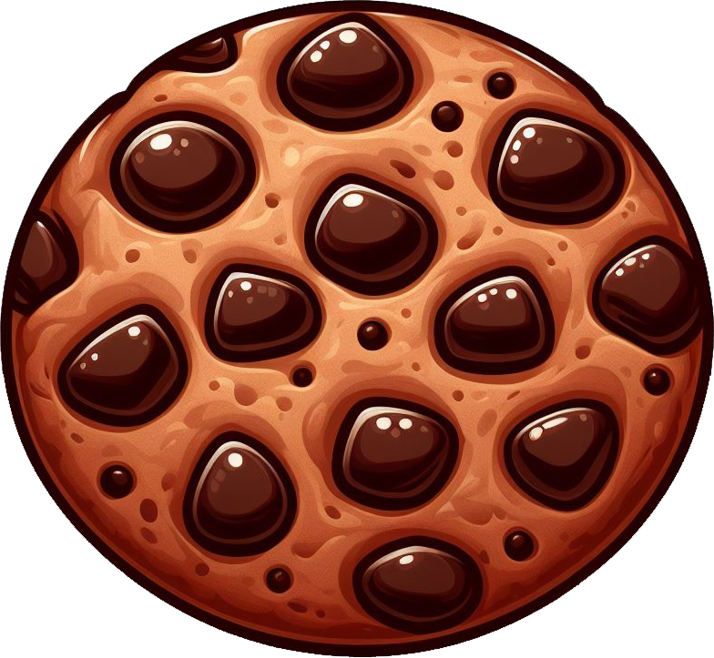
A mixture with the non-uniform composition of components is called a heterogeneous mixture.

