Slide 1
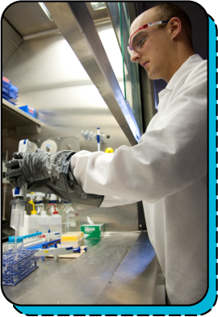
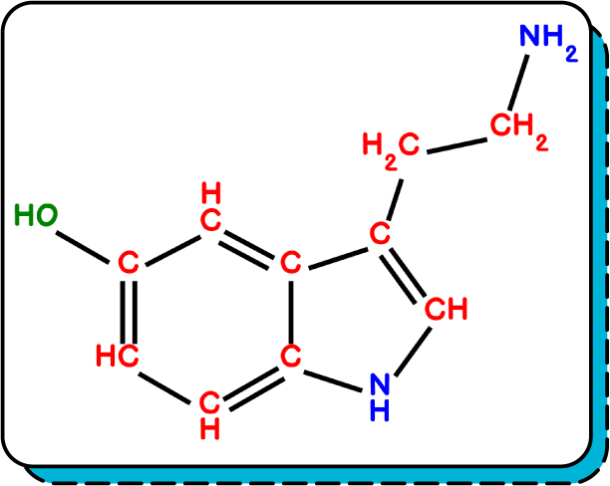

Slide 2


It is a branch of science in which we study the composition, properties, structure and chemical reactions of matter.

Slide 3
It is a branch of science in which we study the composition, properties, structure and chemical reactions of matter.

Slide 4
It is a branch of science in which we study the composition, properties, structure and chemical reactions of matter.

Slide 5
It is a branch of science in which we study the composition, properties, structure and chemical reactions of matter.

Slide 6
It is a branch of science in which we study the composition, properties, structure and chemical reactions of matter.

Slide 7




Slide 8
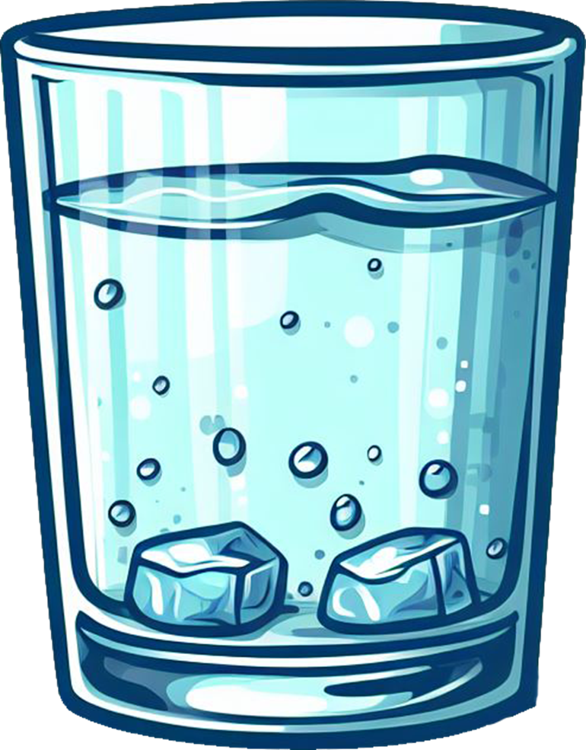

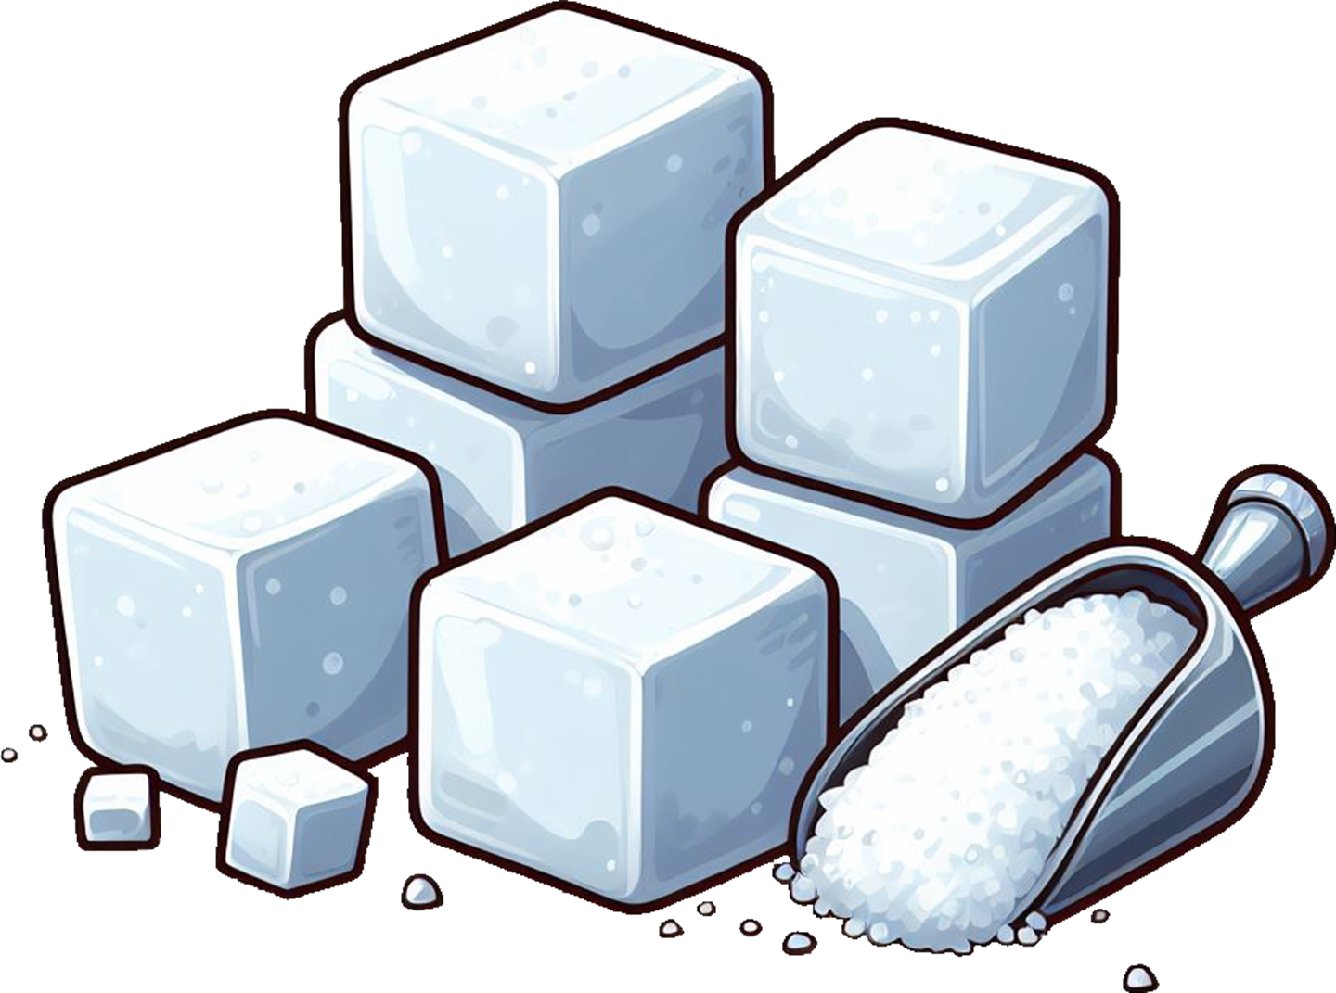

Mixture
Water
Sugar
Lemon Juice
100 g
20 g
30 g
Composition of Lemonade

Slide 9

Mixture
Water
Sugar
Lemon Juice
100 g
20 g
30 g
Composition of Lemonade

Slide 10
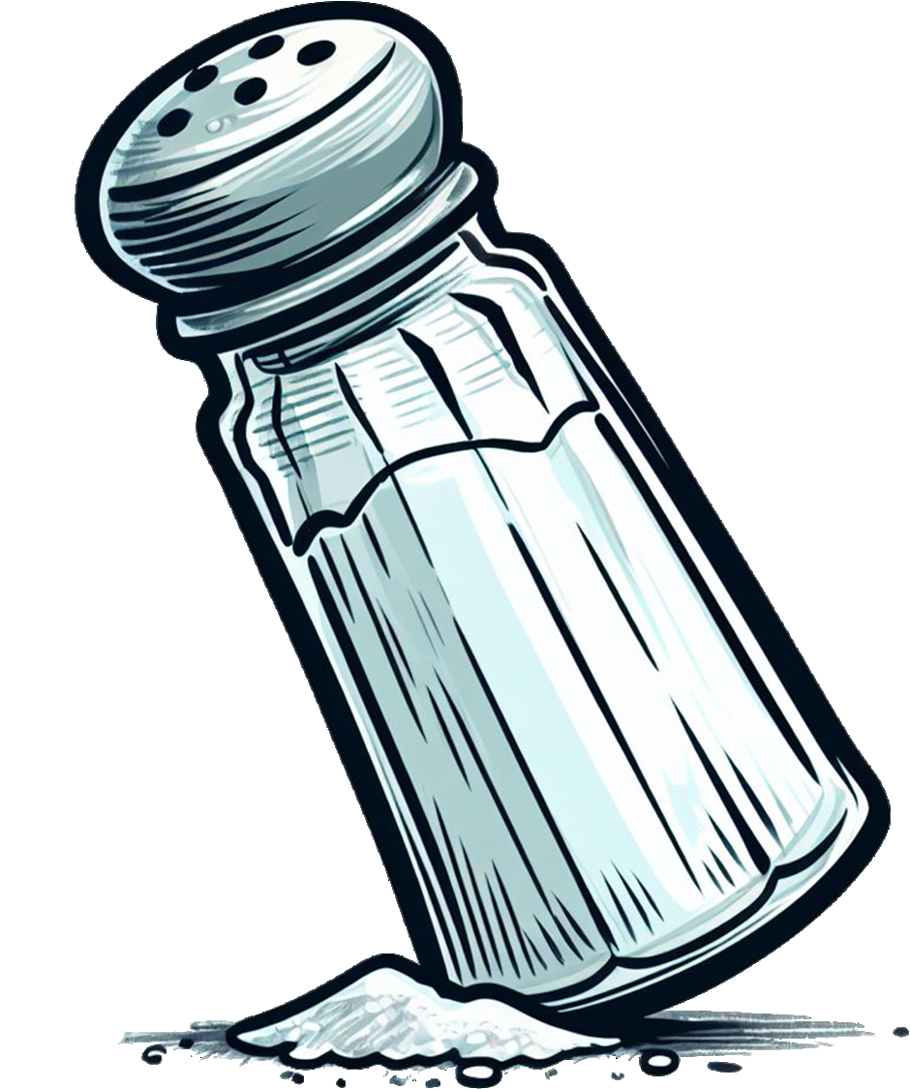
Mixture
Water
Sugar
Lemon Juice
Table Salt
100 g
15 g
30 g
5 g
Composition of Lemonade

Slide 11
Mixture
Water
Sugar
Lemon Juice
Table Salt
100 g
15 g
30 g
5 g
Composition of Lemonade

Slide 12
Lemonade
Water
Sugar
Lemon Juice
Table Salt
100 g
15 g
30 g
5 g
Composition of Lemonade

Slide 13
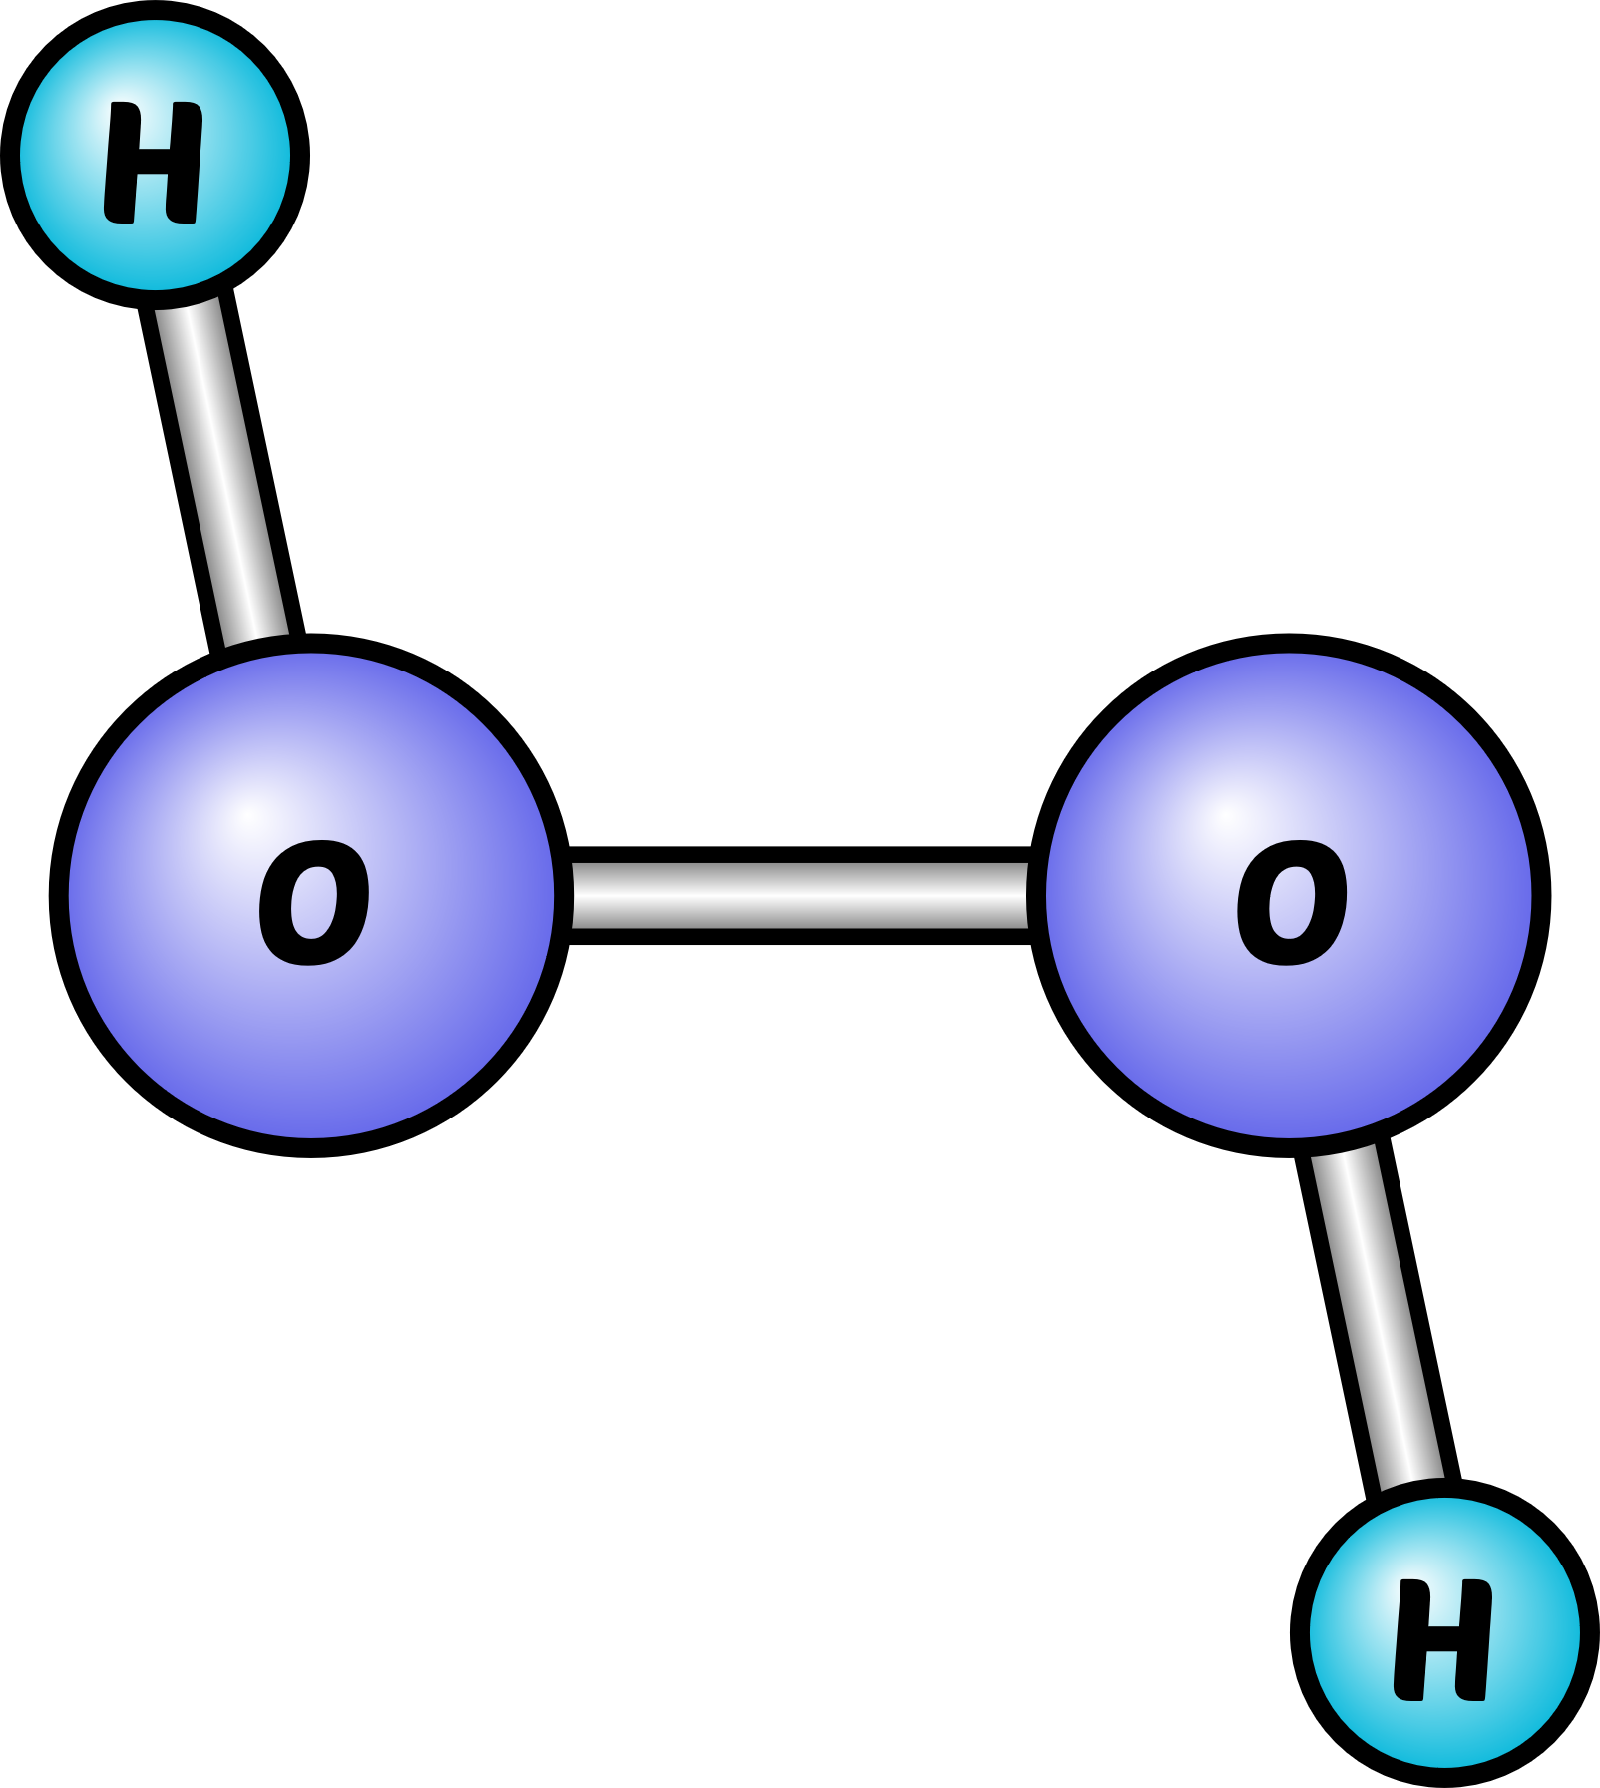
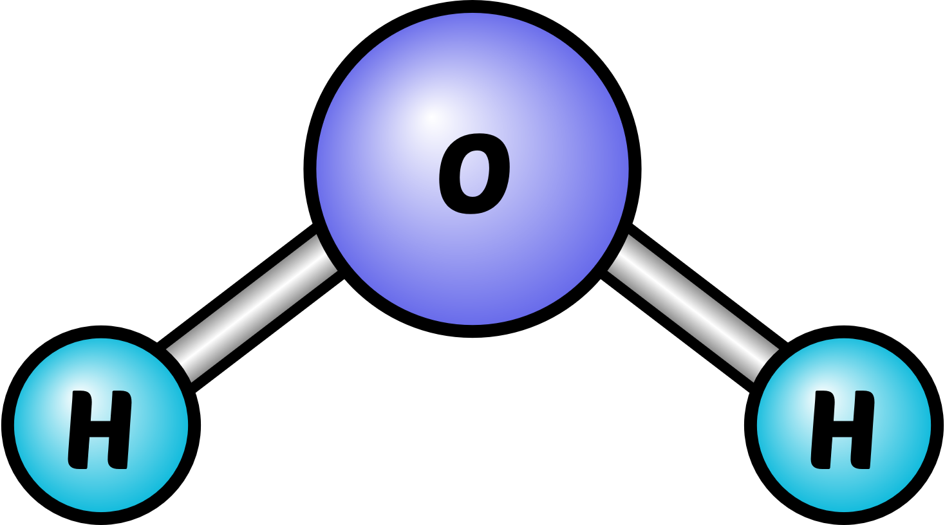
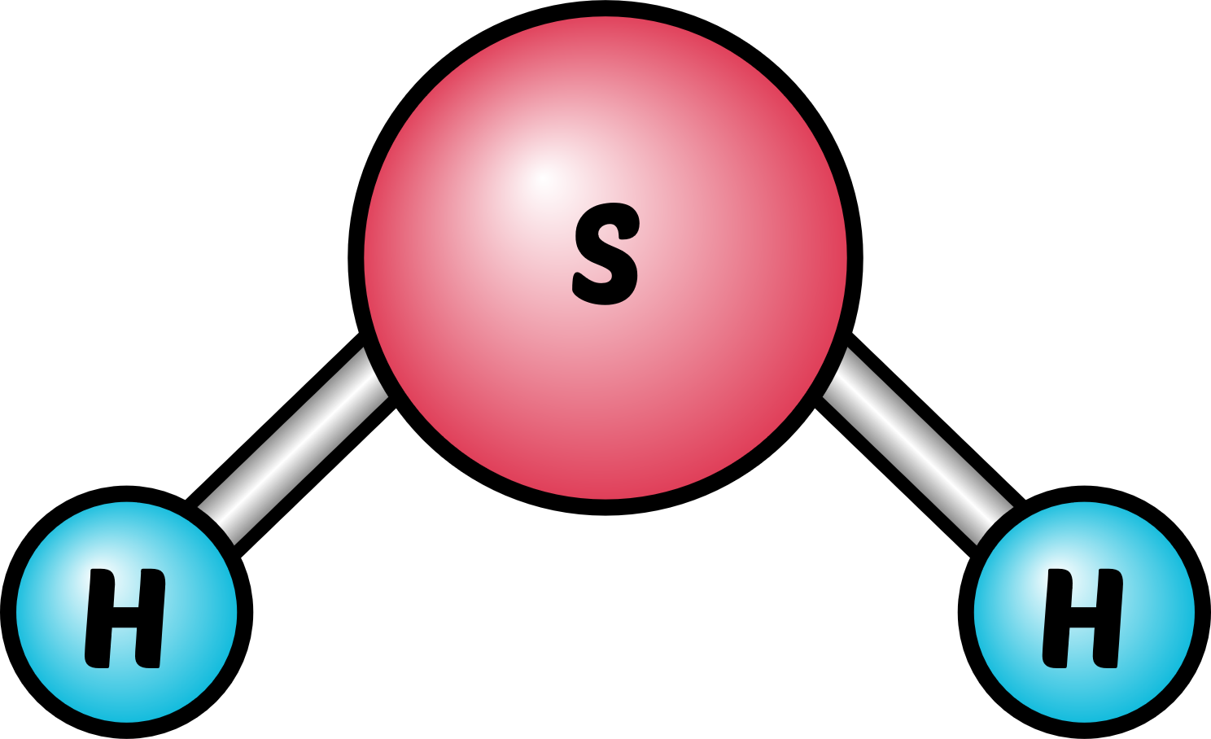


Ratio Changed
Components Changed
Bleach (H₂O₂)
Water (H₂O)
Toxic Gas (H₂S)

Slide 14

Composition of matter distinguishes different types of matter,
and define their properties.
Bleach (H₂O₂)
Water (H₂O)
Toxic Gas (H₂S)

Slide 15


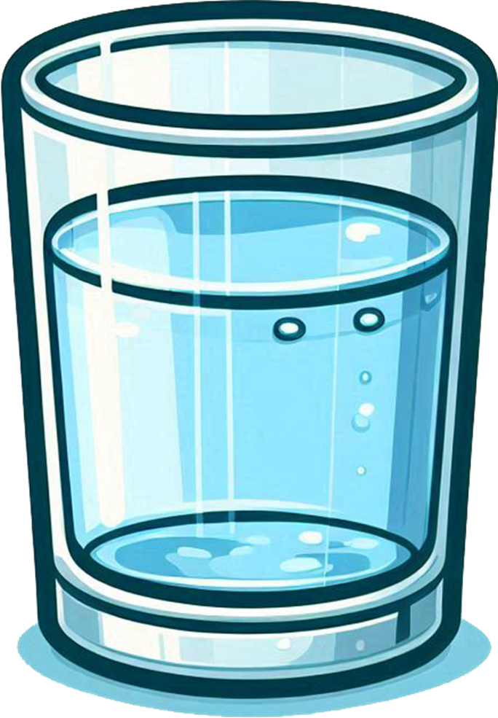
Properties are the characteristics of matter,
that are observable and measurable.

Slide 16
Properties are the characteristics of matter,
that are observable and measurable.

Slide 17
1
Colorless
2
Odorless
3
Tasteless
4
100 g
5
100 mL
6
1 g/mL
7
Polar Solv.
8
Non flamm.
9
m.p = 0 °C
10
b.p = 100 °C
11
Non-Toxic

Slide 18
1
Colorless
2
Odorless
3
Tasteless
4
100 g
5
100 mL
6
1 g/mL
7
Polar Solv.
8
Non flamm.
9
m.p = 0 °C
10
b.p = 100 °C
11
Non-Toxic

Slide 19
1
Colorless
2
Odorless
3
Tasteless
4
100 g
5
100 mL
6
1 g/mL
7
Polar Solv.
8
Non flamm.
9
m.p = 0 °C
10
b.p = 100 °C
11
Non-Toxic

Slide 20
1
Colorless
2
Odorless
3
Tasteless
4
100 g
5
100 mL
6
1 g/mL
7
Polar Solv.
8
Non flamm.
9
m.p = 0 °C
10
b.p = 100 °C
11
Non-Toxic

Slide 21
1
Colorless
2
Odorless
3
Tasteless
4
100 g
5
100 mL
6
1 g/mL
7
Polar Solv.
8
Non flamm.
9
m.p = 0 °C
10
b.p = 100 °C
11
Non-Toxic

Slide 22
1
Colorless
2
Odorless
3
Tasteless
4
100 g
5
100 mL
6
1 g/mL
7
Polar Solv.
8
Non flamm.
9
m.p = 0 °C
10
b.p = 100 °C
11
Non-Toxic

Slide 23
1
Colorless
2
Odorless
3
Tasteless
4
100 g
5
100 mL
6
1 g/mL
7
Polar Solv.
8
Non flamm.
9
m.p = 0 °C
10
b.p = 100 °C
11
Non-Toxic

Slide 24
1
Colorless
=
1
Colorless
2
≠
2
Odorless
Sweet Odor
3
≠
3
Tasteless
Bittersweet
4
≠
4
100 g
78.9 g
5
100 mL
=
5
100 mL
Water
Ethanol
6
≠
6
1 g/mL
0.789 g/mL
7
=
7
Polar Solv.
Polar Solv.
8
≠
8
Non flamm.
Flammable
9
≠
9
m.p = 0 °C
m.p = -114 °C
10
≠
10
b.p = 100 °C
b.p = 78.3 °C
11
≠
11
Non-Toxic
Toxic

Slide 25
1
Colorless
=
1
Colorless
2
≠
2
Odorless
Sweet Odor
3
≠
3
Tasteless
Bittersweet
4
≠
4
100 g
78.9 g
5
100 mL
=
5
100 mL
Water
Ethanol
6
≠
6
1 g/mL
0.789 g/mL
7
=
7
Polar Solv.
Polar Solv.
8
≠
8
Non flamm.
Flammable
9
≠
9
m.p = 0 °C
m.p = -114 °C
10
≠
10
b.p = 100 °C
b.p = 78.3 °C
11
≠
11
Non-Toxic
Toxic

Slide 26
1
Colorless
=
1
Colorless
2
≠
2
Odorless
Sweet Odor
3
≠
3
Tasteless
Bittersweet
4
≠
4
100 g
78.9 g
5
100 mL
=
5
100 mL
6
≠
6
1 g/mL
0.789 g/mL
7
=
7
Polar Solv.
Polar Solv.
8
≠
8
Non flamm.
Flammable
9
≠
9
m.p = 0 °C
m.p = -114 °C
10
≠
10
b.p = 100 °C
b.p = 78.3 °C
Water
Ethanol
11
≠
11
Non-Toxic
Toxic

Slide 27








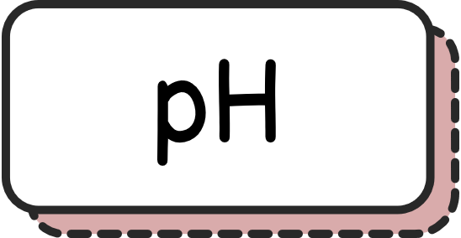





We can use these properties of matter to
identity and distinguish different matters.

Slide 28
Physical Properties
Chemical Properties

Slide 29
Physical Properties
Chemical Properties
Observed and measured without a chemical reaction
Observed and measured with a chemical reaction

Slide 30







Structure of matter refers to the three
dimensional arrangements of its units.
=
≠
Carbon
Carbon
Graphite

Slide 31
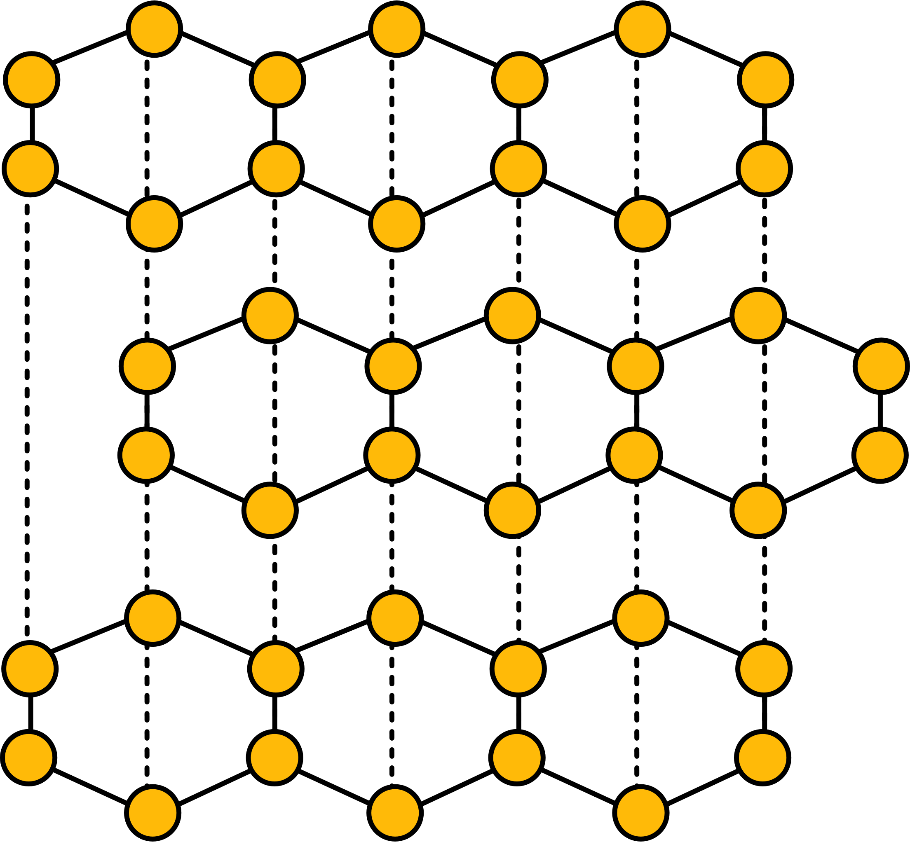
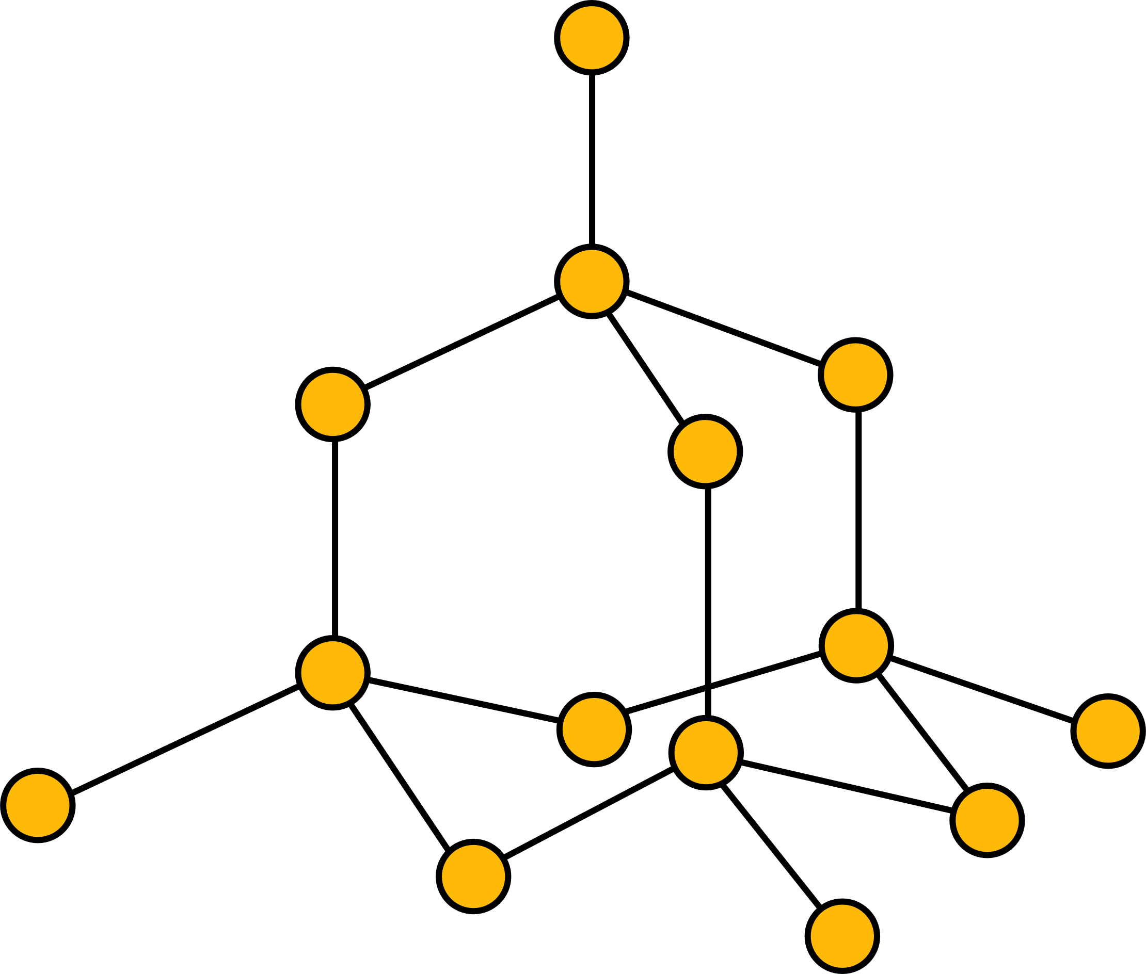
Structure of matter refers to the three
dimensional arrangements of its units.
Arrangement of carbon atoms in graphite
Arrangement of carbon atoms in diamond

Slide 32


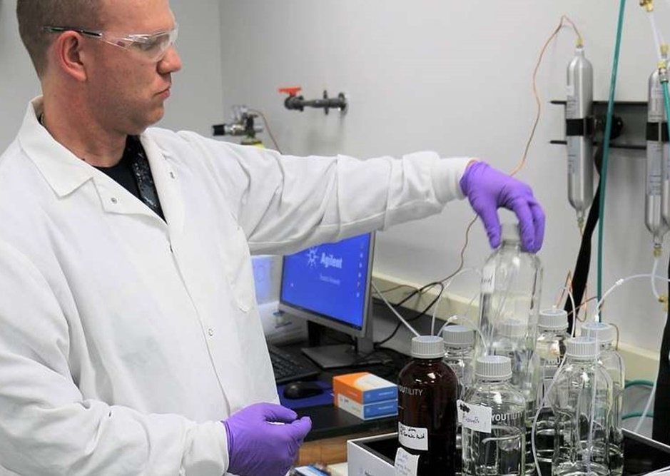
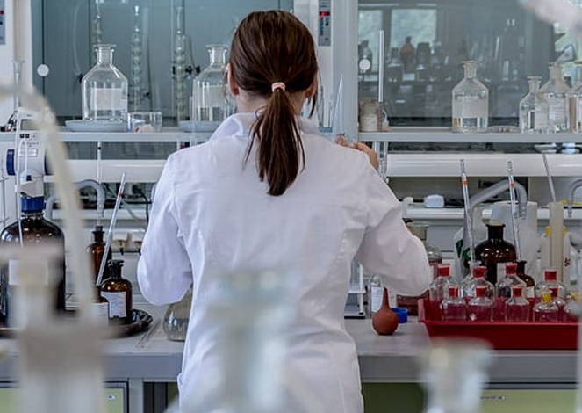
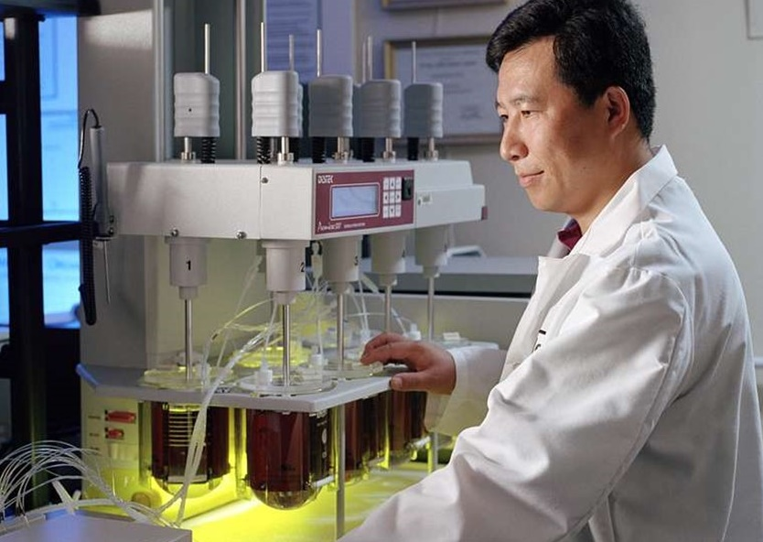

Slide 33


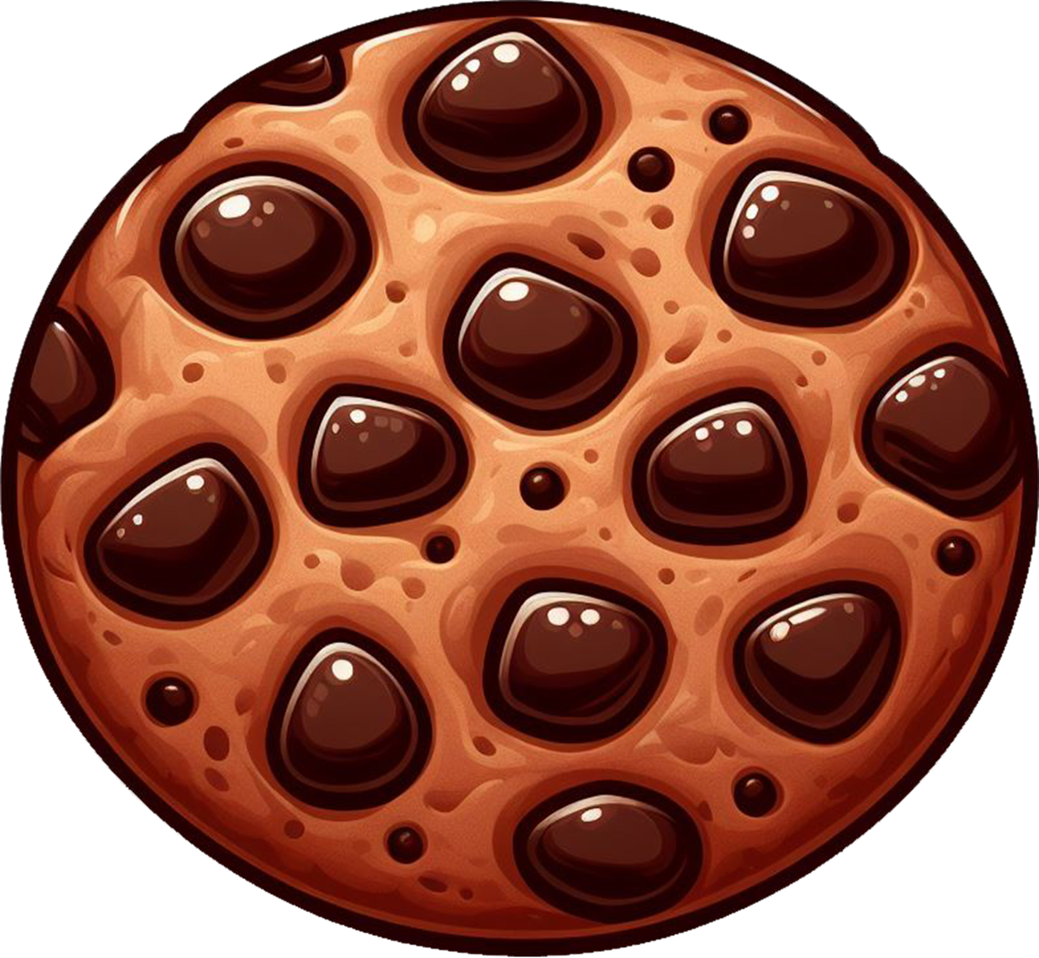
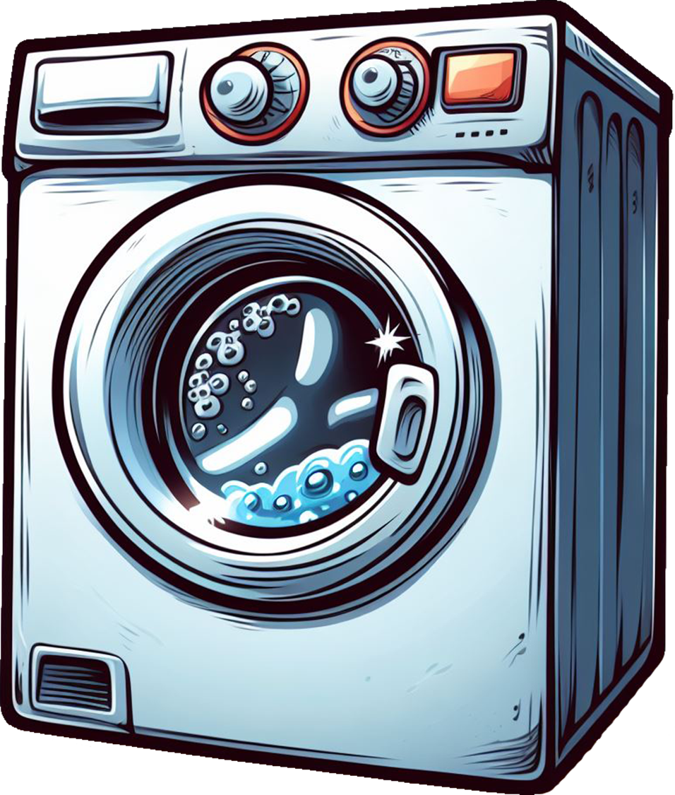
Photo-
synthesis
Boiling an
Egg
Baking a
Cookie
Washing of
Clothes

Slide 34
Chemical reaction is the conversion of one substance into another.
Chemical reaction is the change in the composition or the structure of a substance.
Photo-
synthesis
Boiling an
Egg
Baking a
Cookie
Washing of
Clothes

Slide 35
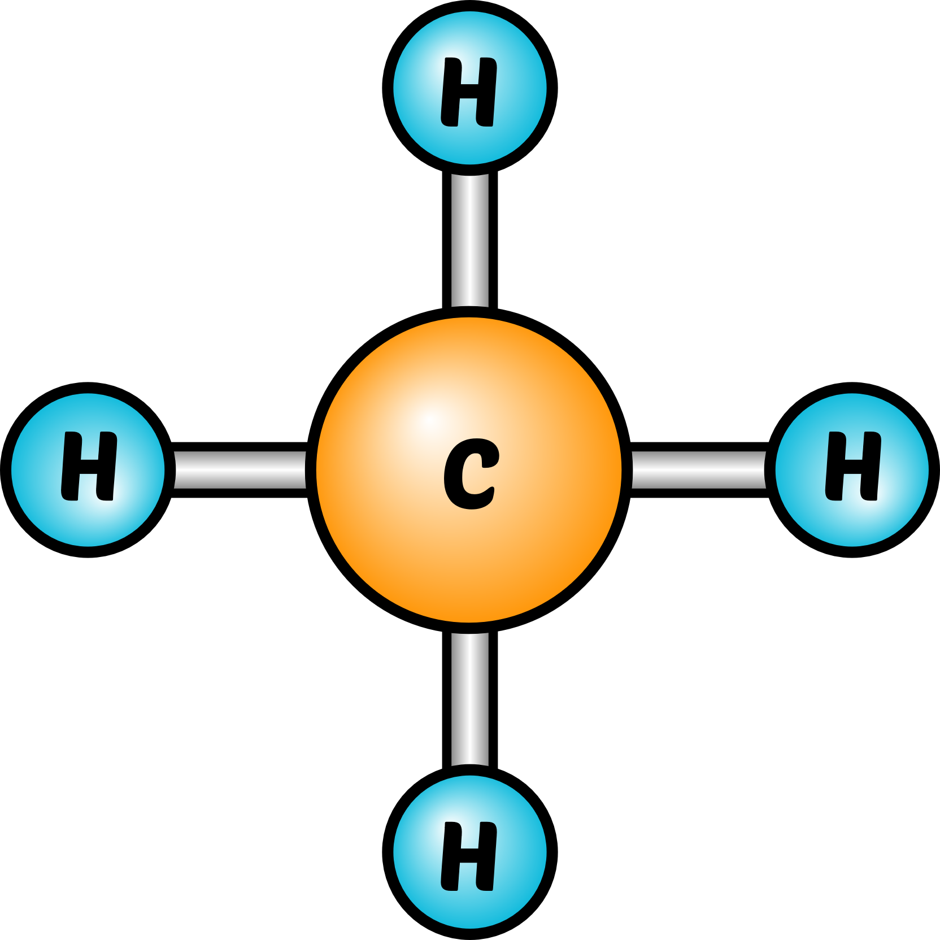
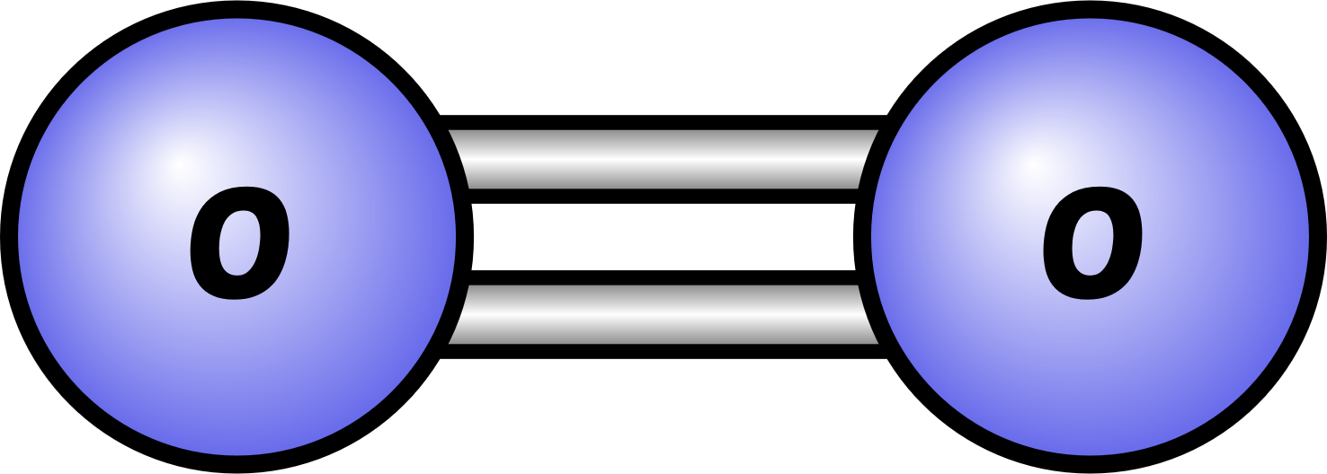
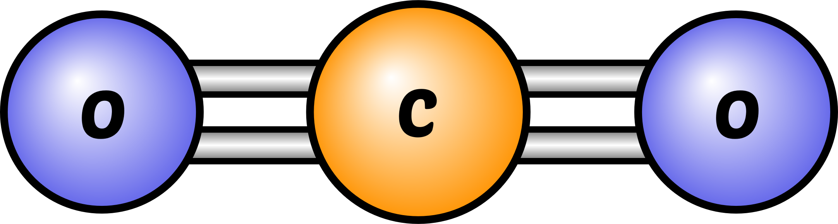
CH₄
+
2 O₂
CO₂
+
2 H₂O
Methane
Oxygen
Carbon Dioxide
Dihydrogen Oxide
(Water)

Slide 36
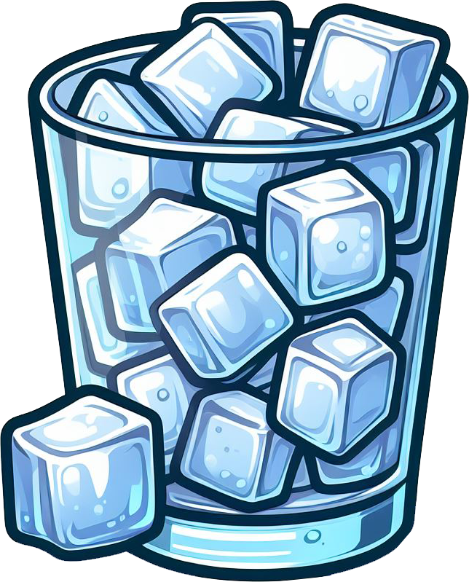
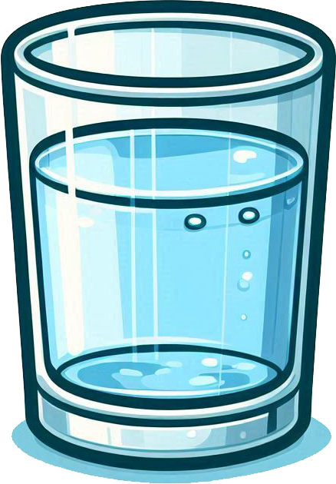
Ice
(Solid H₂O)
Water
(Liquid H₂O)

Slide 37
Ice
(Solid H₂O)
Water
(Liquid H₂O)

Slide 38
This is not a chemical reaction, because ice and water are same substances, and there is no change in composition of structure.
Ice
(Solid H₂O)
Water
(Liquid H₂O)

Slide 39
Graphite
Diamond
This is a chemical reaction because it involves a change in the structure.

Slide 40
What’s Next???
Classification of matter based on its chemical composition

