Slide 1



Slide 2
1
2
2
2
Basic Postulates
of Bohr’s Model
Max Planck’s
Quantum Theory
3
4
2
2
Bohr’s Model
in Detail
Importance of
Quantized Atom

Slide 3


1
Electrons revolve around the nucleus in the fixed circular paths, without radiating energy.
+1

Slide 4
1
Electrons revolve around the nucleus in the fixed circular paths, without radiating energy.
Stationary Orbits
+1

Slide 5
1
Electrons revolve around the nucleus in the fixed circular paths, without radiating energy.
Orbits/Energy Levels
+1

Slide 6
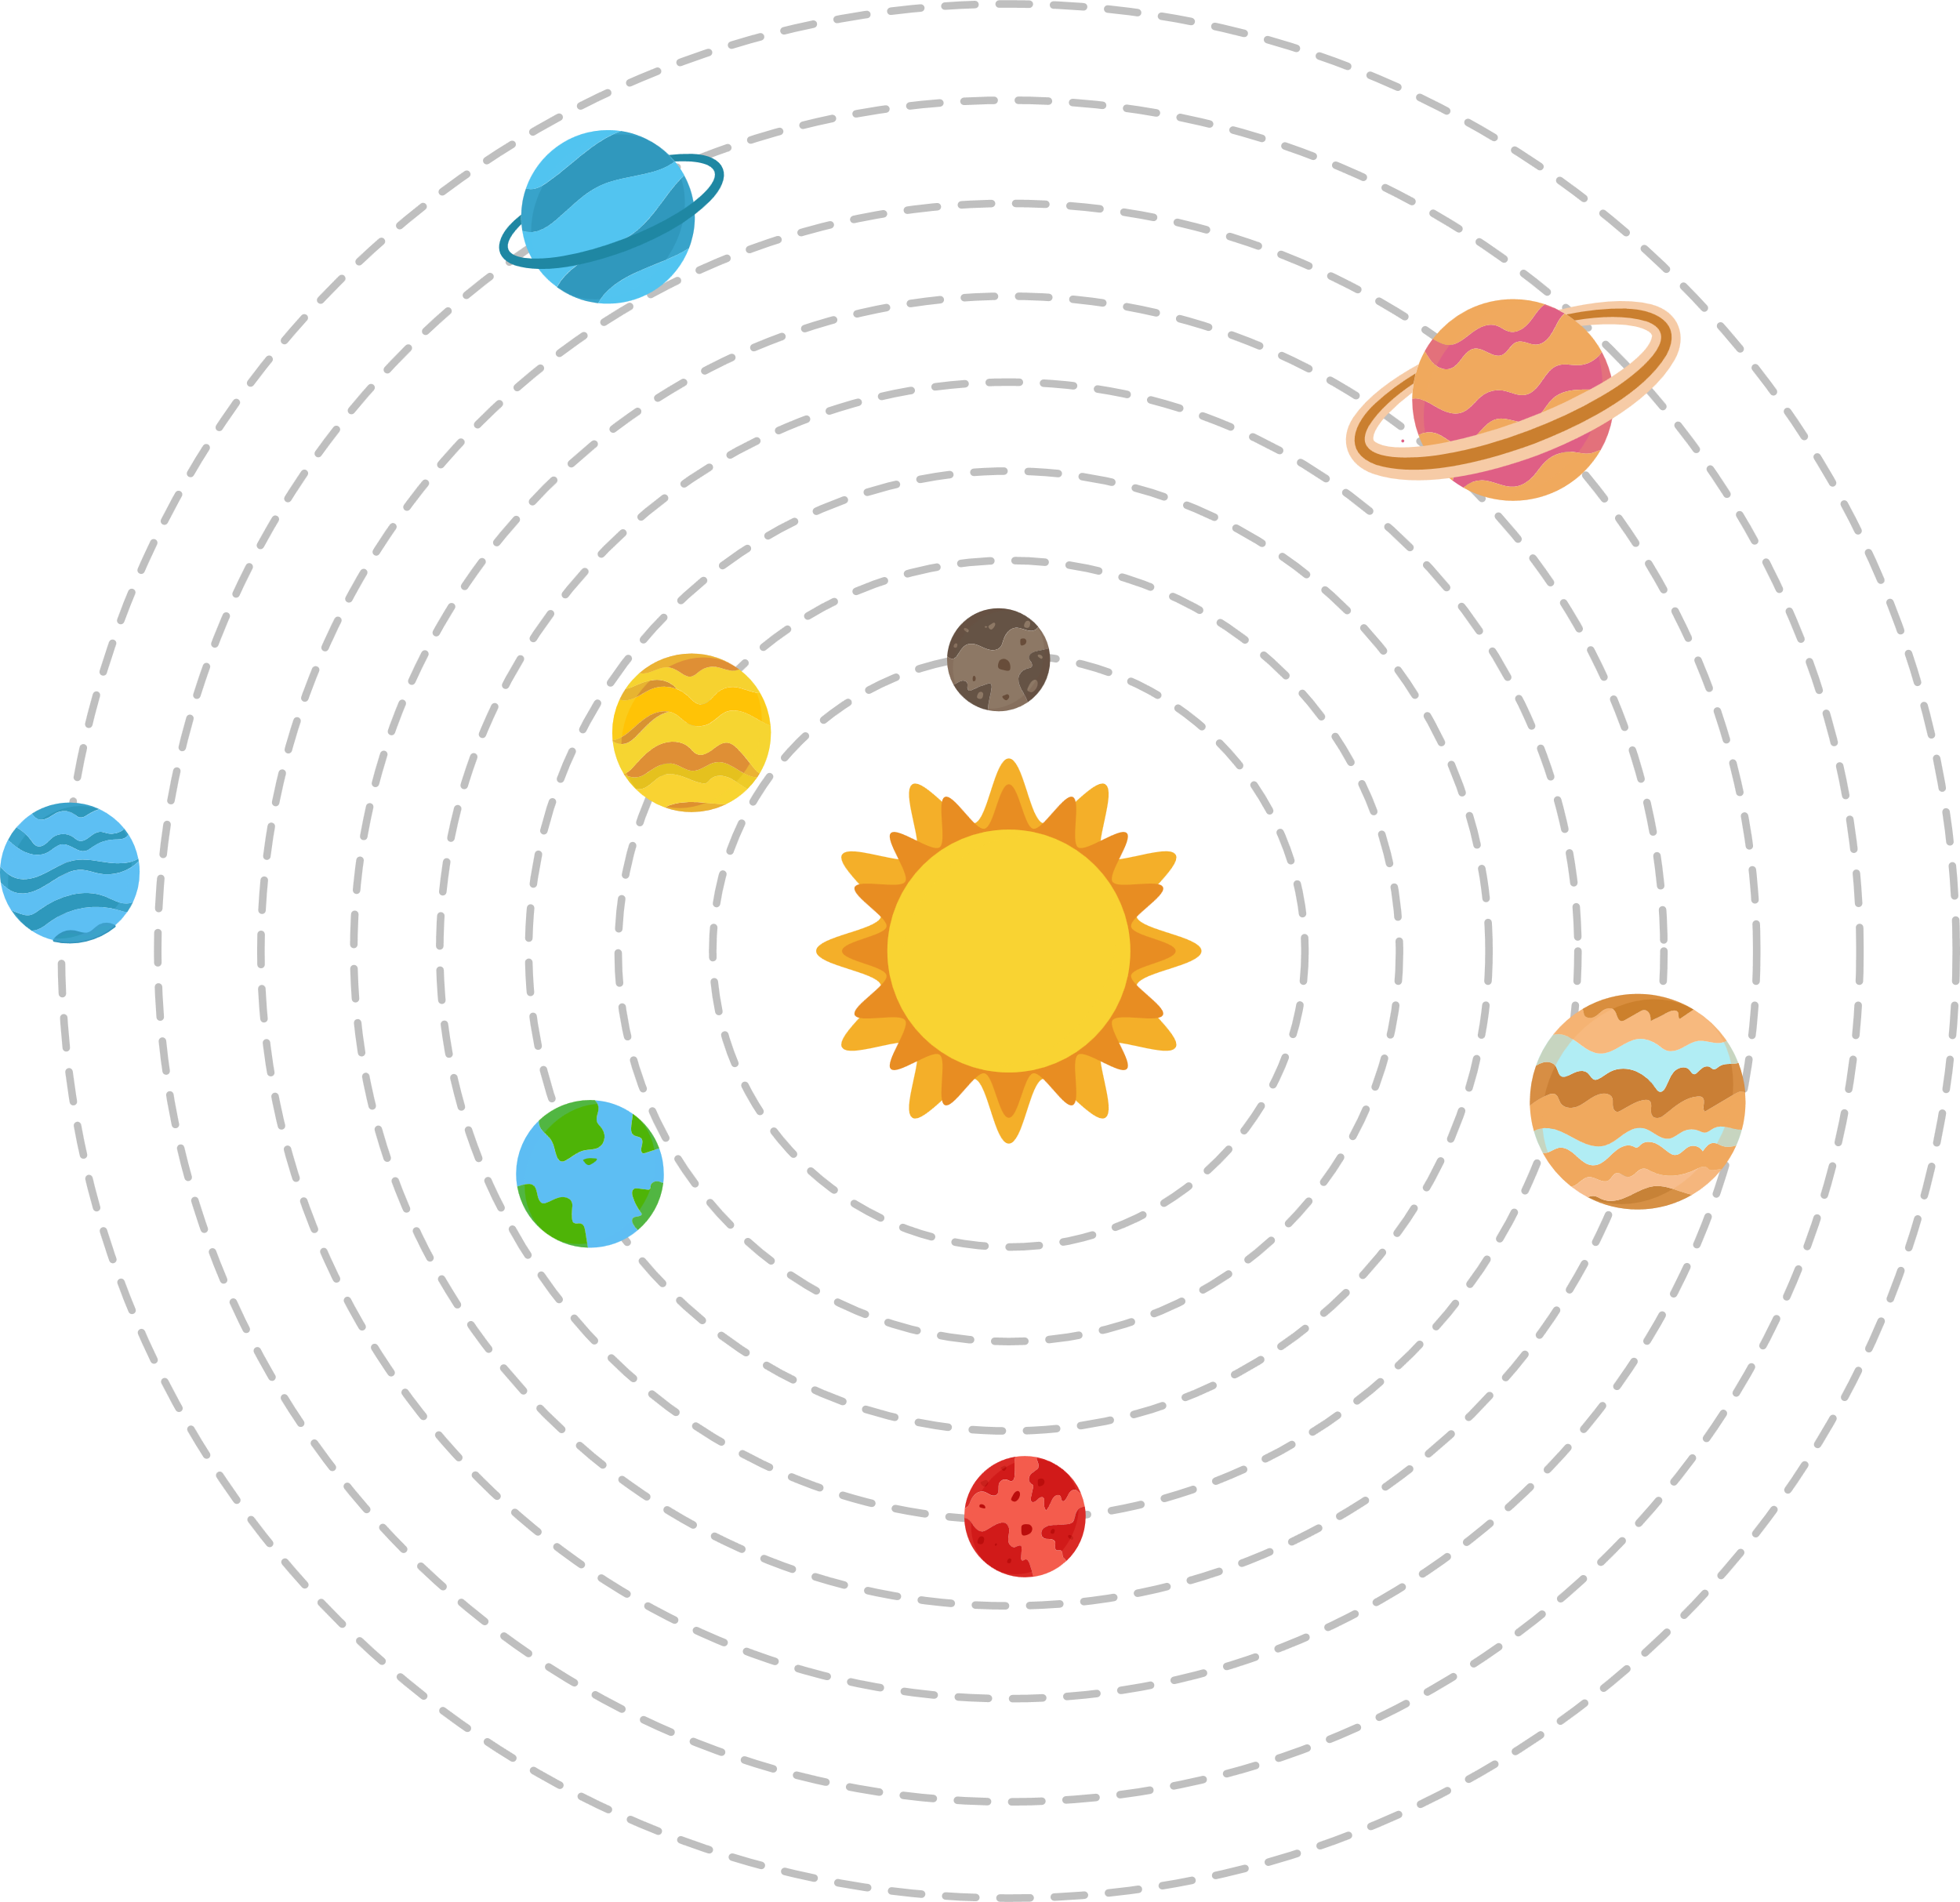
1
Electrons revolve around the nucleus in the fixed circular paths, without radiating energy.
+1

Slide 7
1
Electrons revolve around the nucleus in the fixed circular paths, without radiating energy.
+1

Slide 8
1
Electrons revolve around the nucleus in the fixed circular paths, without radiating energy.
+1

Slide 9






Step 3
r₁
Energy of Electron
+1
Potential Energy
Step 2
E₁
PE₁
Step 1

Slide 10
2
An electron can jump from lower orbit to higher orbit by absorbing a certain amount of energy.
Step 3
Energy of Electron
+1
Potential Energy
Step 2
E₁
PE₁
Step 1

Slide 11
2
An electron can jump from lower orbit to higher orbit by absorbing a certain amount of energy.
Step 3
Energy of Electron
+1
Potential Energy
Step 2
E₁
PE₁
Step 1

Slide 12
Step 3
Energy of Electron
+1
PE₂
Potential Energy
Step 2
E₁
PE₁
Step 1

Slide 13

Step 3
EM
Radiation
E₂
+1
PE₂
Energy of Electron
Potential Energy
Step 2
E₁
PE₁
Step 1

Slide 14








Slide 15
Step 3
E₂
+1
PE₂
Energy of Electron
Potential Energy
Step 2
E₁
PE₁
Step 1

Slide 16
3
An electron can fall from higher orbit to lower orbit by releasing a certain amount of energy.
Step 3
E₂
+1
PE₂
Energy of Electron
Potential Energy
Step 2
E₁
PE₁
Step 1

Slide 17
3
An electron can fall from higher orbit to lower orbit by releasing a certain amount of energy.
Step 3
E₂
+1
PE₂
Energy of Electron
Potential Energy
Step 2
E₁
PE₁
Step 1

Slide 18


Electronic Excitation
2
2
Lower to Higher Orbit
E₃
Absorption of Energy
E₂
+1
Energy of Electron
Electronic Relaxation
2
2
E₁

Slide 19
Electronic Excitation
2
2
Lower to Higher Orbit
E₃
Absorption of Energy
E₂
+1
Energy of Electron
Electronic Relaxation
2
2
E₁
Higher to Lower Orbit
Emission of Energy

Slide 20


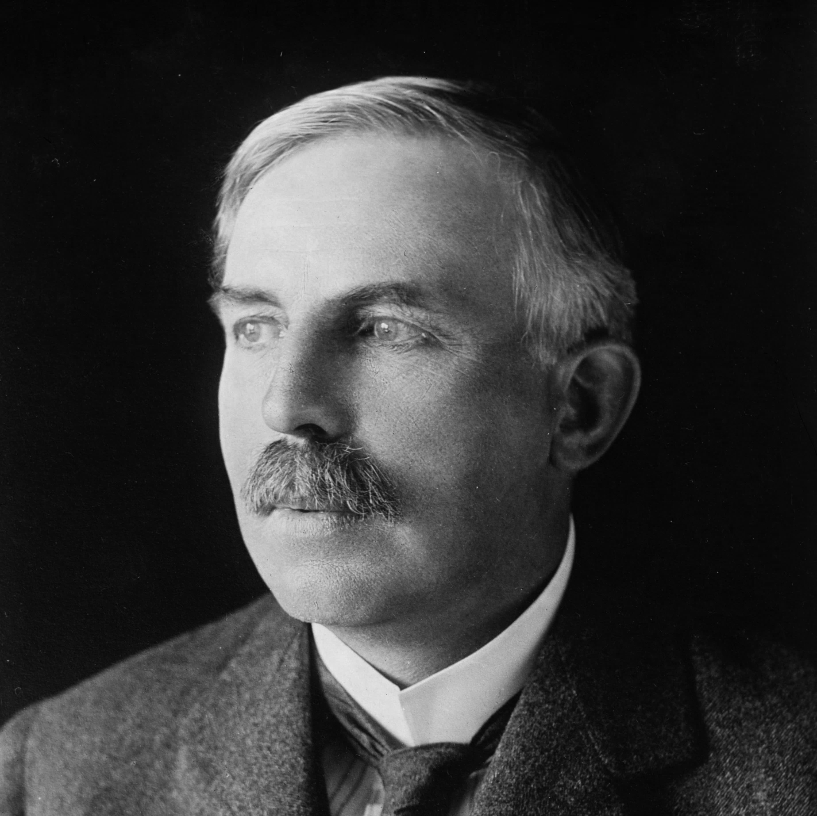
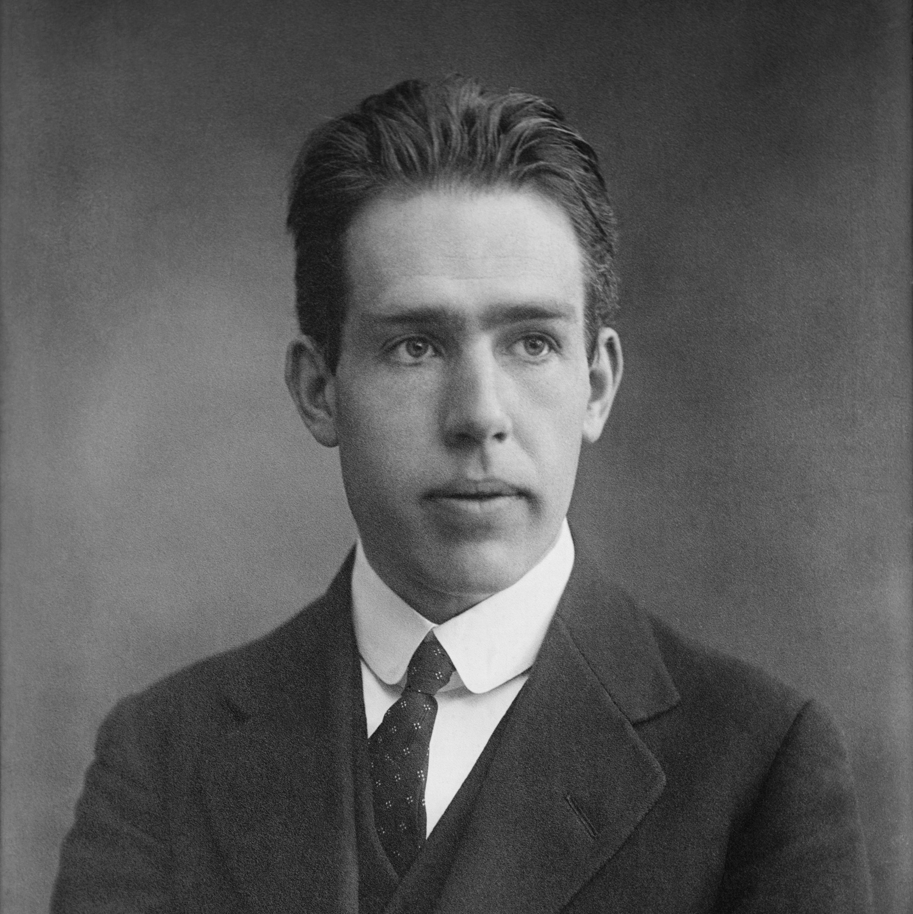
2
2
E. Rutherford
Niels Bohr

Slide 21
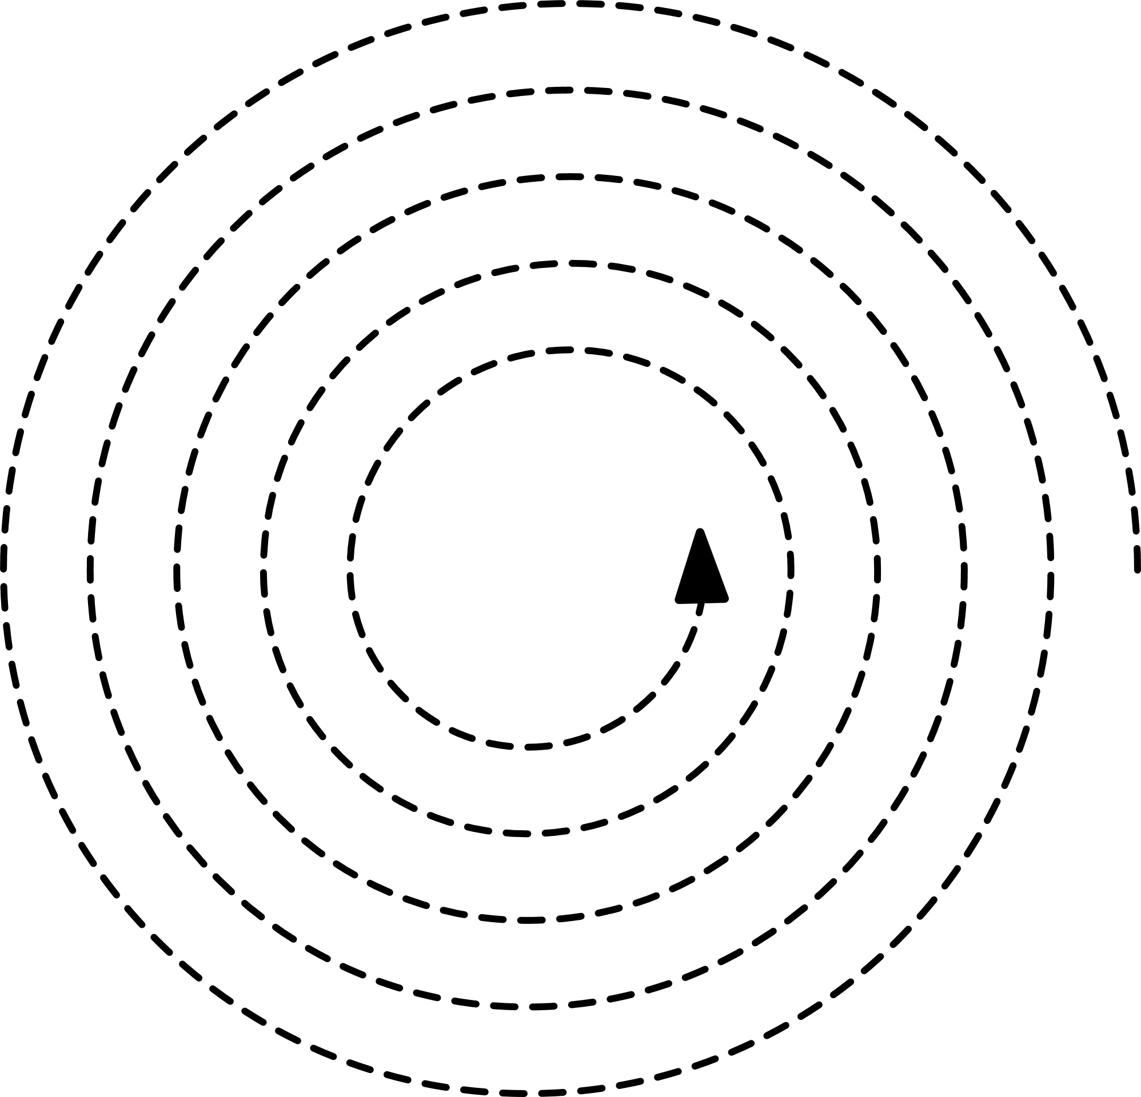
2
2
+1
E. Rutherford
Niels Bohr

Slide 22
2
+1
E. Rutherford
Classical Physics
2
Niels Bohr

Slide 23
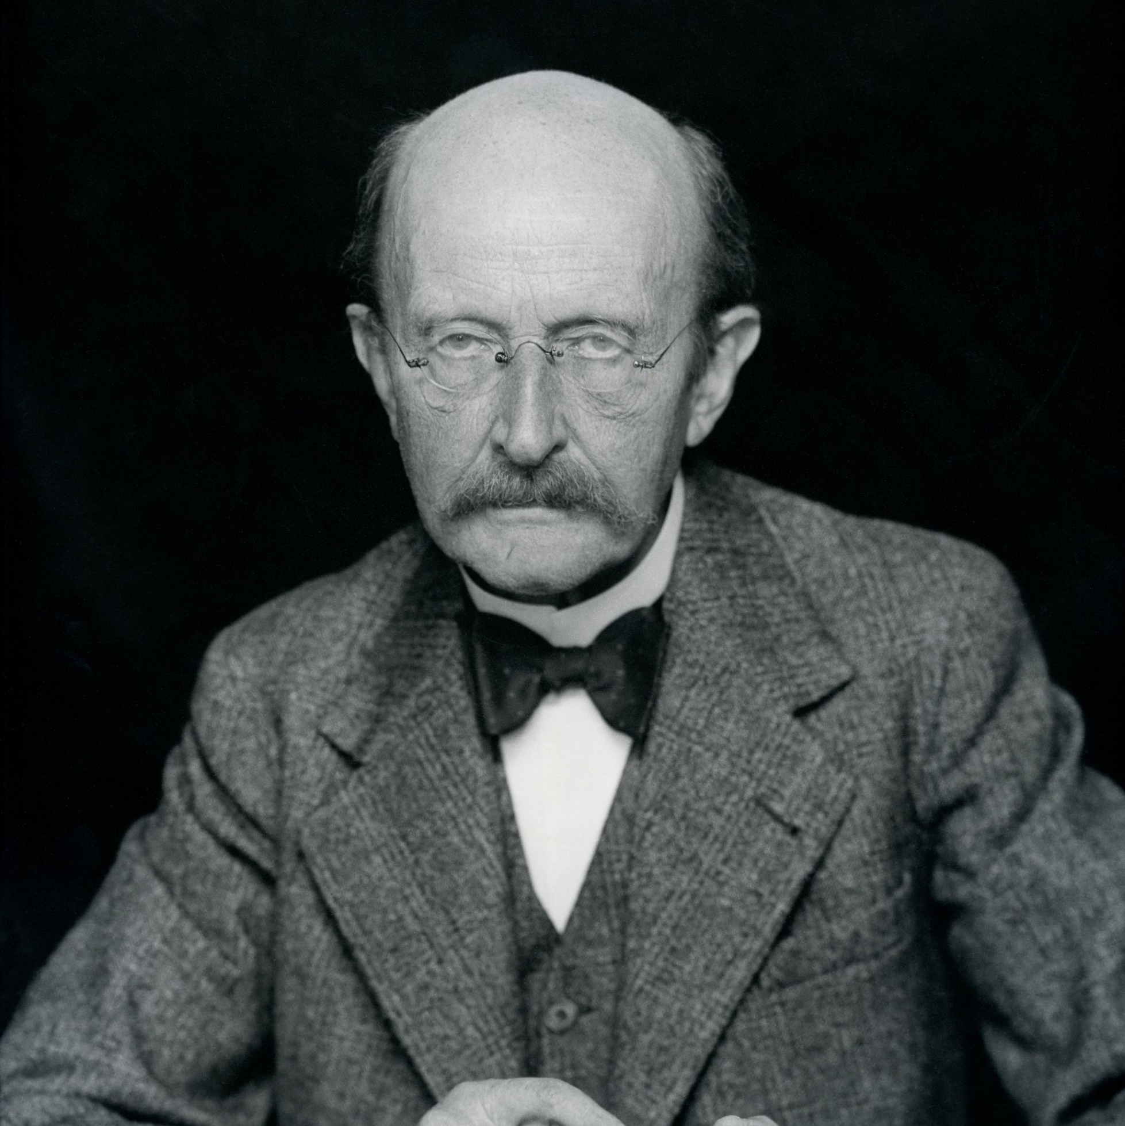
2
2
+1
E. Rutherford
Max Planck
Classical Physics
Quantum Theory
2
Niels Bohr

Slide 24
2
2
2
E. Rutherford
Max Planck
Niels Bohr
Classical Physics
Quantum Theory

Slide 25
2
2
2
E. Rutherford
Max Planck
Niels Bohr
Classical Physics
Quantum Theory

Slide 26
2
2
2
E. Rutherford
Max Planck
Niels Bohr
Quantum Theory
Classical Physics

Slide 27
2
2
2
Classical Physics
Movement of Electrons
E. Rutherford
Max Planck
Niels Bohr
Quantum Theory

Slide 28
2
2
2
Classical Physics
Movement of Electrons
E. Rutherford
Max Planck
Niels Bohr
Quantum Theory

Slide 29
2
2
2
Classical Physics
Movement of Electrons
Quantum Theory
Emission & Absorption
of Energy
E. Rutherford
Max Planck
Niels Bohr

Slide 30

2
2
Quantum Theory
2
Classical Physics
This theory states that energy is absorbed or emitted in the form of
discrete energy packets called Quanta, singular Quantum.
Movement of Electrons
Quantum Theory
“Nu”
E = hv
Emission & Absorption
of Energy
E. Rutherford
Max Planck
Energy of
1 Quantum
Frequency of the radiation
Niels Bohr
Planck’s Constant

Slide 31

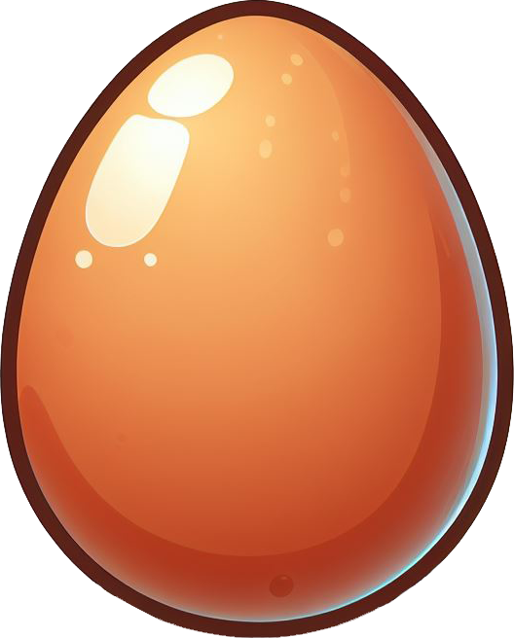

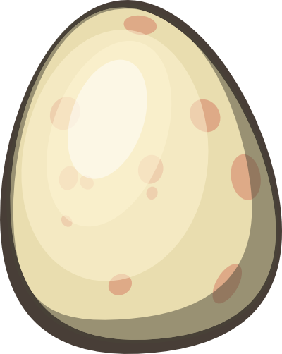
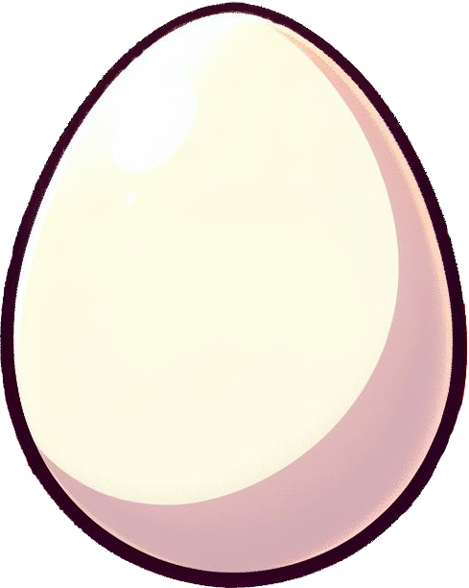





5 Eggs
1
2
3
4
5
6
7
8
9
a
b
c
d
e
f
g
h
i
j
k
l

Slide 32
5 Eggs
1
2
3
4
5
6
7
8
9
a
b
c
d
e
f
g
h
i
j
k
l
7 Eggs

Slide 33
5 Eggs
3
4
5
6
7
8
9
f
g
h
i
j
k
l
7 Eggs
1
2
a
b
c
d
e
3 Eggs

Slide 34
5 Eggs
3
4
5
6
7
f
g
h
i
j
k
7 Eggs
1
2
a
b
c
d
e
3 Eggs
8
9
l

Slide 35
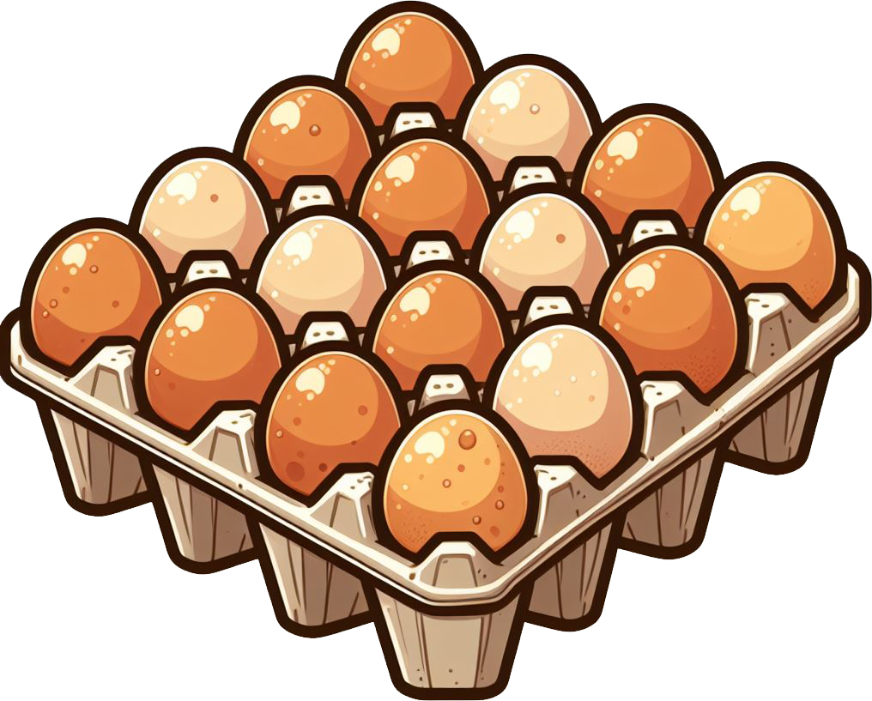
16 Eggs
= 16 Eggs

Slide 36
16 Eggs
32 Eggs
= 16 Eggs

Slide 37
16 Eggs
You are selling eggs in the integral multiples of 16.
32 Eggs
49 Eggs
= 16 Eggs

Slide 38
16 Eggs
You are selling eggs in the integral multiples of 16.
32 Eggs
48 Eggs
= 16 Eggs

Slide 39
16 Eggs
You are selling eggs in the integral multiples of 16.
32 Eggs
48 Eggs
= 16 Eggs

Slide 40
16 Eggs
You are selling eggs in the integral multiples of 16.
32 Eggs
64 Eggs
= 16 Eggs

Slide 41
16 Eggs
You are selling eggs in the integral multiples of 16.
32 Eggs
64 Eggs
= 16 Eggs

Slide 42
16 Eggs
You are selling eggs in the integral multiples of 16.
32 Eggs
64 Eggs
= 16 Eggs

Slide 43

Quantized Eggs
1 Quantum
of Eggs
Non-Quantized Eggs
16 Eggs
1
2
3
4
5
6
7
8
9
a
b
c
d
e
f
g
h
i
j
k
l
32 Eggs
32 Eggs
Number of eggs
that can be sold
=
n
x
Eggs in
1 box
No Limitations
n is a positive integer (1, 2, 3, …)
= 16 Eggs

Slide 44







Non-Quantized Water
Quantized Water

Slide 45
250
200
150
Mass (g) of Water
100
50
0
Non-Quantized Water
Quantized Water

Slide 46
250
200
150
Mass (g) of Water
100
50
0
Non-Quantized Water
Quantized Water

Slide 47
250
200
150
Mass (g) of Water
100
50
0
Non-Quantized Water
Quantized Water

Slide 48
250
96
84
No Limitations
= 12 g
200
72
Mass of
Water
=
n
x
Mass of
1 Ice Cube
60
150
n is a positive integer (1, 2, 3, …)
Mass (g) of Water
48
Mass (g) of Water
100
36
24
50
12
0
Non-Quantized Water
Quantized Water
0

Slide 49
Quantum Theory
2
This theory states that energy is absorbed or emitted in the form of
discrete energy packets called Quanta, singular Quantum.
“Nu”
E
=
h
v
Energy of
1 Quantum
Frequency of the radiation
Planck’s Constant

Slide 50

Wavelength
E
=
h
v
c
=
v
λ
Speed
of Light
2

Slide 51
c
v
=
v
=
h
E
h
E
=
v
λ
2

Slide 52
c
c
E
=
h
v
E
=
h
v
=
v
λ
λ
2

Slide 53
c
c
E
=
h
v
E
=
h
=
v
λ
λ
2
c = 2.998 x 10⁸ ms⁻¹
h = 6.626 X 10⁻³⁴ J.s
λ = 700 nm

Slide 54
c
c
c
v
=
=
h
=
h
E
h
E
E
=
v
λ
λ
λ
2
c = 2.998 x 10⁸ ms⁻¹
h = 6.626 X 10⁻³⁴ J.s
λ = 700 x 10⁻⁹ m

Slide 55
c
c
E
=
h
v
E
=
h
=
v
λ
λ
2
c = 2.998 x 10⁸ ms⁻¹
h = 6.626 X 10⁻³⁴ J.s
λ = 700 x 10⁻⁹ m
c
E
=
h
λ

Slide 56
c
c
E
=
h
v
E
=
h
=
v
λ
λ
2
c = 2.998 x 10⁸ ms⁻¹
h = 6.626 X 10⁻³⁴ J.s
λ = 700 x 10⁻⁹ m
2.998 x 10⁸ ms⁻¹
E
=
6.626 X 10⁻³⁴ J.s
x
700 x 10⁻⁹ m

Slide 57
c
c
E
=
h
v
E
=
h
=
v
λ
λ
2
c = 2.998 x 10⁸ ms⁻¹
h = 6.626 X 10⁻³⁴ J.s
λ = 700 x 10⁻⁹ m
E
=
2.84 x 10⁻¹⁹ J
E (J)
E (eV) =
1.602 X 10⁻¹⁹

Slide 58
c
c
E
=
h
v
E
=
h
=
v
λ
λ
2
c = 2.998 x 10⁸ ms⁻¹
h = 6.626 X 10⁻³⁴ J.s
λ = 700 x 10⁻⁹ m
2.84 x 10⁻¹⁹ J
E
=
E (J)
E (eV) =
1.602 X 10⁻¹⁹
1.602 X 10⁻¹⁹

Slide 59
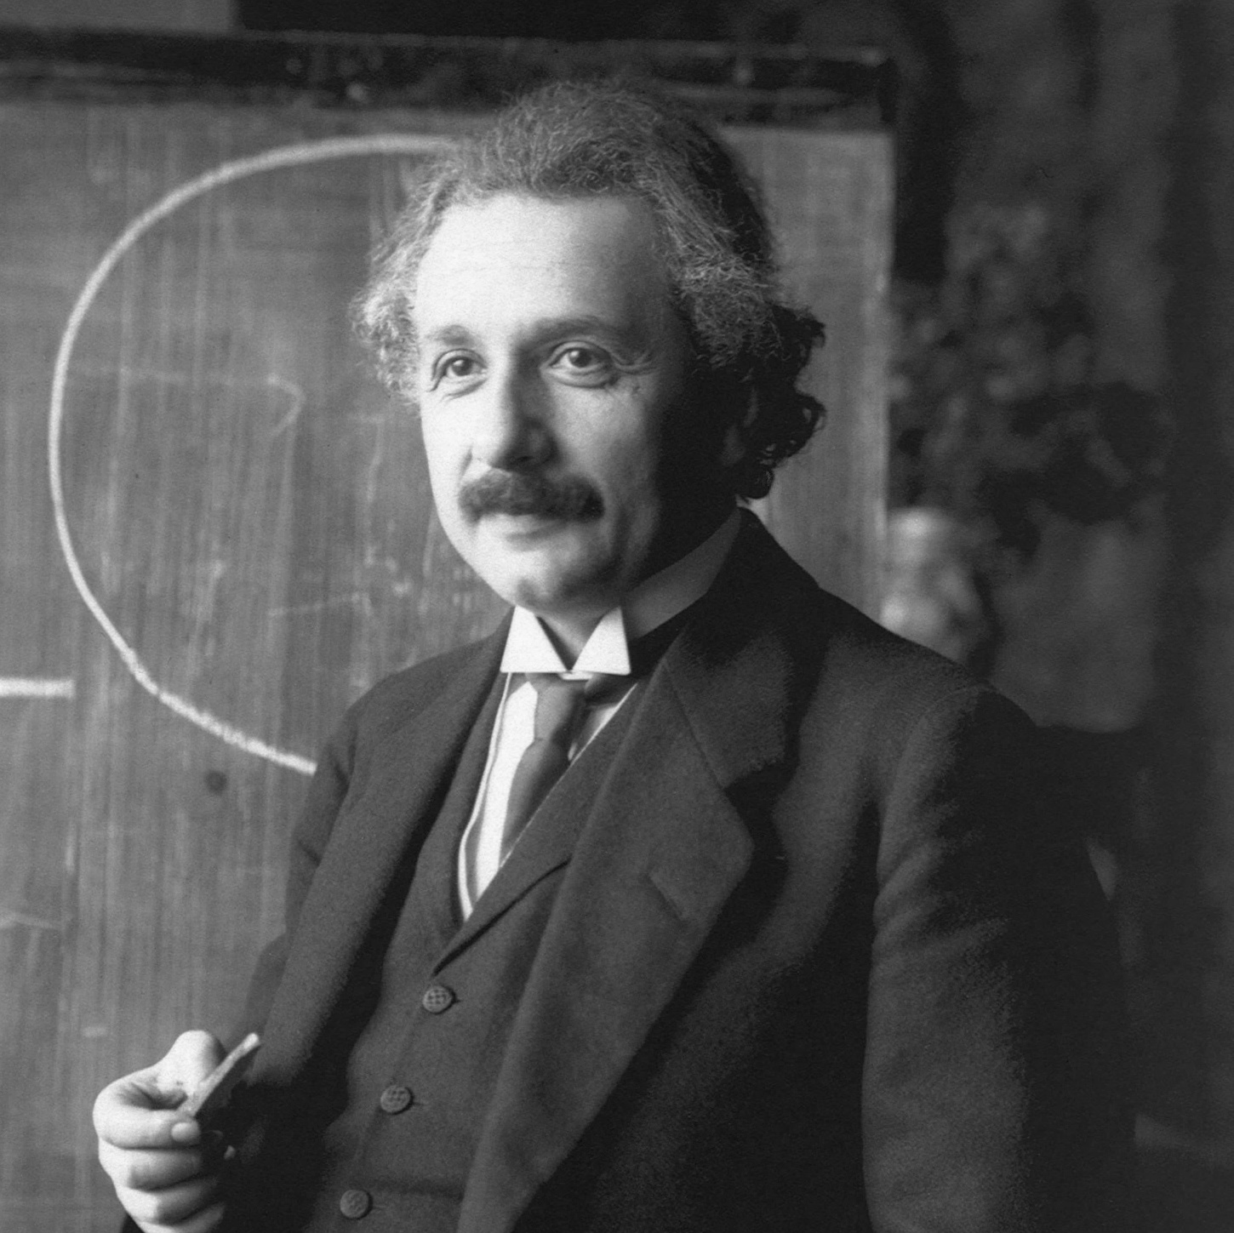
c
c
E
=
h
v
E
=
h
=
v
λ
λ
2
c = 2.998 x 10⁸ ms⁻¹
h = 6.626 X 10⁻³⁴ J.s
λ = 700 x 10⁻⁹ m
E
=
n
h
v
E
=
1.77 eV
E (J)
E (eV) =
=
1.602 X 10⁻¹⁹
n
1, 2, 3, …
1.77 eV
2

Slide 60
c
c
E
=
h
v
E
=
h
=
v
λ
λ
2
c = 2.998 x 10⁸ ms⁻¹
h = 6.626 X 10⁻³⁴ J.s
λ = 700 x 10⁻⁹ m
E
=
n
h
v
n
=
1, 2, 3, …
5.31 eV
7.08 eV
1.77 eV
n
=
3
n
=
4
2

Slide 61
c
c
E
=
h
v
E
=
h
=
v
λ
λ
2
c = 2.998 x 10⁸ ms⁻¹
h = 6.626 X 10⁻³⁴ J.s
λ = 700 x 10⁻⁹ m
E
=
n
h
v
n
=
1, 2, 3, …
5.12 eV
7.08 eV
1.77 eV
n
=
2.89
n
=
4
2

Slide 62
c
c
E
=
h
v
E
=
h
=
v
λ
λ
2
c = 2.998 x 10⁸ ms⁻¹
h = 6.626 X 10⁻³⁴ J.s
λ = 700 x 10⁻⁹ m
E
=
n
h
v
n
=
1, 2, 3, …
5.12 eV
7.19 eV
1.77 eV
n
=
2.89
n
=
4.06
2

Slide 63
c
c
E
=
h
v
E
=
h
=
v
λ
λ
2
c = 2.998 x 10⁸ ms⁻¹
h = 6.626 X 10⁻³⁴ J.s
λ = 700 x 10⁻⁹ m
Light/Energy must be absorbed in the form of whole particle/quantum.
1.77 eV
2

Slide 64



2
c
c
E
=
h
v
E
=
h
=
v
λ
λ
c = 2.998 x 10⁸ ms⁻¹
h = 6.626 X 10⁻³⁴ J.s
2
Light as Wave
Photon
Light as Particle

Slide 65


Planck’s
Constant
Mass of
Electron
Radius of
the Orbit
h
L
=
m_{e}
v_{e}
r
=
n
+1
2π
Angular
Momentum
Velocity of
Electron
n = 1, 2, 3, 4, 5, …

Slide 66

r₁ = 5.29 x 10⁻¹¹ m
Principal Quantum
Number
Bohr
Radius
r_{1.5} = 1.19 x 10⁻¹⁰ m
a_{o}
r_{n}
=
n²
x
Z
+1
r₂ = 2.12 x 10⁻¹⁰ m
Radius of
the n^{th} Orbit
Atomic Number
of the Atom
n = 1
r_{2.5} = 3.31 x 10⁻¹⁰ m
n = 2
a_{o} = 5.29 x 10⁻¹¹ m
n = 3
r₃ = 4.76 x 10⁻¹⁰ m
n = 1, 2, 3, 4, 5, …

Slide 67
Forbidden Orbits
Forbidden Energy Levels
Allowed Orbits
Allowed Energy Levels
+1
n = 1
n = 2
n = 3

Slide 68
+1
E₁
E₂
E₃
n = 1
n = 2
n = 3

Slide 69
R_{H} = 2.18 X 10⁻¹⁸ J
Rydberg’s Constant
-R_{H}
E_{n}
=
+1
E₁
E₂
E₃
n²
n = 1
Principal Quantum Number
n = 2
n = 3

Slide 70
n = 5
-8.72 x 10⁻²⁰ J
n = 4
-1.36 x 10⁻¹⁹ J
R_{H} = 2.18 X 10⁻¹⁸ J
n = 3
-2.42 x 10⁻¹⁹ J
-R_{H}
E_{n}
=
n = 2
-5.45 x 10⁻¹⁹ J
+1
E₁
E₂
E₃
n²
n = 1
n = 2
n = 1
-2.18 x 10⁻¹⁸ J
n = 3
+1

Slide 71
n = 5
-0.54 eV
n = 4
-0.85 eV
R_{H} = 2.18 X 10⁻¹⁸ J
n = 3
-1.51 eV
-R_{H}
E_{n}
=
n = 2
-3.40 eV
+1
E₁
E₂
E₃
n²
n = 1
-13.7 eV
n = 2
n = 1
-13.6 eV
n = 3
-13.5 eV
+1

Slide 72
n = 5
-0.54 eV
Negative Sign With Energy
n = 4
-0.85 eV
n = 3
-1.51 eV
The electron is bound to the nucleus
n = 2
-3.40 eV
Bound to the nucleus
More Negative
Value
More Strongly
Bound
More Stable
n = 1
-13.6 eV
+1

Slide 73
n = 5
-0.54 eV
Negative Sign With Energy
n = 4
-0.85 eV
n = 3
-1.51 eV
The electron is bound to the nucleus
n = 2
-3.40 eV
More Negative
Value
More Strongly
Bound
More Stable
n = 1
-13.6 eV
+1

Slide 74

Unbound/Escape Orbit
Negative Sign With Energy
n = ∞
0 eV
Free Electron
The electron is bound to the nucleus
More Negative
Value
More Strongly
Bound
More Stable
n = 5
-0.54 eV
n = 4
-0.85 eV
n = 3
-1.51 eV
n = 2
-3.40 eV
n = 1
-13.6 eV
+1

Slide 75
n = ∞
0 eV
n = 5
-0.54 eV
Negative Sign With Energy
n = 4
-0.85 eV
n = 3
-1.51 eV
The electron is bound to the nucleus
n = 2
-3.40 eV
More Negative
Value
More Strongly
Bound
More Stable
n = 1
-13.6 eV
+1

Slide 76
n = 5
-0.54 eV
n = 4
-0.85 eV
n = 3
-1.51 eV
Electronic Excitation
Electronic Relaxation
2
2
n = 2
-3.40 eV
Lower to Higher Orbit
Higher to Lower Orbit
Absorption of Energy
Release of Energy
n = 1
-13.6 eV
+1

Slide 77

n = 5
-0.54 eV
n = 4
-0.85 eV
ΔE
=
E_{f}
-
E_{i}
n = 3
-1.51 eV
Energy of
Initial Orbit
Change in Energy
Energy of
Final Orbit
n = 2
-3.40 eV
-R_{H}
-R_{H}
=
E_{n}
=
E_{n}
n²
n²
n = 1
-13.6 eV
+1

Slide 78
n = 5
-0.54 eV
n = 4
-0.85 eV
ΔE
=
E_{f}
-
E_{i}
n = 3
-1.51 eV
Energy of
Initial Orbit
Change in Energy
Energy of
Final Orbit
n = 2
-3.40 eV
-R_{H}
-R_{H}
E_{n}
=
E_{n}
=
n²
n²
n = 1
-13.6 eV
+1

Slide 79
n = 5
-0.54 eV
n = 4
-0.85 eV
ΔE
=
E_{f}
-
E_{i}
n = 3
-1.51 eV
Energy of
Initial Orbit
Change in Energy
Energy of
Final Orbit
n = 2
-3.40 eV
-R_{H}
-R_{H}
E_{f}
=
E_{i}
=
n²
n²
n = 1
-13.6 eV
f
i
+1

Slide 80
n = 5
-0.54 eV
-R_{H}
-R_{H}
n = 4
-0.85 eV
ΔE
=
-
n = 3
-1.51 eV
n²
n²
f
i
n = 2
-3.40 eV
n = 1
-13.6 eV
+1

Slide 81
n = 5
-0.54 eV
1
1
n = 4
-0.85 eV
-R_{H}
ΔE
=
-R_{H}
[
-
]
n = 3
-1.51 eV
n²
n²
f
i
n = 2
-3.40 eV
ΔE is positive
ΔE is negative
2
2
Lower to Higher Orbit
Higher to Lower Orbit
Absorption of Energy
Release of Energy
n = 1
-13.6 eV
+1

Slide 82
n = 5
-0.54 eV
1
1
n = 4
-0.85 eV
ΔE
=
-R_{H}
[
-
]
n = 3
-1.51 eV
n²
n²
f
i
n = 2
-3.40 eV
1
1
=
-
R_{H}
[
-
]
2²
1²
n = 1
-13.6 eV
+1
R_{H} = 2.18 X 10⁻¹⁸ J

Slide 83
n = 5
-0.54 eV
1
1
n = 4
-0.85 eV
ΔE
=
-R_{H}
[
-
]
n = 3
-1.51 eV
n²
n²
f
i
1
1
n = 2
-3.40 eV
=
-
2.18 X 10⁻¹⁸ J
[
-
]
2²
1²
n = 1
-13.6 eV
+1
R_{H} = 2.18 X 10⁻¹⁸ J

Slide 84
n = 5
-0.54 eV
1
1
n = 4
-0.85 eV
ΔE
=
-R_{H}
[
-
]
n = 3
-1.51 eV
n²
n²
f
i
n = 2
-3.40 eV
=
+
1.635 X 10⁻¹⁸ J
n = 1
-13.6 eV
+1

Slide 85
n = 5
-0.54 eV
1
1
n = 4
-0.85 eV
ΔE
=
-R_{H}
[
-
]
n = 3
-1.51 eV
n²
n²
f
i
n = 2
-3.40 eV
=
+
10.2 eV
10.2 eV
n = 1
-13.6 eV
+1

Slide 86


n = 5
-0.54 eV
1
n = 4
-0.85 eV
1
1
1
-
-
R_{H}
R_{H}
-
=
-
ΔE
=
[
[
]
]
n = 3
-1.51 eV
n²
n²
n²
n²
i
f
i
f
n = 2
-3.40 eV
E
=
h
v
n = 1
-13.6 eV
+1

Slide 87
n = 5
-0.54 eV
1
n = 4
-0.85 eV
1
1
1
-
-
R_{H}
R_{H}
-
=
-
=
[
[
]
v
]
h
v
h
n = 3
-1.51 eV
n²
n²
n²
n²
i
f
i
f
n = 2
-3.40 eV
n = 1
-13.6 eV
+1

Slide 88


n = 5
-0.54 eV
1
1
n = 4
-0.85 eV
h
v
=
-
R_{H}
[
-
]
n = 3
-1.51 eV
n²
n²
f
i
n = 2
-3.40 eV
1
1
h
v
=
-
R_{H}
[
-
]
n²
n²
f
i
n = 1
-13.6 eV
c
v
=
+1
λ

Slide 89
n = 5
-0.54 eV
1
1
n = 4
-0.85 eV
h
v
=
-
R_{H}
[
-
]
n = 3
-1.51 eV
n²
n²
f
i
n = 2
-3.40 eV
c
1
1
h
=
-
R_{H}
[
-
]
λ
n²
n²
f
i
n = 1
-13.6 eV
+1

Slide 90
n = 5
-0.54 eV
-
R_{H}
1
1
n = 4
-0.85 eV
v
=
[
-
]
n = 3
-1.51 eV
h
n²
n²
f
i
n = 2
-3.40 eV
c
1
1
h
=
-
R_{H}
[
-
]
λ
n²
n²
f
i
n = 1
-13.6 eV
+1

Slide 91
n = 5
-0.54 eV
-
R_{H}
1
1
n = 4
-0.85 eV
v
=
[
-
]
n = 3
-1.51 eV
h
n²
n²
f
i
n = 2
-3.40 eV
1
-
R_{H}
1
1
=
[
-
]
λ
h
c
n²
n²
f
i
n = 1
-13.6 eV
+1

Slide 92
-
R_{H}
n = 5
-0.54 eV
1
1
v
=
[
-
]
n = 4
-0.85 eV
h
n²
n²
f
i
n = 3
-1.51 eV
n = 2
-3.40 eV
n = 1
-13.6 eV
+1

Slide 93
-
n = 5
-0.54 eV
-
R_{H}
R_{H}
1
1
1
1
=
-
=
[
-
]
v
[
]
v
n = 4
-0.85 eV
h
n²
n²
h
n²
n²
f
i
n = 3
-1.51 eV
f
i
n = 2
-3.40 eV
n = 1
-13.6 eV
+1

Slide 94
-
R_{H}
n = 5
-0.54 eV
1
1
v
=
[
-
]
n = 4
-0.85 eV
h
n²
n²
f
i
n = 3
-1.51 eV
n = 2
-3.40 eV
-
R_{H}
1
1
v
=
[
-
]
h
n²
n²
f
i
n = 1
-13.6 eV
+1

Slide 95
-
R_{H}
n = 5
-0.54 eV
1
1
v
=
[
-
]
n = 4
-0.85 eV
h
n²
n²
f
i
n = 3
-1.51 eV
n = 2
-3.40 eV
-
R_{H}
1
1
v
=
[
-
]
h
3²
1²
n = 1
-13.6 eV
+1
R_{H} = 2.18 x 10⁻¹⁸ J
h = 6.626 x 10⁻³⁴ J.s

Slide 96
-
R_{H}
n = 5
-0.54 eV
1
1
v
=
[
-
]
n = 4
-0.85 eV
h
n²
n²
f
i
n = 3
-1.51 eV
n = 2
-3.40 eV
-
2.18 x 10⁻¹⁸ J
1
1
v
=
[
-
]
6.626 x 10⁻³⁴ J.s
3²
1²
n = 1
-13.6 eV
+1
R_{H} = 2.18 x 10⁻¹⁸ J
h = 6.626 x 10⁻³⁴ J.s

Slide 97
-
R_{H}
n = 5
-0.54 eV
1
1
v
=
[
-
]
n = 4
-0.85 eV
h
n²
n²
f
i
n = 3
-1.51 eV
n = 2
-3.40 eV
v
=
2.92 x 10¹⁵ s⁻¹
n = 1
-13.6 eV
+1

Slide 98
-
R_{H}
n = 5
-0.54 eV
1
1
v
=
[
-
]
n = 4
-0.85 eV
h
n²
n²
f
i
n = 3
-1.51 eV
n = 2
-3.40 eV
v
=
2.92 x 10¹⁵ Hz
2.92 x 10¹⁵ Hz
n = 1
-13.6 eV
+1

Slide 99
+1
+2
+3
+4
1
4
+
7
2+
9
3+
H
He
Li
Be
1
2
3
4

Slide 100


2D Plane
(Disk Like)
+1
2D Plane
(Disk Like)
Front View
Side View

Slide 101
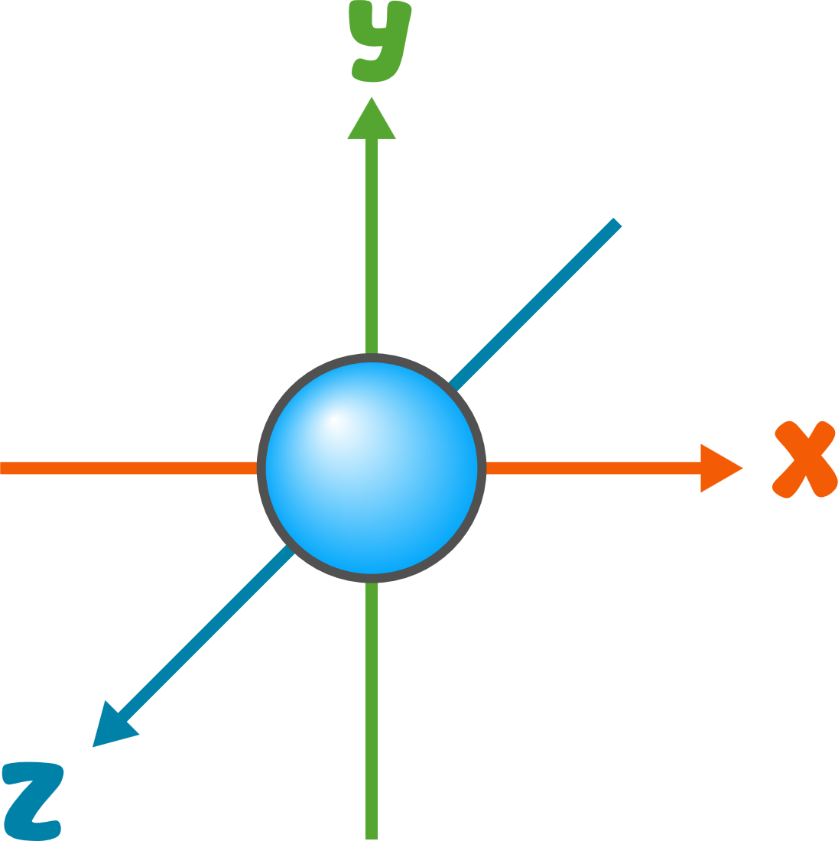
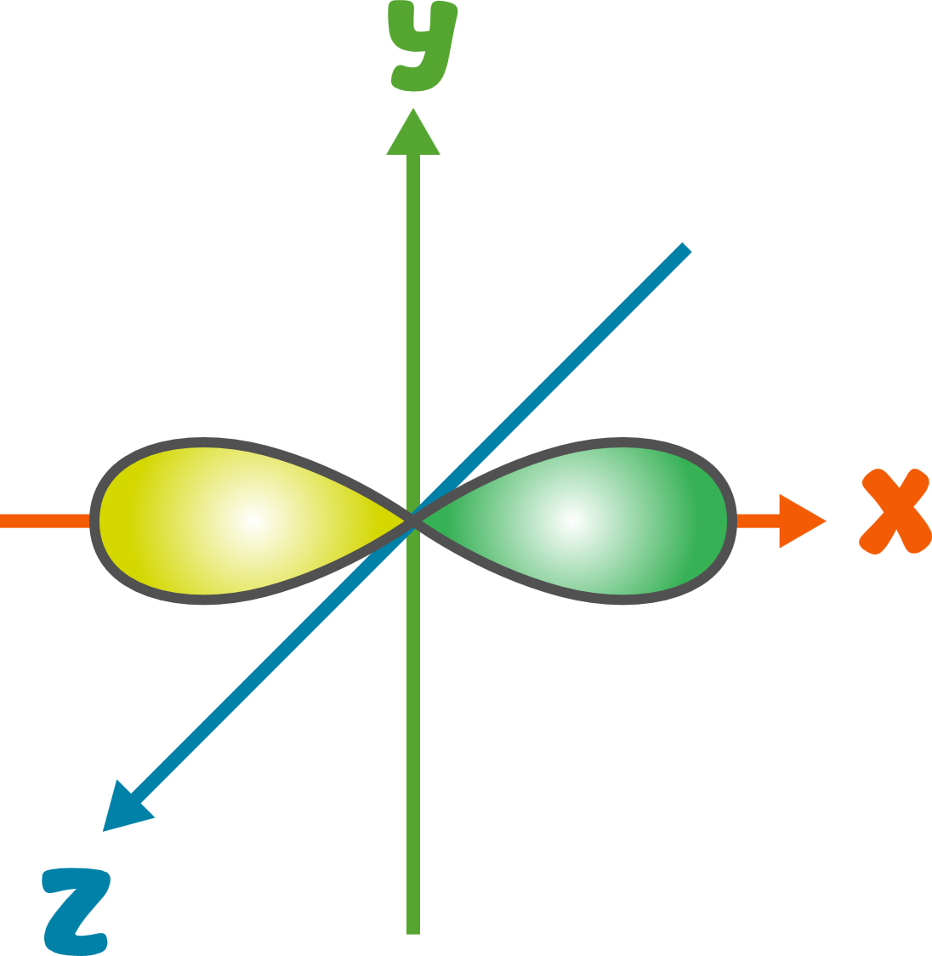
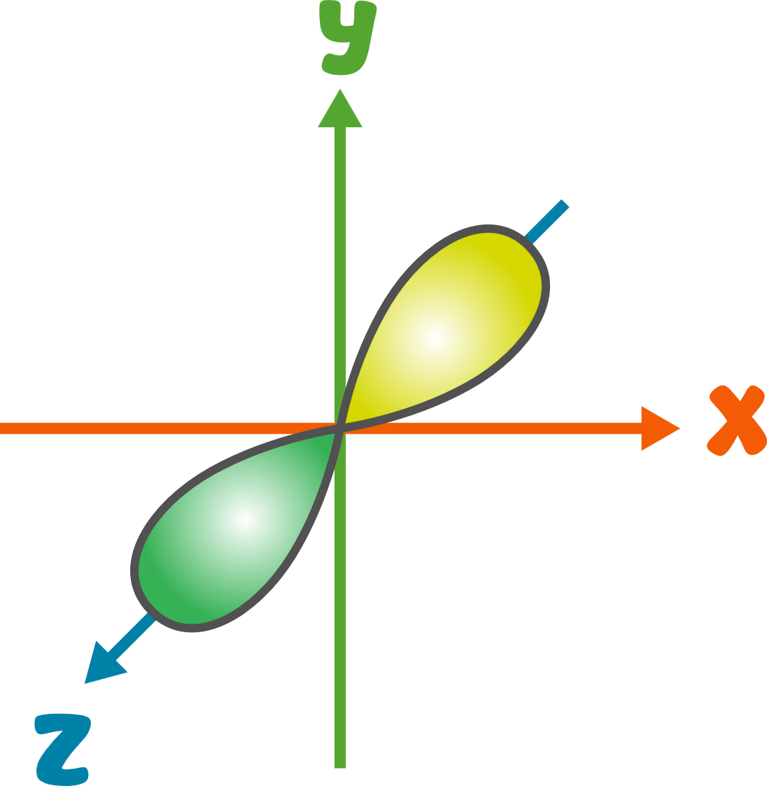
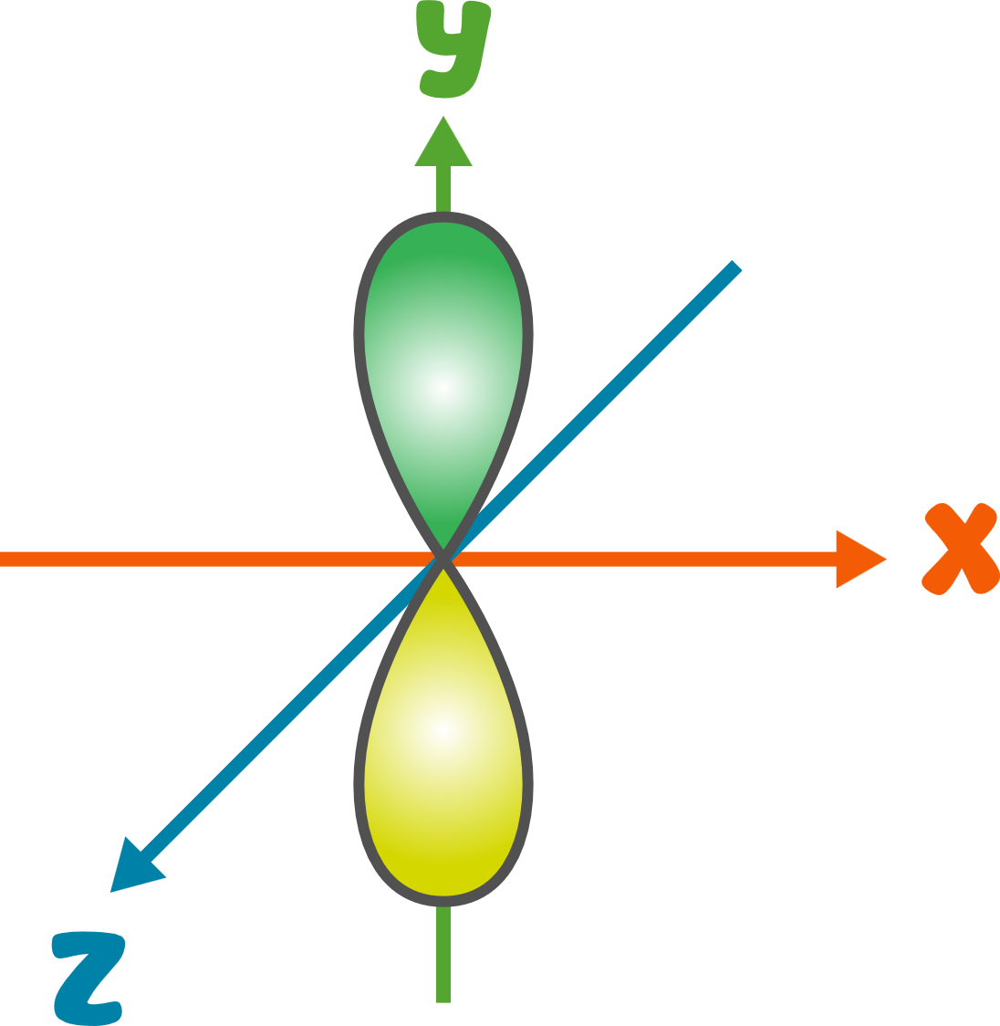
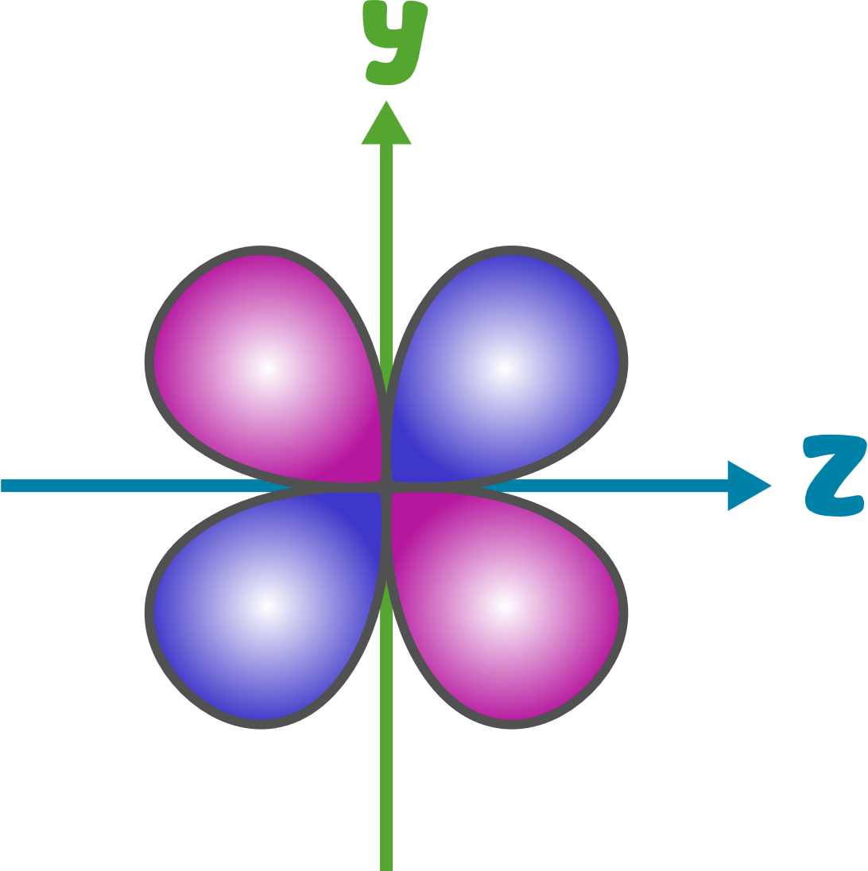


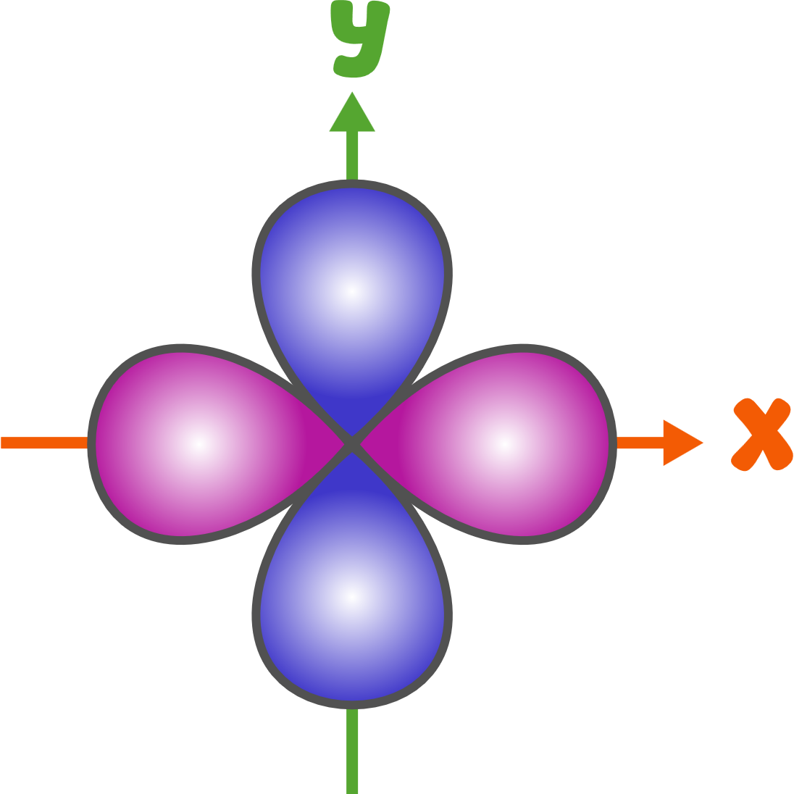
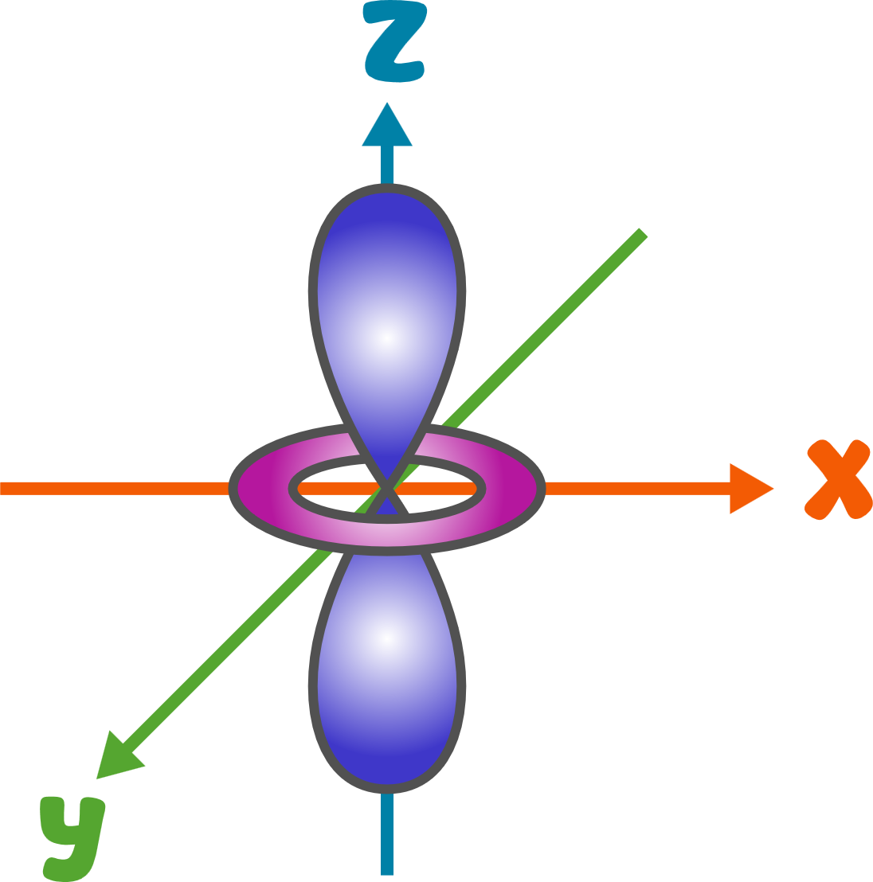

Slide 102


+18
+18
Quantized Atom
Non-Quantized Atom

Slide 103
It does not follow
Quantum Theory
No definite orbits or
energy levels
+18
+18
Inconsistent Electronic Configuration
Quantized Atom
Non-Quantized Atom

Slide 104
It does not follow
Quantum Theory
No definite orbits or
energy levels
+18
+18
+18
+18
+18
+18
+18
+18
+18
+18
Inconsistent Electronic Configuration
Quantized Atom
Non-Quantized Atom
Unpredictable Chemical Reactions

Slide 105
It does not follow
Quantum Theory
No definite orbits or
energy levels
+18
+18
Inconsistent Electronic Configuration
Quantized Atom
Non-Quantized Atom
Unpredictable Chemical Reactions

Slide 106
It follows
Quantum Theory
It does not follow
Quantum Theory
Definite orbits or
energy levels
No definite orbits or
energy levels
+18
+18
Consistent Electronic Configuration
Inconsistent Electronic Configuration
Predictable Chemical Behavior
Quantized Atom
Non-Quantized Atom
Unpredictable Chemical Reactions

Slide 107
H
He
1s¹
1s²
Li
Be
B
C
N
O
F
Ne
2s¹
2s²
2s² 2p¹
2s² 2p²
2s² 2p³
2s² 2p⁴
2s² 2p⁵
2s² 2p⁶
Na
Mg
Al
Si
P
S
Cl
Ar
3s¹
3s²
3s² 3p¹
3s² 3p²
3s² 3p³
3s² 3p⁴
3s² 3p⁵
3s² 3p⁶
K
Ca
Sc
Ti
V
Cr
Mn
Fe
Co
Ni
Cu
Zn
Ga
Ge
As
Se
Br
Kr
4s¹
4s²
3d¹ 4s²
3d² 4s²
3d³ 4s²
3d⁵ 4s¹
3d⁵ 4s²
3d⁶ 4s²
3d⁷ 4s²
3d⁸ 4s²
3d¹⁰ 4s¹
3d¹⁰ 4s²
4s² 4p¹
4s² 4p²
4s² 4p³
4s² 4p⁴
4s² 4p⁵
4s² 4p⁶
Rb
Sr
Y
Zr
Nb
Mo
Tc
Ru
Rh
Pd
Ag
Cd
In
Sn
Sb
Te
I
Xe
5s¹
5s²
4d¹ 5s²
4d² 5s²
4d⁴ 5s¹
4d⁵ 5s¹
4d⁵ 5s²
4d⁷ 5s¹
4d⁸ 5s¹
4d¹⁰
4d¹⁰ 5s¹
4d¹⁰ 5s²
5s² 5p¹
5s² 5p²
5s² 5p³
5s² 5p⁴
5s² 5p⁵
5s² 5p⁶
Cs
Ba
Hf
Ta
W
Re
Os
Ir
Pt
Au
Hg
Tl
Pb
Bi
Po
At
Rn
6s¹
6s²
4f¹⁴ 5d² 6s²
5d³ 6s²
5d⁴ 6s²
5d⁵ 6s²
5d⁶ 6s²
5d⁷ 6s²
5d⁹ 6s¹
5d¹⁰ 6s¹
5d¹⁰ 6s²
6s² 6p¹
6s² 6p²
6s² 6p³
6s² 6p⁴
6s² 6p⁵
6s² 6p⁶
Fr
Ra
Rf
Db
Sg
Bh
Hs
Mt
Ds
Rg
Cn
Nh
Fl
Mc
Lv
Ts
Og
7s¹
7s²
5f¹⁴ 6d² 7s²
6d³ 7s²
6d⁴ 7s²
6d⁵ 7s²
6d⁶ 7s²
6d⁷ 7s²
6d⁸ 7s²
6d⁹ 7s²
6d¹⁰ 7s²
7s² 7p¹
7s² 7p²
7s² 7p³
7s² 7p⁴
7s² 7p⁵
7s² 7p⁶
La
Ce
Pr
Nd
Pm
Sm
Eu
Gd
Tb
Dy
Ho
Er
Tm
Yb
Lu
5d¹ 6s²
4f² 5d⁰ 6s²
4f³ 5d⁰ 6s²
4f⁴ 5d⁰ 6s²
4f⁵ 5d⁰ 6s²
4f⁶ 5d⁰ 6s²
4f⁷ 5d⁰ 6s²
4f⁷ 5d¹ 6s²
4f⁹ 5d⁰ 6s²
4f¹⁰ 5d⁰ 6s²
4f¹¹ 5d⁰ 6s²
4f¹² 5d⁰ 6s²
4f¹³ 5d⁰ 6s²
4f¹⁴ 5d⁰ 6s²
4f¹⁴ 5d¹ 6s²
Ac
Th
Pa
U
Np
Pu
Am
Cm
Bk
Cf
Es
Fm
Md
No
Lr
6d¹ 7s²
5f⁰ 6d² 7s²
5f² 6d¹ 7s²
5f³ 6d¹ 7s²
5f⁴ 6d¹ 7s²
5f⁶ 6d⁰ 7s²
5f⁷ 6d⁰ 7s²
5f⁷ 6d¹ 7s²
5f⁹ 6d⁰ 7s²
5f¹⁰ 6d⁰ 7s²
5f¹¹ 6d⁰ 7s²
5f¹² 6d⁰ 7s²
5f¹³ 6d⁰ 7s²
5f¹⁴ 6d⁰ 7s²
5f¹⁴ 6d¹ 7s²

Slide 108
1
2
H
He
1.008
4.003
3
4
5
6
7
8
9
10
Li
Be
B
C
N
O
F
Ne
6.94
9.012
10.81
12.01
14.01
15.99
18.99
20.18
11
12
13
14
15
16
17
18
Na
Mg
Al
Si
P
S
Cl
Ar
22.99
24.31
26.98
28.09
30.97
32.06
35.45
39.95
19
20
21
22
23
24
25
26
27
28
29
30
31
32
33
34
35
36
K
Ca
Sc
Ti
V
Cr
Mn
Fe
Co
Ni
Cu
Zn
Ga
Ge
As
Se
Br
Kr
39.10
40.08
44.96
47.88
50.94
52.00
54.94
55.85
58.93
58.69
63.55
65.39
69.72
72.64
74.92
78.96
79.90
83.79
37
38
39
40
41
42
43
44
45
46
47
48
49
50
51
52
53
54
Rb
Sr
Y
Zr
Nb
Mo
Tc
Ru
Rh
Pd
Ag
Cd
In
Sn
Sb
Te
I
Xe
85.47
87.62
88.91
91.22
92.91
95.96
(98)
101.1
102.9
106.4
107.9
112.4
114.8
118.7
121.8
127.6
126.9
131.3
55
56
72
73
74
75
76
77
78
79
80
81
82
83
84
85
86
Cs
Ba
Hf
Ta
W
Re
Os
Ir
Pt
Au
Hg
Tl
Pb
Bi
Po
At
Rn
132.9
137.3
178.5
180.9
183.9
186.2
190.2
192.2
195.1
197.0
200.5
204.38
207.2
209.0
(209)
(210)
(222)
87
88
104
105
106
107
108
109
110
111
112
113
114
115
116
117
118
Fr
Ra
Rf
Db
Sg
Bh
Hs
Mt
Ds
Rg
Cn
Nh
Fl
Mc
Lv
Ts
Og
(223)
(226)
(265)
(268)
(271)
(270)
(277)
(276)
(281)
(280)
(285)
(284)
(289)
(288)
(293)
(294)
(294)
57
58
59
60
61
62
63
64
65
66
67
68
69
70
71
La
Ce
Pr
Nd
Pm
Sm
Eu
Gd
Tb
Dy
Ho
Er
Tm
Yb
Lu
138.9
140.1
140.9
144.2
(145)
150.4
152.0
157.2
158.9
162.5
164.9
167.3
168.9
173.0
175.0
89
90
91
92
93
94
95
96
97
98
99
100
101
102
103
Ac
Th
Pa
U
Np
Pu
Am
Cm
Bk
Cf
Es
Fm
Md
No
Lr
(227)
232.0
231.0
238.0
(237)
(244)
(243)
(247)
(247)
(251)
(252)
(257)
(258)
(259)
(262)

Slide 109
13
112
12
102
61
96
95
15
86
70
111
37
3
Al
90
Cn
Mg
No
Pm
Cm
Am
P
Rn
Yb
Rg
Rb
Li
Th
26.98
232.0
(285)
24.31
(259)
(145)
(247)
(243)
30.97
(222)
173.0
(280)
85.47
6.94
105
2
75
76
20
55
100
25
44
Db
He
Re
Os
Ca
116
Cs
Fm
Mn
47
Ru
87
27
99
5
Lv
Ag
Fr
(268)
Co
Es
186.2
B
190.2
40.08
132.9
(257)
4.003
(293)
54.94
107.9
101.1
(223)
58.93
(252)
92
10.81
77
58
73
106
U
Ir
Ce
115
Ta
82
71
78
17
Sg
Mc
Pb
Lu
46
Pt
Cl
32
48
238.0
63
192.2
180.9
Pd
Ge
Cd
(271)
Eu
140.1
207.2
175.0
195.1
35.45
29
91
53
101
(288)
106.4
72.64
112.4
Cu
152.0
Pa
I
Md
36
4
14
93
69
Si
63.55
231.0
Kr
Np
Be
Tm
108
97
126.9
(258)
72
28.09
Hs
Bk
114
84
45
57
83.79
Hf
(237)
9.012
168.9
Fl
Po
Rh
La
62
33
(277)
(247)
Sm
As
103
178.5
41
1
(289)
(209)
102.9
138.9
Lr
65
Nb
H
150.4
74.92
Tb
107
85
(262)
64
40
92.91
Bh
1.008
At
60
66
59
8
11
50
Gd
Zr
158.9
Nd
Dy
Pr
O
Na
Sn
110
(270)
(210)
140.9
Ds
157.2
91.22
39
56
144.2
162.5
15.99
22.99
118.7
Y
Ba
88
(281)
98
Ra
35
26
54
Cf
19
88.91
137.3
16
Br
80
Fe
Xe
28
7
51
117
K
S
(226)
Hg
Ni
N
Sb
Ts
(251)
79.90
55.85
131.3
121.8
(294)
39.10
109
67
32.06
200.5
58.69
14.01
Mt
Ho
113
6
43
9
164.9
81
68
118
10
49
Nh
89
C
34
Tc
F
(276)
Tl
Er
Og
Ne
In
104
Ac
Se
Rf
18.99
204.38
167.3
(294)
20.18
114.8
(284)
(227)
12.01
78.96
(98)
94
(265)
Pu
83
22
74
24
38
30
42
21
Bi
Ti
18
52
W
Cr
31
Sr
Zn
23
(244)
Mo
79
Sc
Ar
Te
Ga
V
Au
209.0
47.88
39.95
183.9
52.00
87.62
65.39
50.94
95.96
44.96
127.6
69.72
197.0

Slide 110
Quantized Atom
Non-Quantized Atom
Stable Atom
Unstable Atom
+18
Consistent Electronic Arrangement
Inconsistent Electronic Arrangement
Predictable Chemical Behavior
Unpredictable Chemical Behavior
Non-Quantized Atom

Slide 111
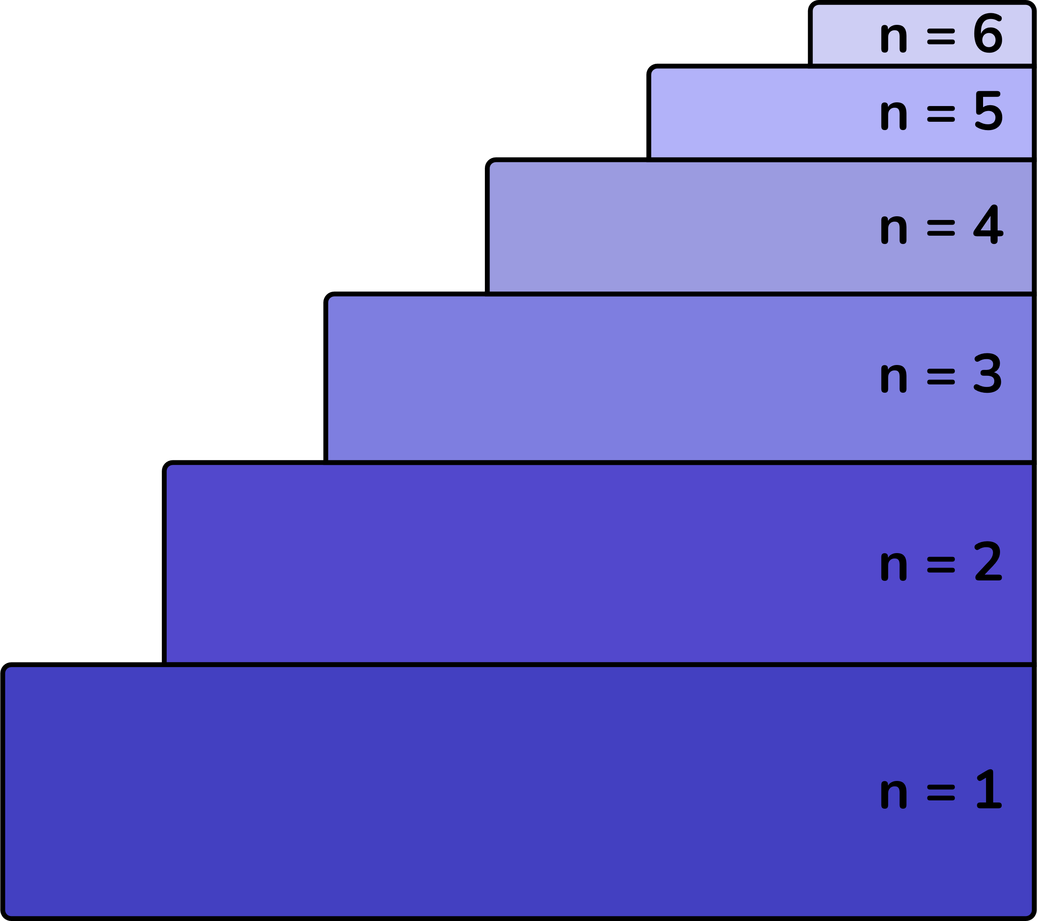

Quantized Atom
Non-Quantized Atom

Slide 112
400 nm
450 nm
480 nm
530 nm
580 nm
600 nm
650 nm

Slide 114
400 nm
450 nm
480 nm
530 nm
580 nm
600 nm
650 nm

Slide 115
+1
n = 1
n = 2
n = 3

