Slide 2


It is a branch of science in which we study the composition, properties, structure and chemical reactions of matter.

Slide 3
It is a branch of science in which we study the composition, properties, structure and chemical reactions of matter.

Slide 4
It is a branch of science in which we study the composition, properties, structure and chemical reactions of matter.

Slide 5
It is a branch of science in which we study the composition, properties, structure and chemical reactions of matter.

Slide 6
It is a branch of science in which we study the composition, properties, structure and chemical reactions of matter.

Slide 7








Slide 8


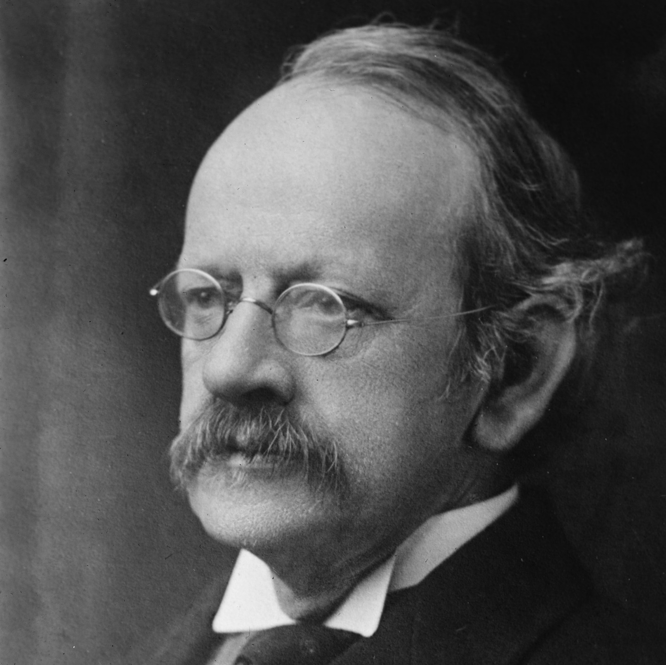
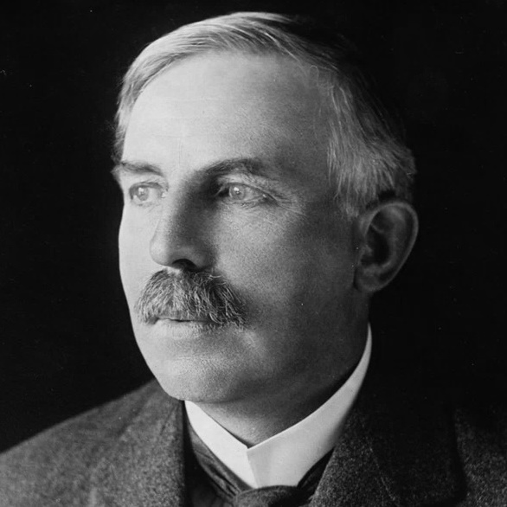
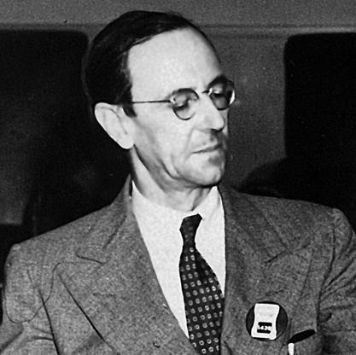
Electron
Proton
Neutron
J. J. Thomson
Ernest Rutherford
James Chadwick
9.10 × 10⁻³¹ kg
1.67 x 10⁻²⁷ kg
≈
1.67 x 10⁻²⁷ kg
-1
+1
Neutral (0)

Slide 9
Nucleus
-1
+1
-1
+1
+1
-1
Neutral Lithium Atom

Slide 10
Nucleus
+3
Neutral Lithium Atom

Slide 11




Number of Protons in an atom
Sum of Protons & Neutrons
in an atom
Used to identify atoms of different elements
Used to identify different atoms of same elements
Also used to predict the properties of elements.

Slide 12
Number of Protons in an atom
Used to identify atoms of different elements

Slide 13
1
2
H
He
1.008
4.003
3
4
5
6
7
8
9
10
Li
Be
B
C
N
O
F
Ne
6.94
9.012
10.81
12.01
14.01
15.99
18.99
20.18
11
12
13
14
15
16
17
18
Na
Mg
Al
Si
P
S
Cl
Ar
22.99
24.31
26.98
28.09
30.97
32.06
35.45
39.95
19
20
21
22
23
24
25
26
27
28
29
30
31
32
33
34
35
36
K
Ca
Sc
Ti
V
Cr
Mn
Fe
Co
Ni
Cu
Zn
Ga
Ge
As
Se
Br
Kr
39.10
40.08
44.96
47.88
50.94
52.00
54.94
55.85
58.93
58.69
63.55
65.39
69.72
72.64
74.92
78.96
79.90
83.79
37
38
39
40
41
42
43
44
45
46
47
48
49
50
51
52
53
54
Rb
Sr
Y
Zr
Nb
Mo
Tc
Ru
Rh
Pd
Ag
Cd
In
Sn
Sb
Te
I
Xe
85.47
87.62
88.91
91.22
92.91
95.96
(98)
101.1
102.9
106.4
107.9
112.4
114.8
118.7
121.8
127.6
126.9
131.3
55
56
72
73
74
75
76
77
78
79
80
81
82
83
84
85
86
Cs
Ba
Hf
Ta
W
Re
Os
Ir
Pt
Au
Hg
Tl
Pb
Bi
Po
At
Rn
132.9
137.3
178.5
180.9
183.9
186.2
190.2
192.2
195.1
197.0
200.5
204.38
207.2
209.0
(209)
(210)
(222)
87
88
104
105
106
107
108
109
110
111
112
113
114
115
116
117
118
Fr
Ra
Rf
Db
Sg
Bh
Hs
Mt
Ds
Rg
Cn
Nh
Fl
Mc
Lv
Ts
Og
(223)
(226)
(265)
(268)
(271)
(270)
(277)
(276)
(281)
(280)
(285)
(284)
(289)
(288)
(293)
(294)
(294)
57
58
59
60
61
62
63
64
65
66
67
68
69
70
71
La
Ce
Pr
Nd
Pm
Sm
Eu
Gd
Tb
Dy
Ho
Er
Tm
Yb
Lu
138.9
140.1
140.9
144.2
(145)
150.4
152.0
157.2
158.9
162.5
164.9
167.3
168.9
173.0
175.0
89
90
91
92
93
94
95
96
97
98
99
100
101
102
103
Ac
Th
Pa
U
Np
Pu
Am
Cm
Bk
Cf
Es
Fm
Md
No
Lr
(227)
232.0
231.0
238.0
(237)
(244)
(243)
(247)
(247)
(251)
(252)
(257)
(258)
(259)
(262)

Slide 14
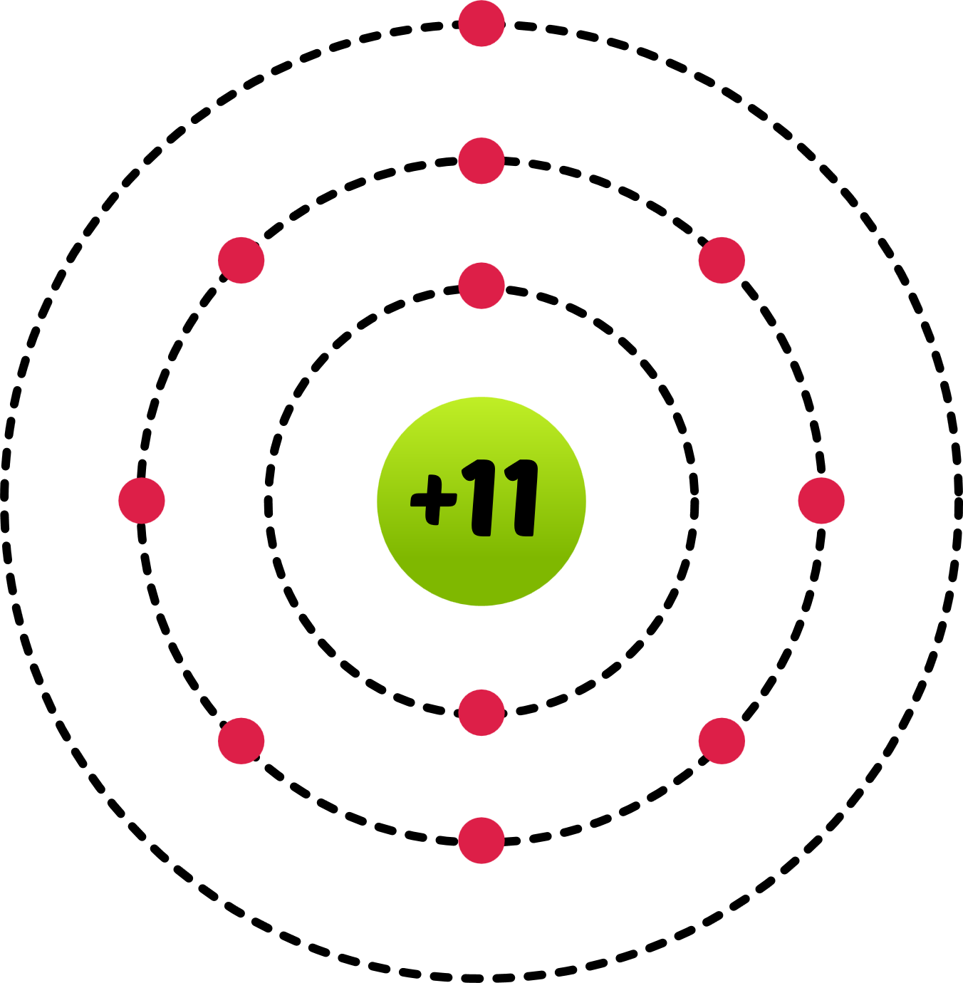
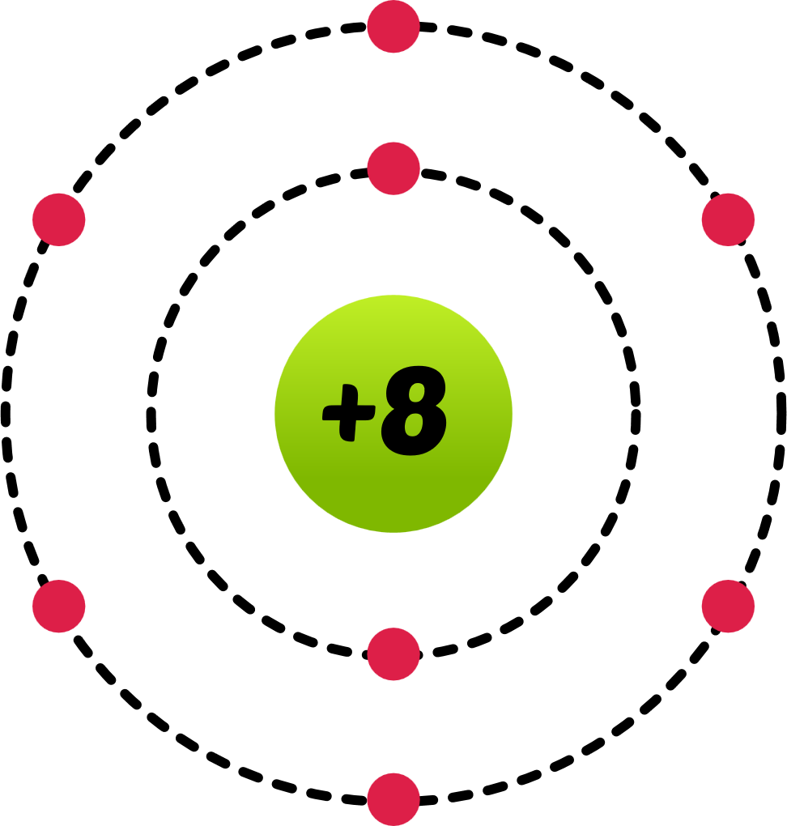
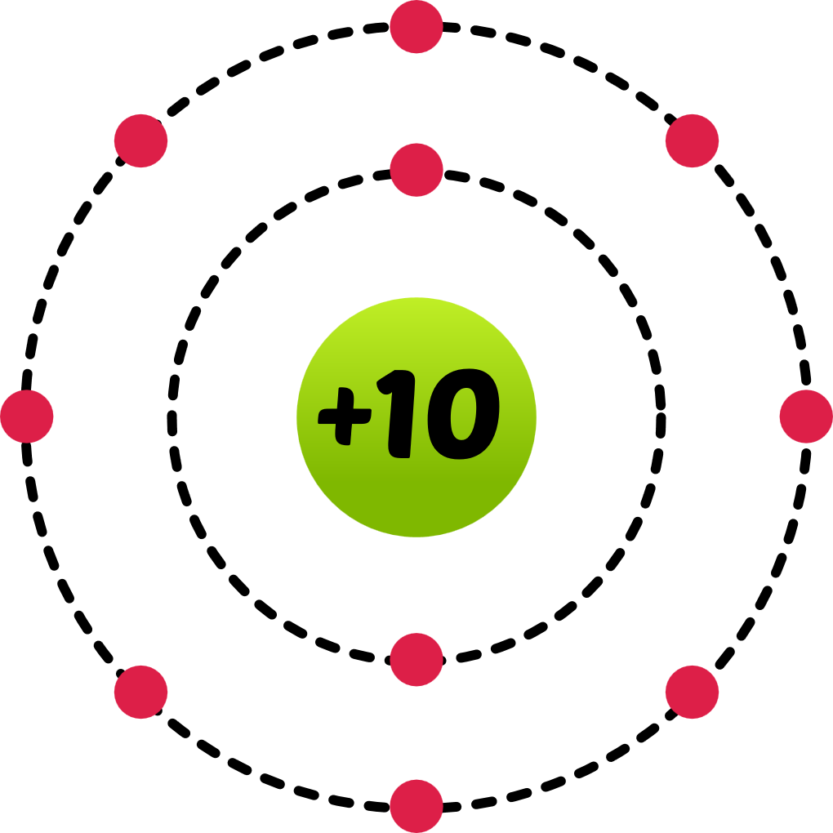
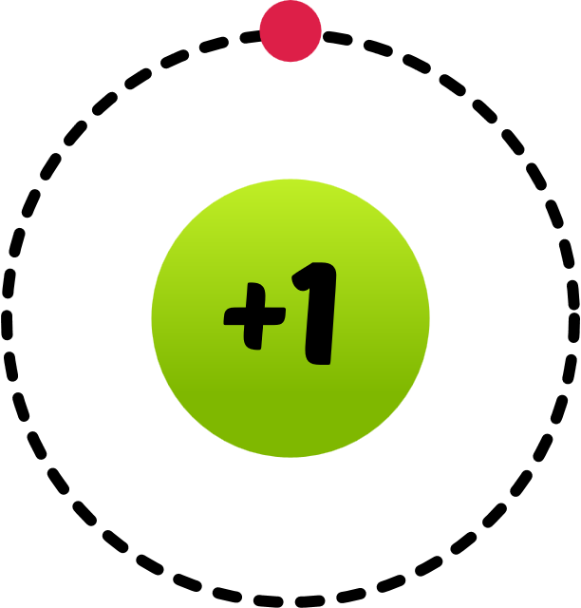
Number of Protons in an atom
Used to identify atoms of different elements
H
O
Ne
Na
1
8
10
11

Slide 15

Sum of Protons & Neutrons
in an atom
Used to identify different atoms of same elements
Protium
Deuterium
Tritium
1
H
2
H
3
H
1
1
1

Slide 16


Sum of Protons & Neutrons
in an atom
Used to identify different atoms of same elements
They are the atoms that have same atomic number (same element) but different mass numbers.
Protium
Deuterium
Tritium
1
H
2
H
3
H
1
1
1

Slide 17
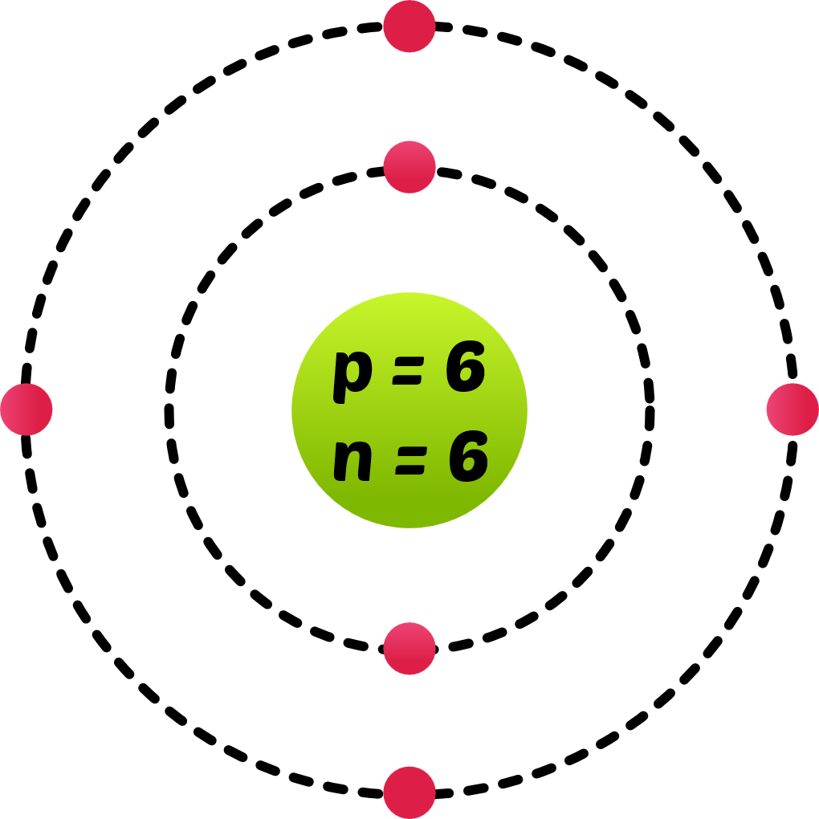
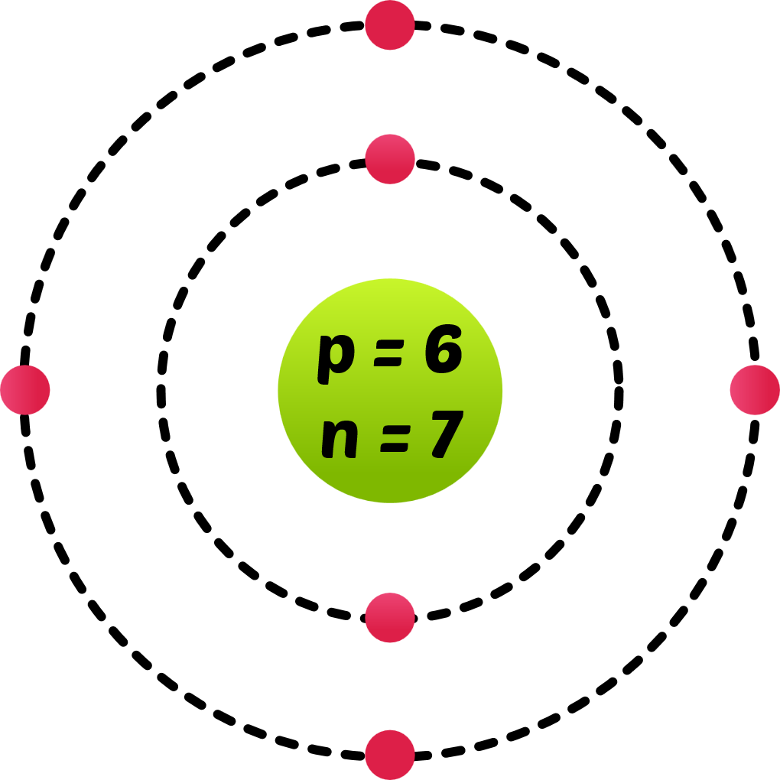
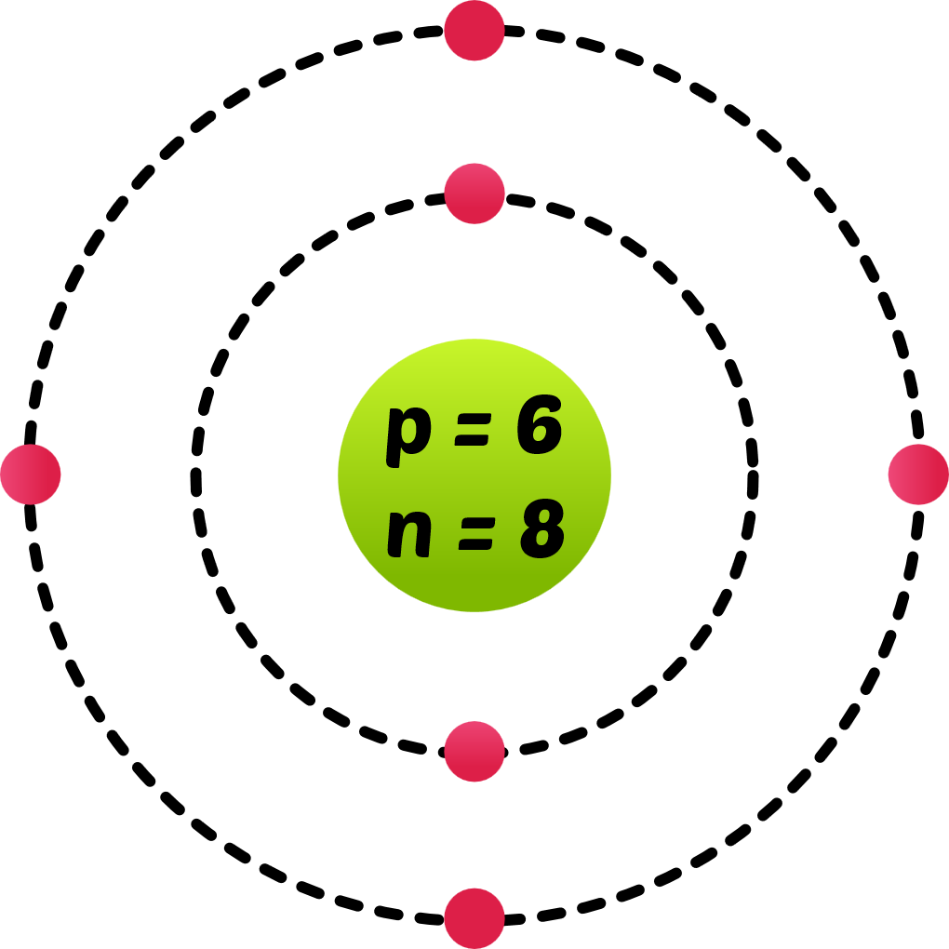
They are the atoms that have same atomic number (same element) but different mass numbers.
C-12
C-13
C-14
12
C
13
C
14
C
6
6
6

Slide 18
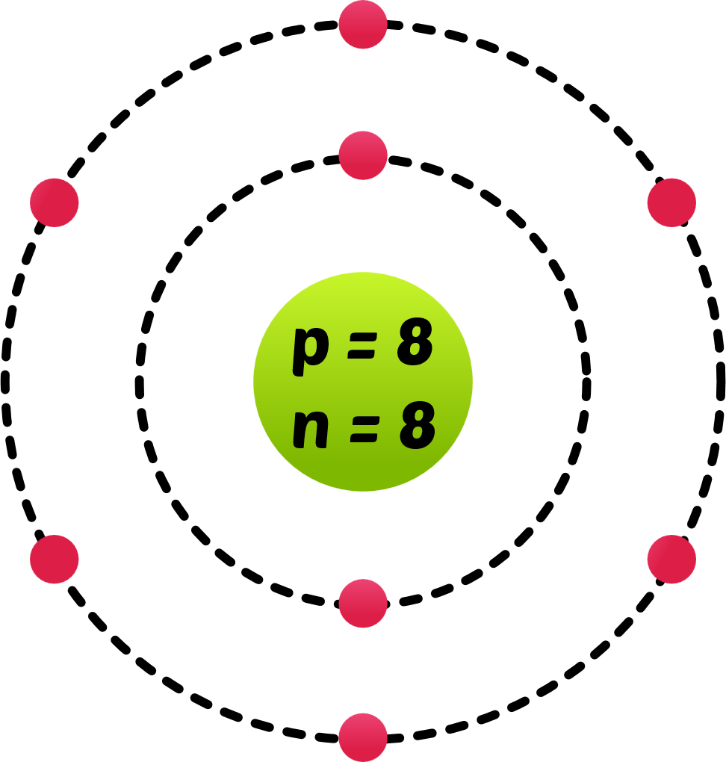
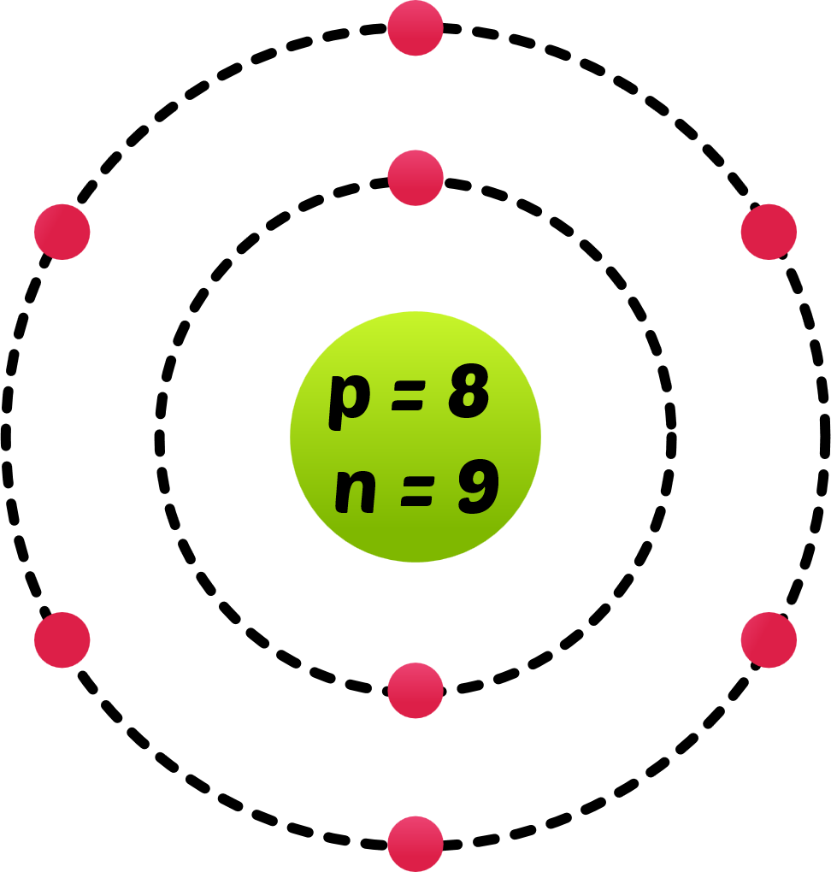
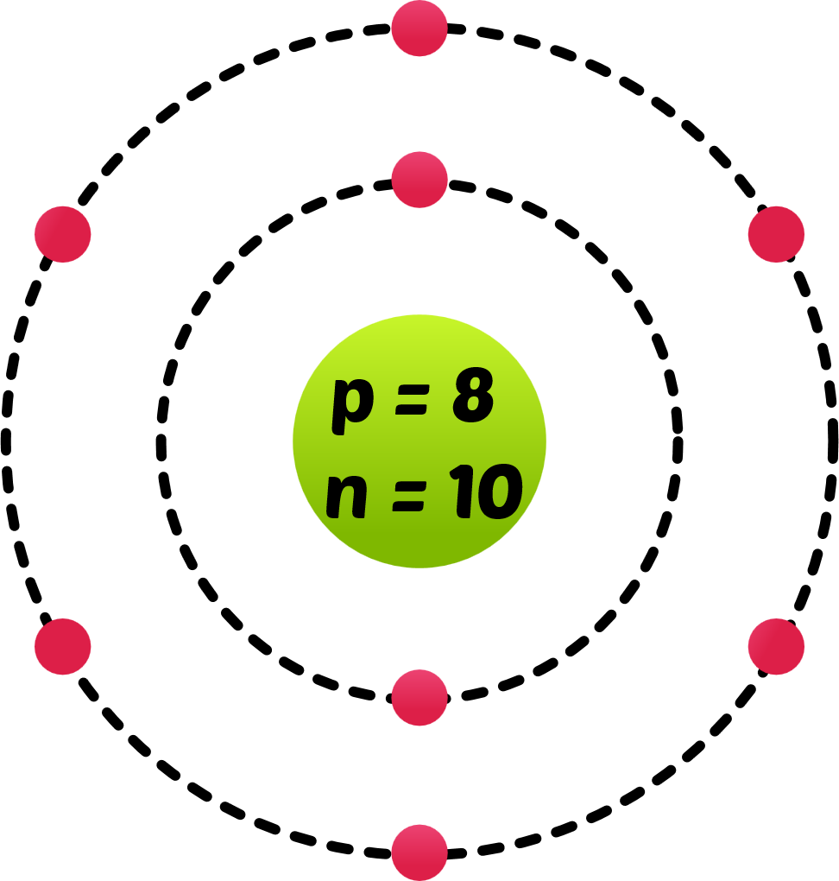
They are the atoms that have same atomic number (same element) but different mass numbers.
O-16
O-17
O-18
16
O
17
O
18
O
8
8
8

Slide 19
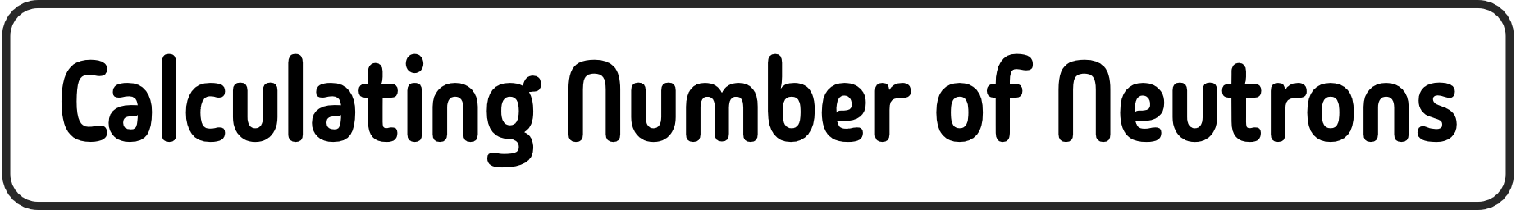

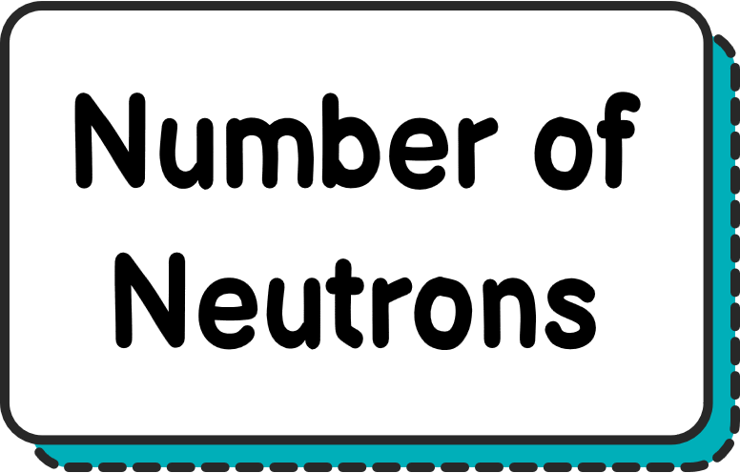
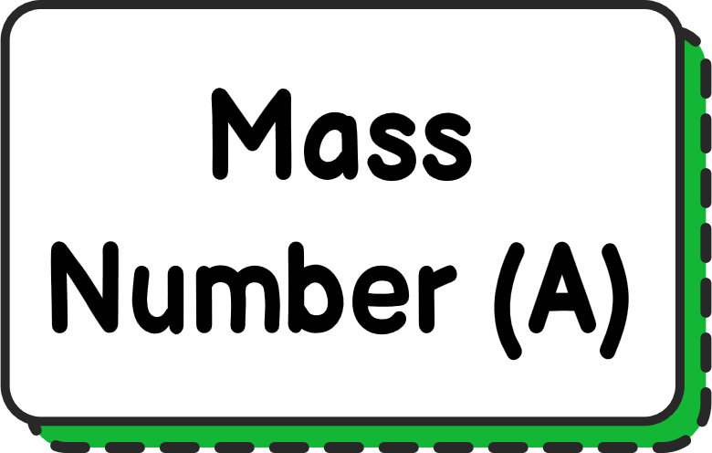
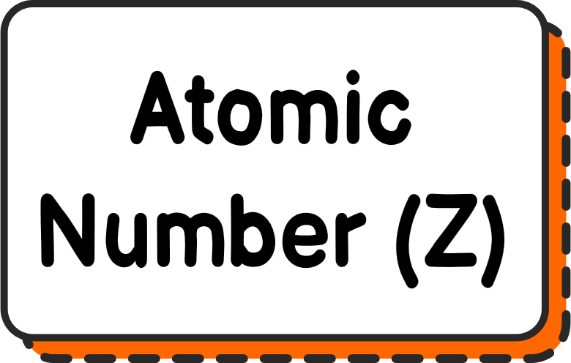
O-18
=
-
Number of
Neutrons in ¹⁸O
=
18
-
8
-
18
O
8

Slide 20
O-18
=
-
Number of
Neutrons in ¹⁸O
=
18
-
8
-
18
O
8

Slide 21
O-18
=
-
Number of
Neutrons in ¹⁸O
=
18
-
8
-
18
O
8

Slide 22
O-18
=
-
Number of
Neutrons in ¹⁸O
=
18
-
8
18
O
8

Slide 23
O-18
=
-
Number of
Neutrons in ¹⁸O
=
10
18
O
8

Slide 24
A CHEMICAL REACTION CAN NEVER CHANGE
AN ATOM’S ATOMIC NUMBER OR MASS NUMBER.

Slide 25




+1
Orbits/Shells
Orbitals

Slide 26


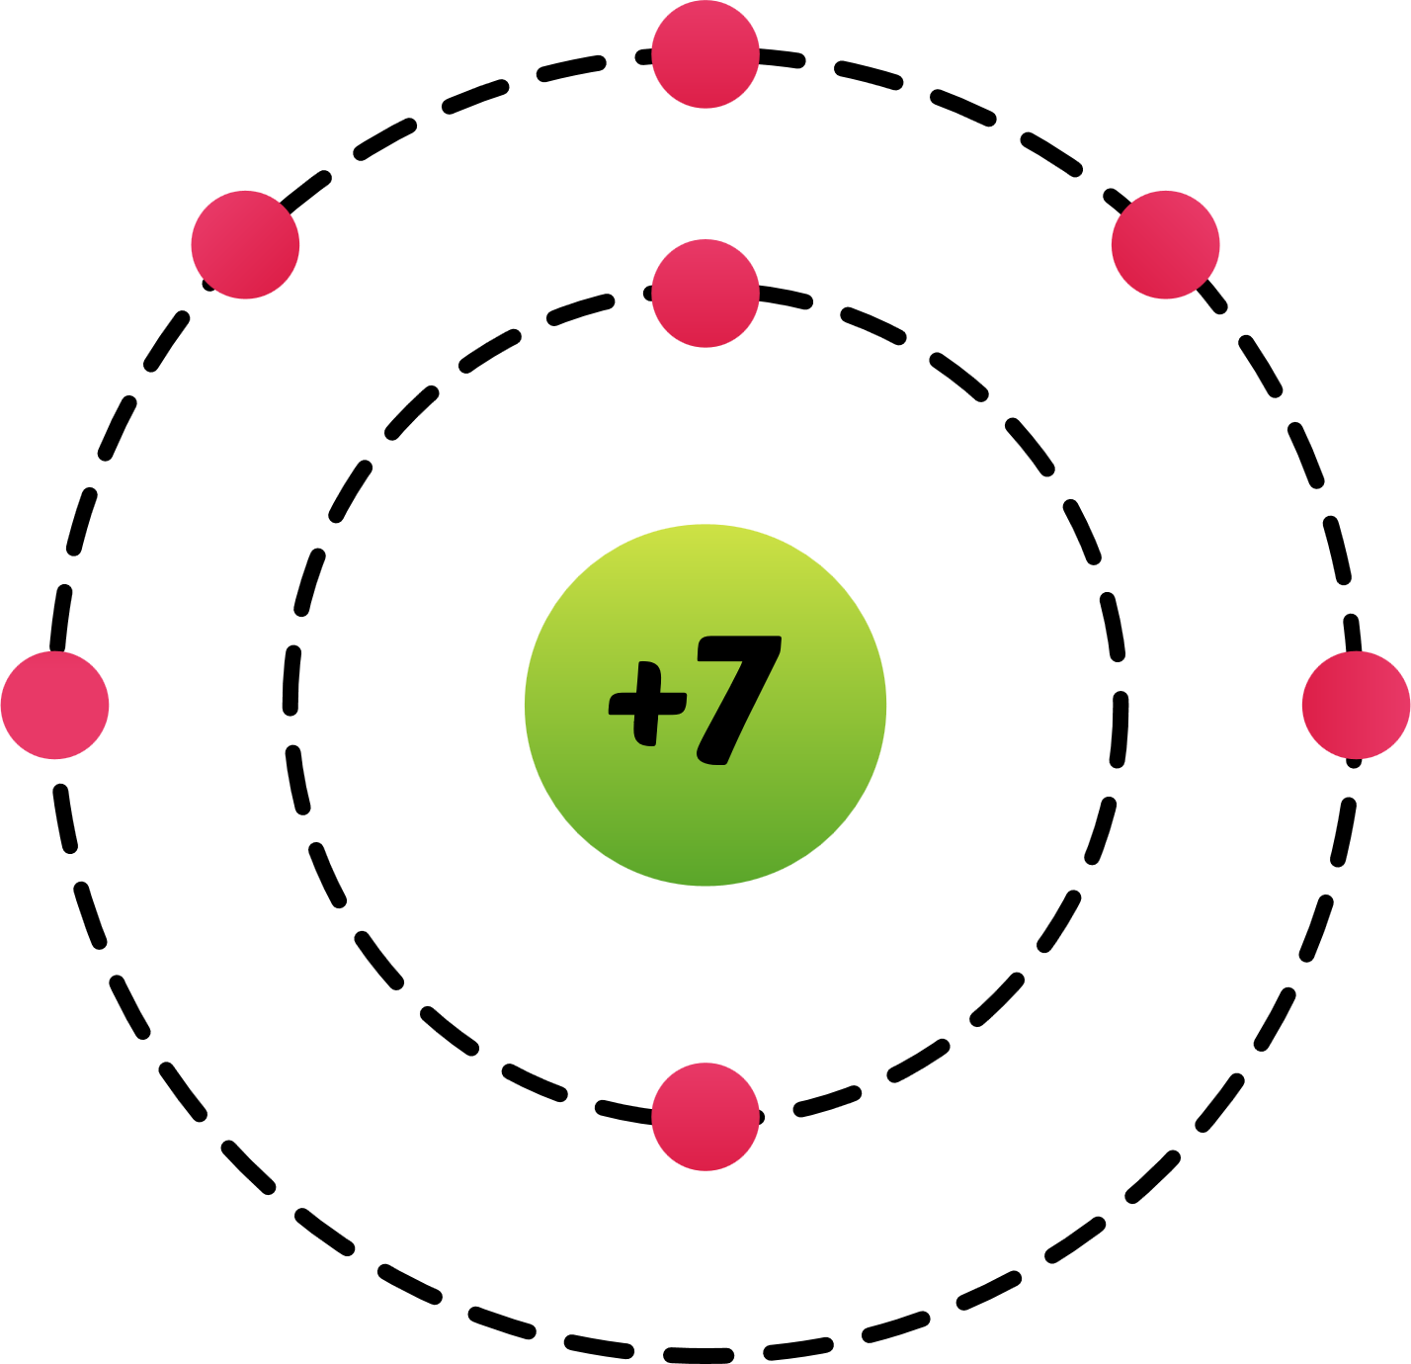

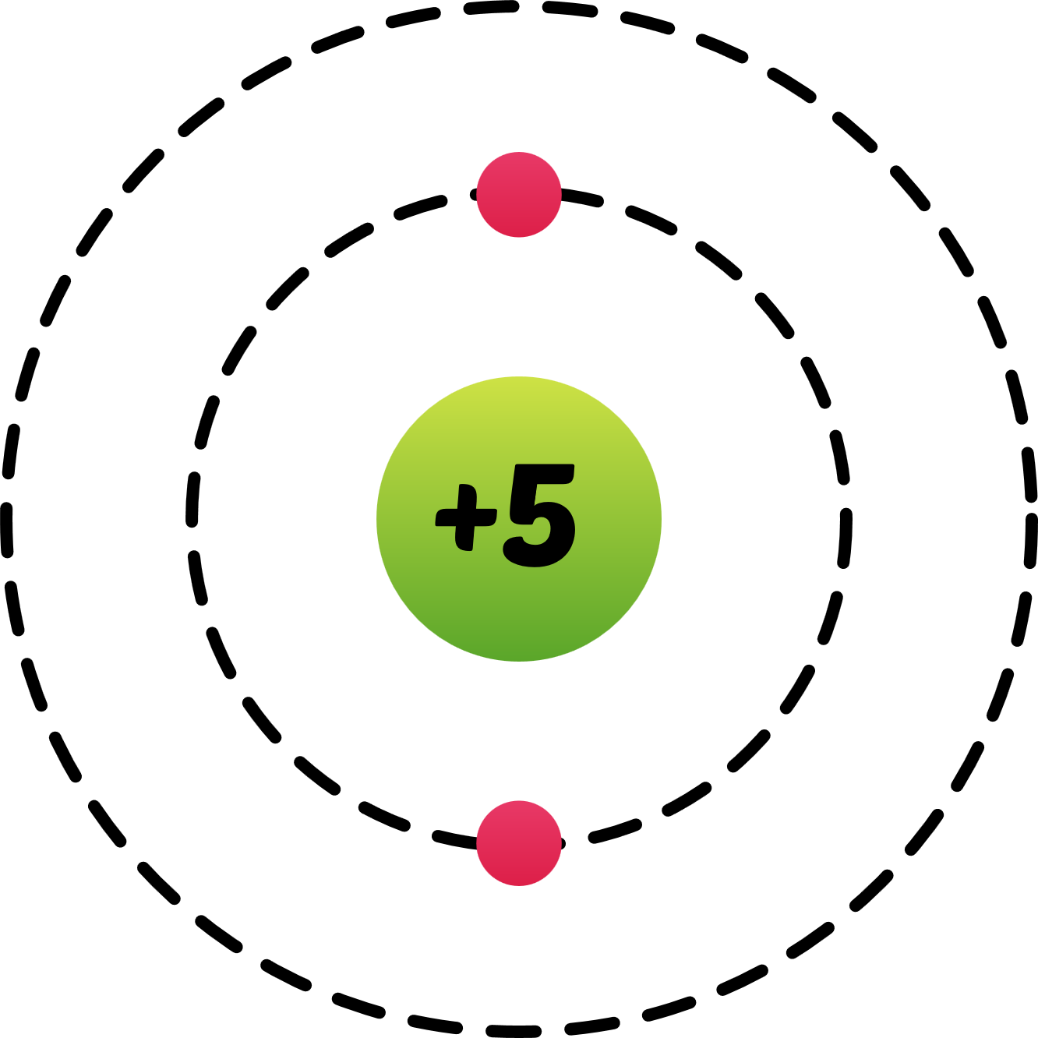
Chemical reactions can change the number of electrons an
atom has.
Add Electrons
Remove Electrons

Slide 27
Chemical reactions can change the number of electrons an
atom has.
Add Electrons
Remove Electrons
An ion is an atom that carries a charge on it.

Slide 28

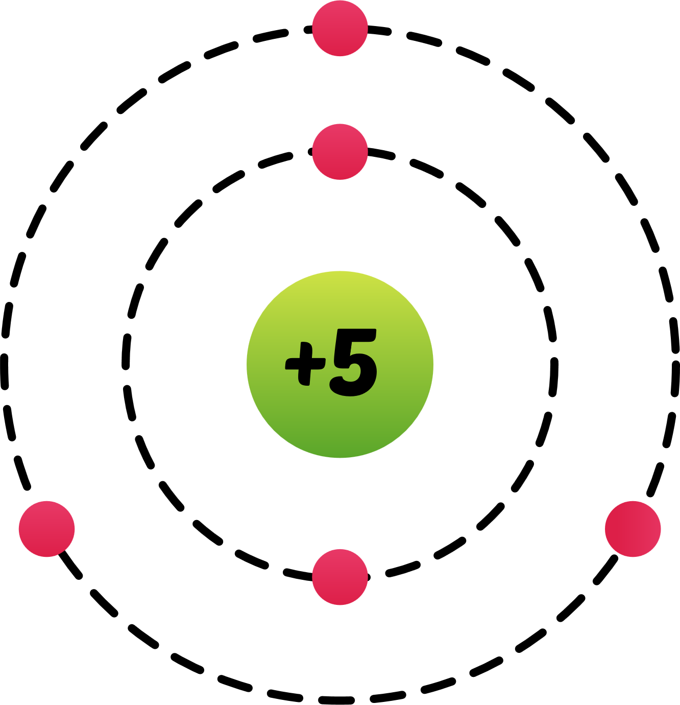
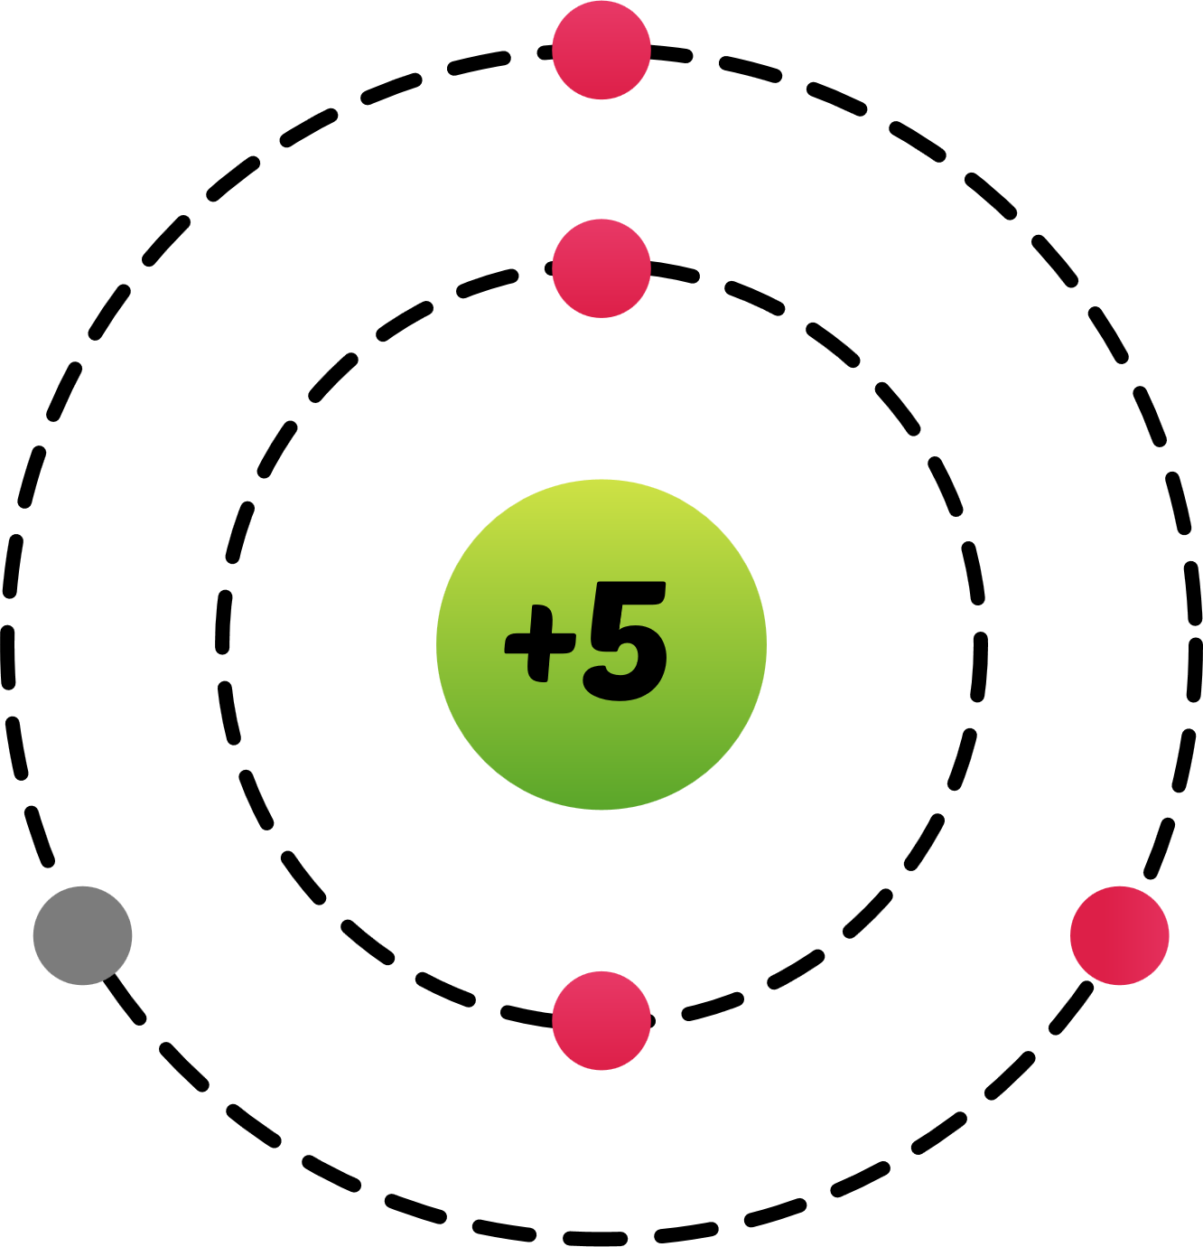
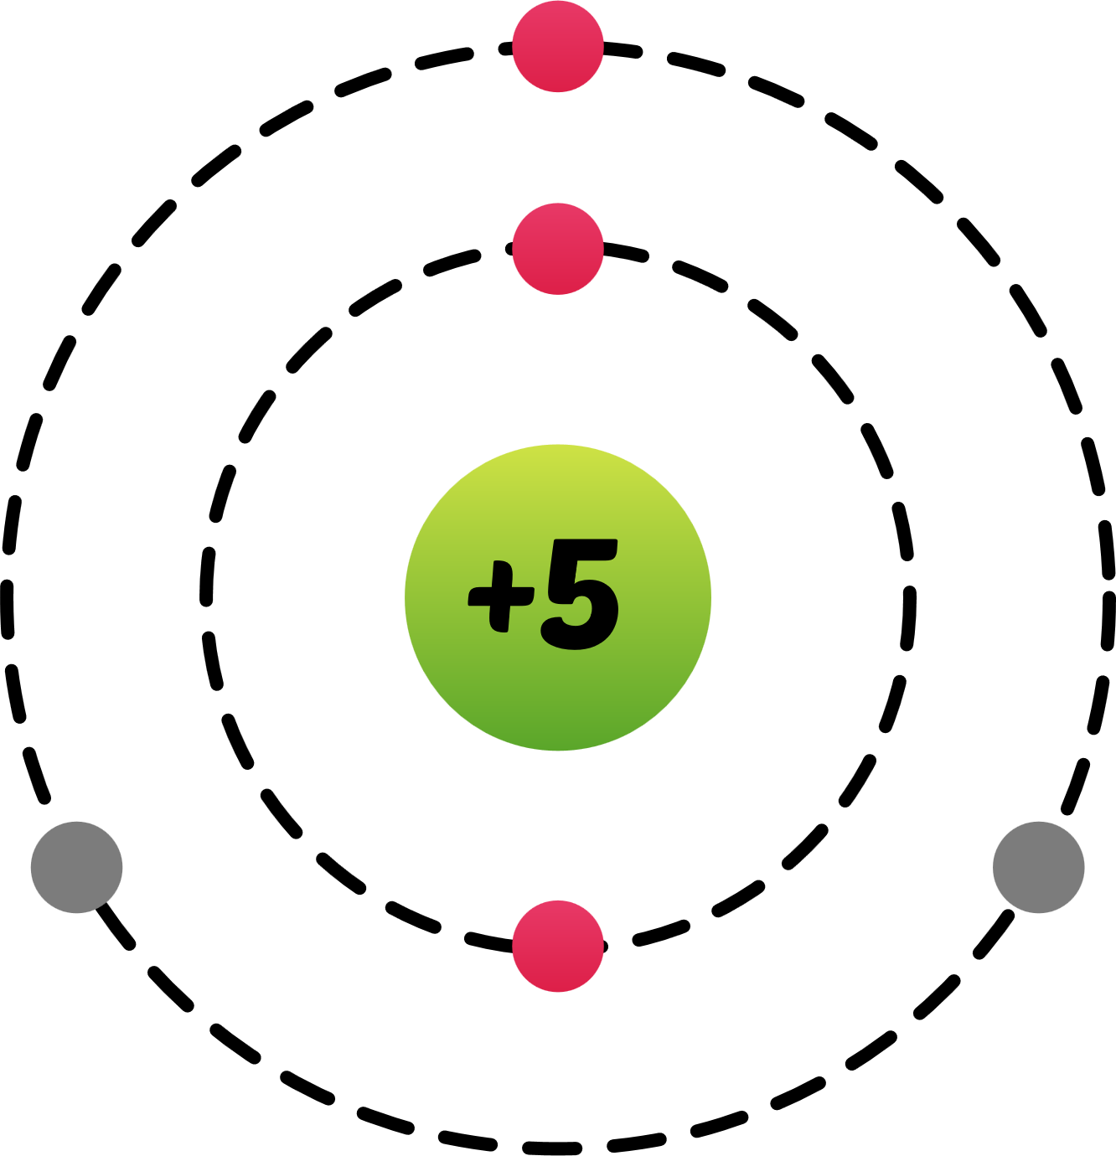
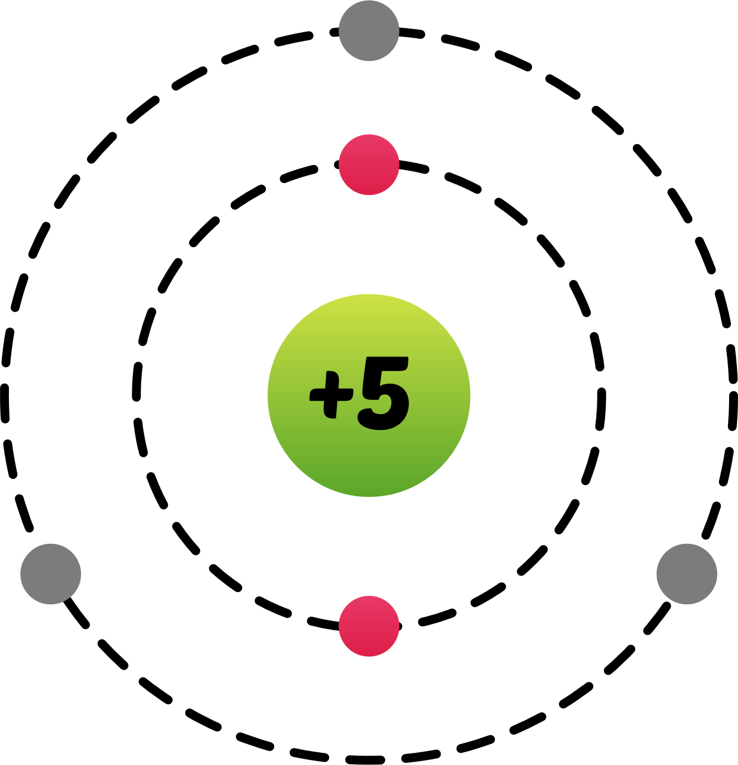
If a neutral atom loses one or more electrons, it is converted into a positively charged atom called cation.
No Electron Lost
One Electron Lost
Two Electrons Lost
Three Electrons Lost
11
11
+
11
2+
11
3+
B
B
B
B
5
5
5
5

Slide 29

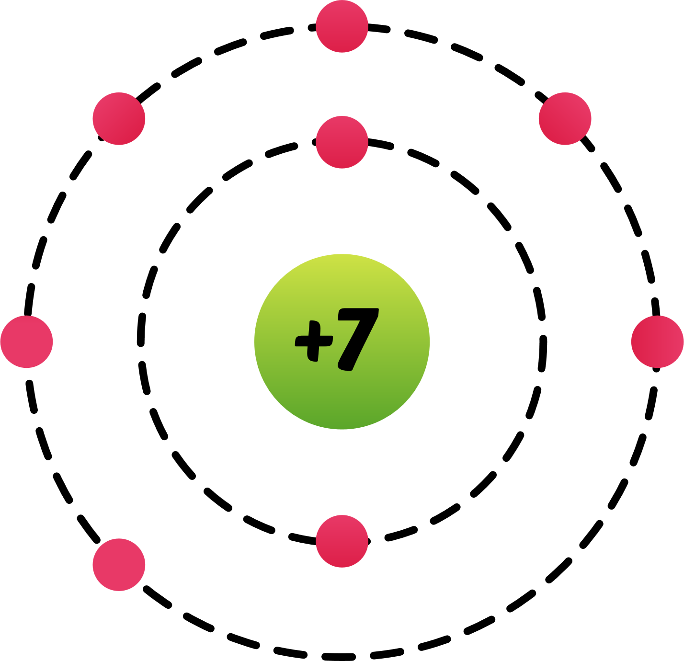
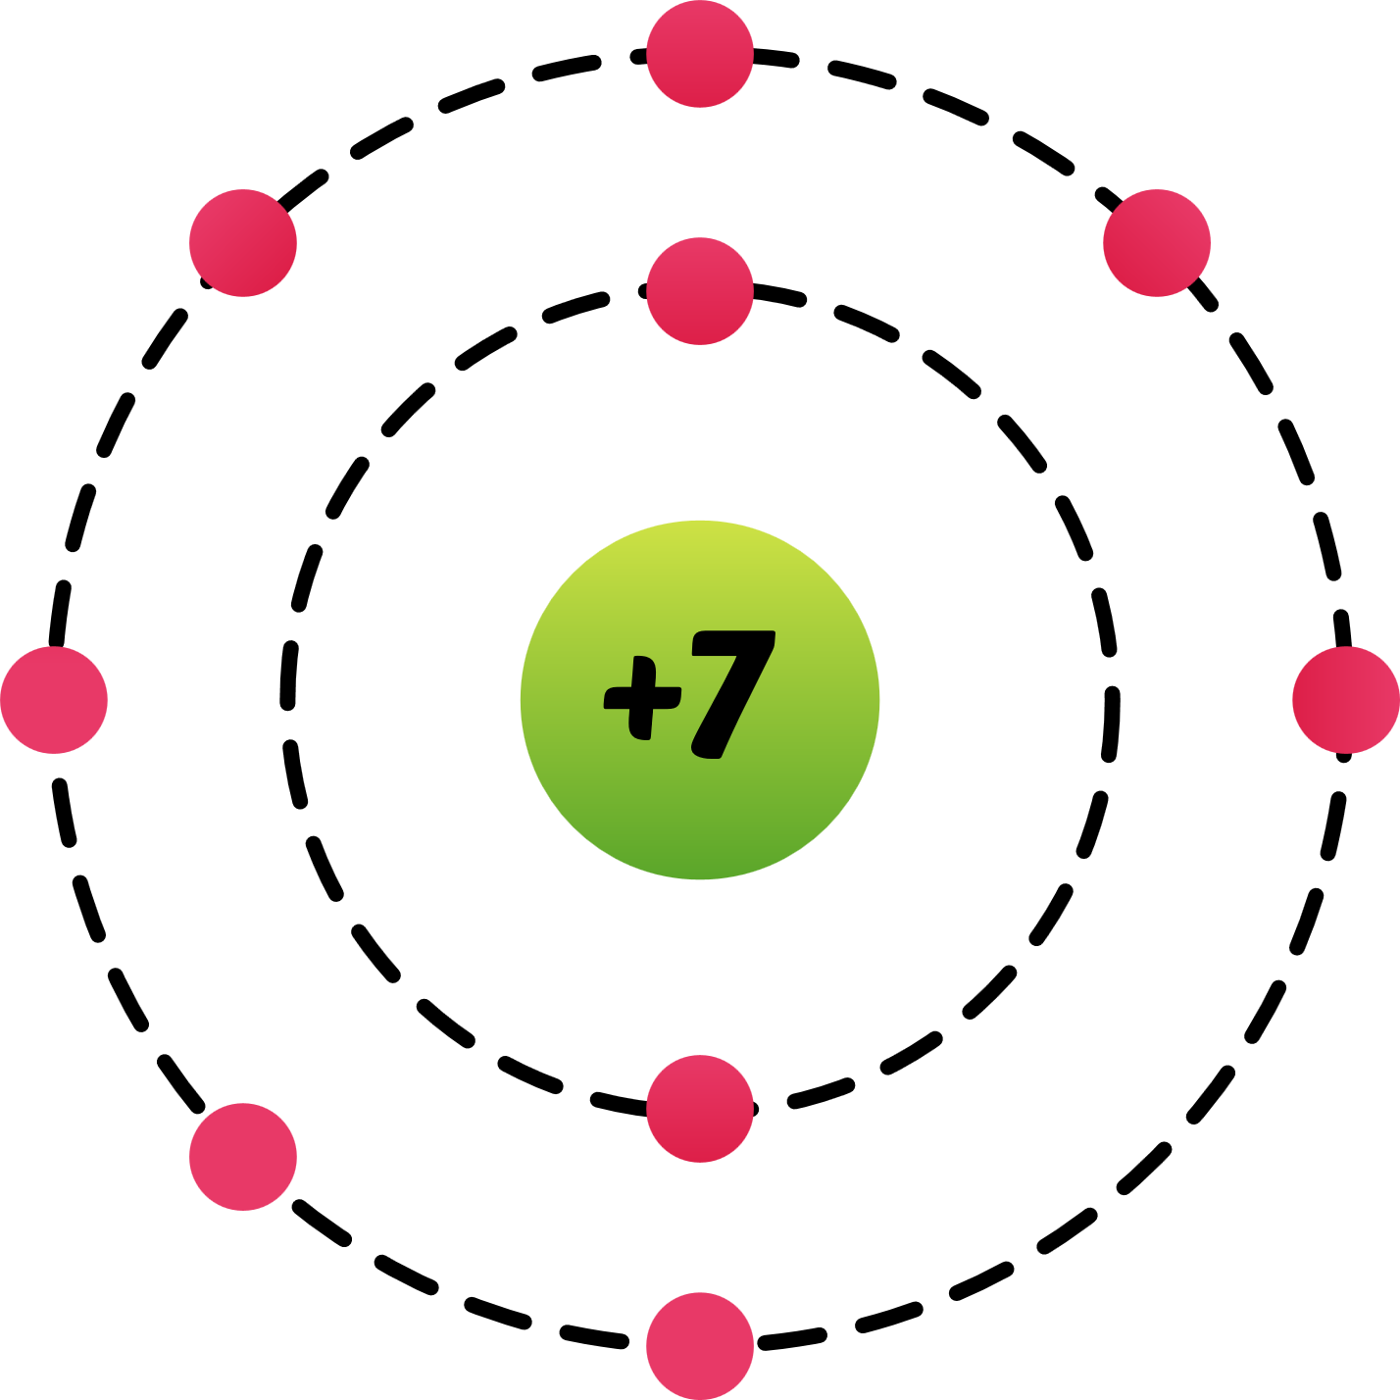
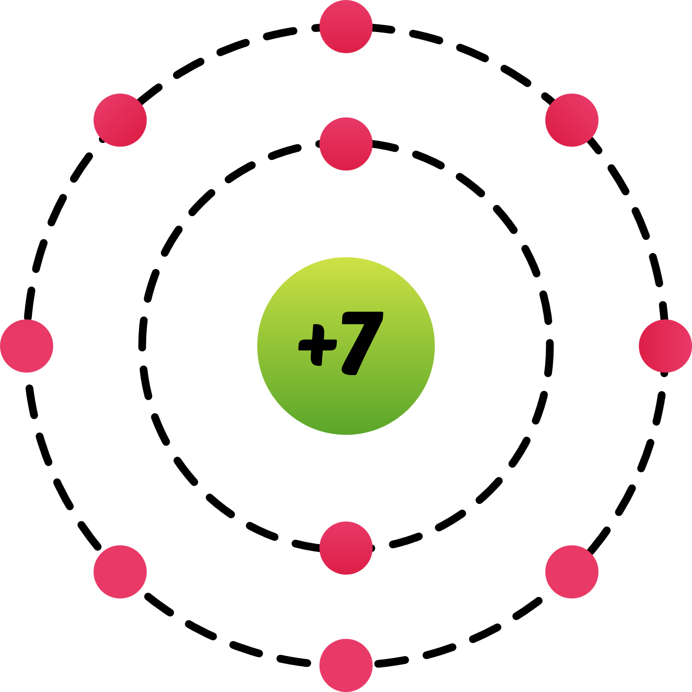
If a neutral atom gains one or more electrons, it is converted into a negatively charged atom called anion.
No Electron Gained
One Electron Gained
Two Electrons Gained
Three Electrons Gained
14
N
14
-
14
2-
14
3-
N
N
N
7
7
7
7

Slide 30
If a neutral atom gains one or more electrons, it is converted into a negatively charged atom called anion.
No Electron Gained
One Electron Gained
Two Electrons Gained
Three Electrons Gained
14
N
14
-
14
2-
14
3-
N
N
N
7
7
7
7

Slide 31


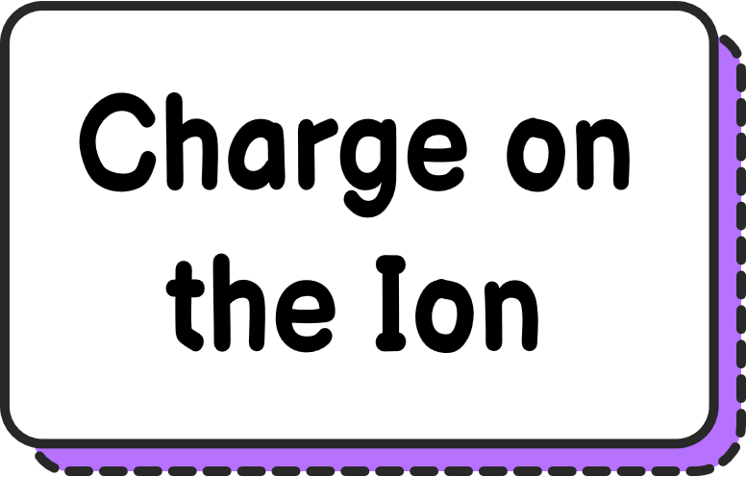
=
-
14
N
3-
Number of
Electrons in ₇ N ³⁻
=
7
-
-3
7

Slide 32
=
-
14
N
3-
Number of
Electrons in ₇ N ³⁻
=
10
7

