Slide 1


It is a branch of science in which we study the composition, properties, structure and chemical reactions of matter.

Slide 2


It is a branch of science in which we study the composition, properties, structure and chemical reactions of matter.

Slide 3










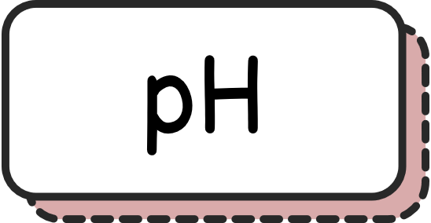





Properties are the characteristics of matter, that are observable and measurable.

Slide 4





Physical properties don’t need any chemical reaction for them to be studied.
Chemical properties will always require a chemical reaction for them to be studied.

Slide 5



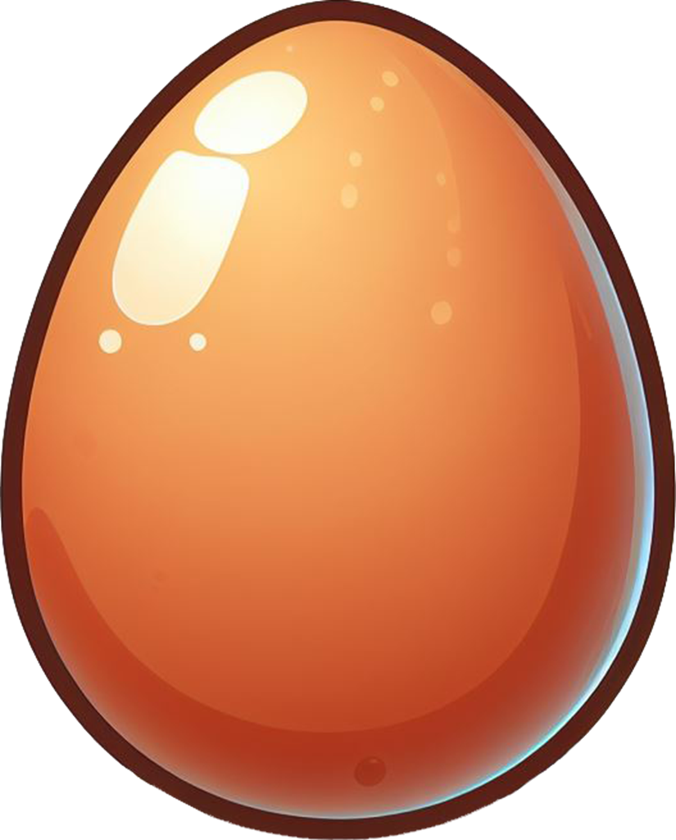
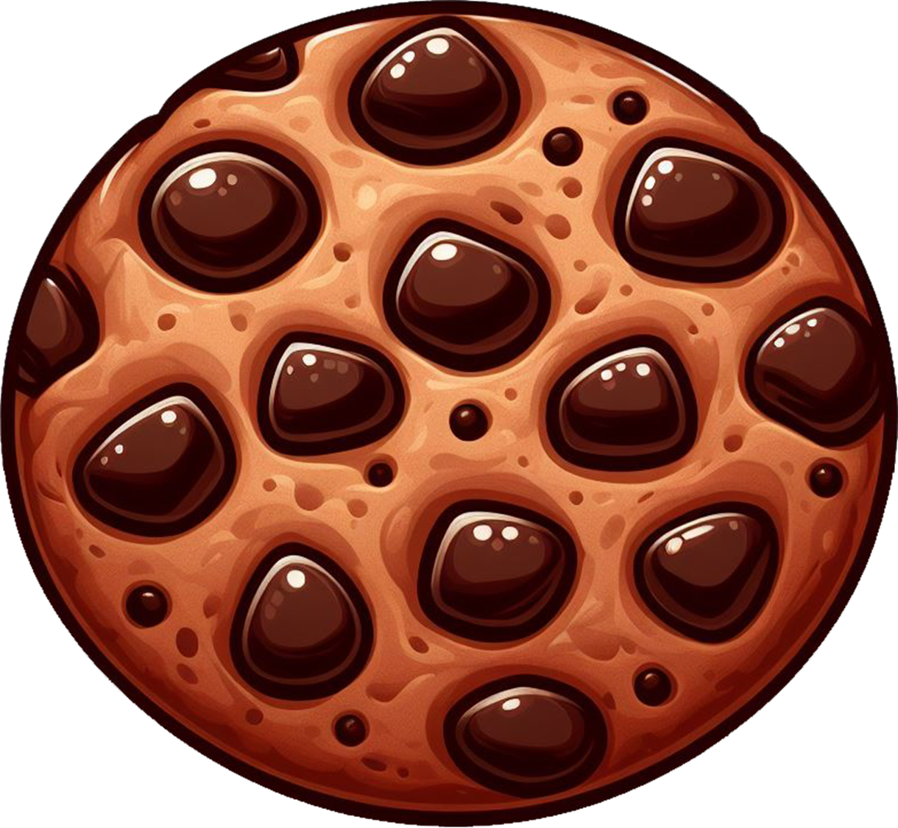
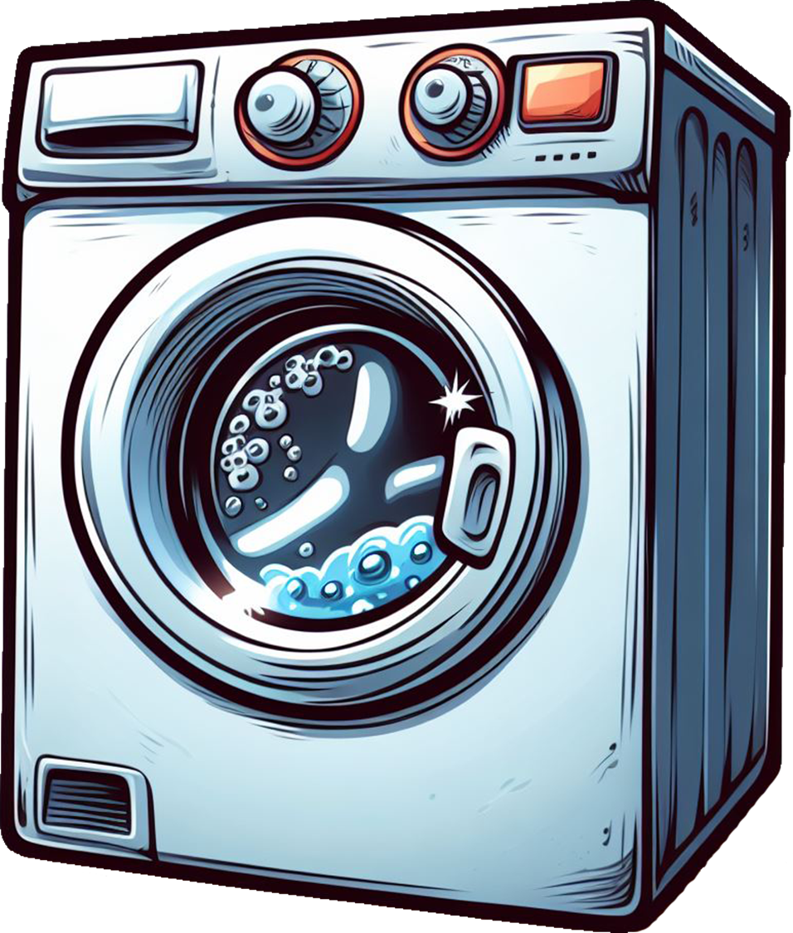
Chemical reaction is the change in the composition or the structure of a substance.
Chemical reaction is the conversion of one substance into another.
Photo-
synthesis
Boiling an
Egg
Baking a
Cookie
Washing of
Clothes

Slide 6
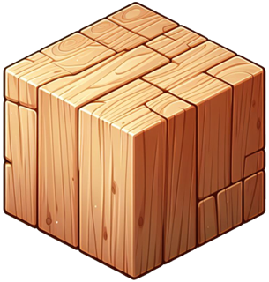
Physical properties don’t need any chemical reaction for them to be studied.
Chemical properties will always require a chemical reaction for them to be studied.

Slide 7

Physical properties don’t need any chemical reaction for them to be studied.
Chemical properties will always require a chemical reaction for them to be studied.

Slide 8



Physical properties don’t need any chemical reaction for them to be studied.
Chemical properties will always require a chemical reaction for them to be studied.

Slide 9
Physical properties don’t need any chemical reaction for them to be studied.
Chemical properties will always require a chemical reaction for them to be studied.

Slide 10

Physical properties don’t need any chemical reaction for them to be studied.
Chemical properties will always require a chemical reaction for them to be studied.
Chemical Reaction Needed?

Slide 11

Physical properties don’t need any chemical reaction for them to be studied.
Chemical properties will always require a chemical reaction for them to be studied.
Chemical Reaction Needed?
Chemical Reaction Needed?

Slide 12
Physical properties don’t need any chemical reaction for them to be studied.
Chemical properties will always require a chemical reaction for them to be studied.
Chemical Reaction Needed?
Chemical Reaction Needed?
Chemical Reaction Needed?
Chemical Reaction Needed?

Slide 13
Physical properties don’t need any chemical reaction for them to be studied.
Chemical properties will always require a chemical reaction for them to be studied.

Slide 14






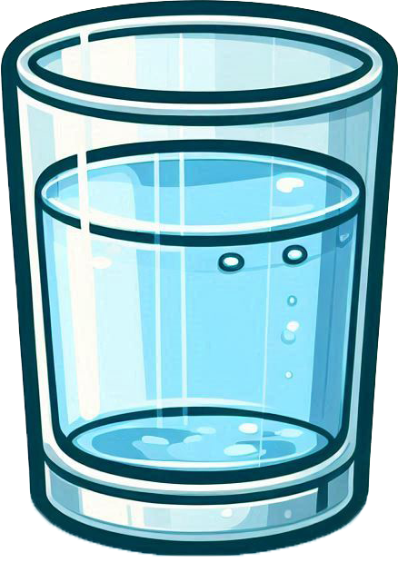
Extensive properties depend on the amount of matter being studied.
Intensive properties don’t depend on the amount of matter being studied.

Slide 15
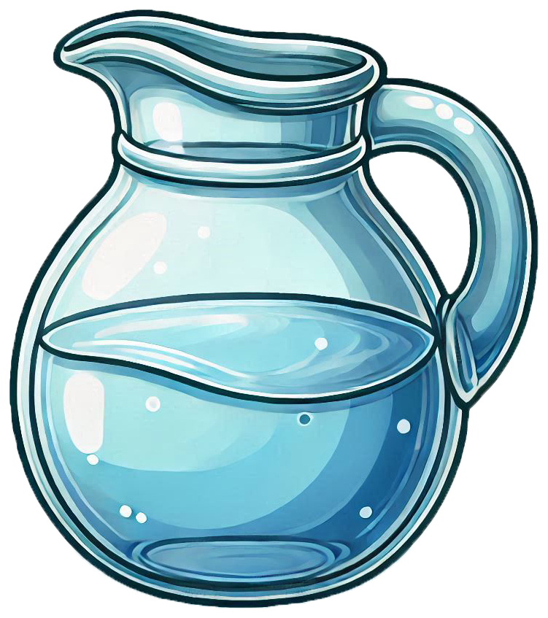
Extensive properties depend on the amount of matter being studied.
Intensive properties don’t depend on the amount of matter being studied.

Slide 16
Extensive properties depend on the amount of matter being studied.
Intensive properties don’t depend on the amount of matter being studied.
Depends on the amount of matter ?

Slide 17
Extensive properties depend on the amount of matter being studied.
Intensive properties don’t depend on the amount of matter being studied.
Depends on the amount of matter ?

Slide 18
Extensive properties depend on the amount of matter being studied.
Intensive properties don’t depend on the amount of matter being studied.
Depends on the amount of matter ?
Depends on the amount of matter ?

Slide 19
Extensive properties depend on the amount of matter being studied.
Intensive properties don’t depend on the amount of matter being studied.
Depends on the amount of matter ?
Depends on the amount of matter ?
Depends on the amount of matter ?
Depends on the amount of matter ?

Slide 20





Extensive properties depend on the amount of matter being studied.
Intensive properties don’t depend on the amount of matter being studied.

